Slide 1
Neural Network Acceleration
Ch.1: Introduction to Neural Networks
Tsung-Chu Huang (黃宗柱)
Electronics Eng., NCUE
TestLab, NCUE

Slide 2
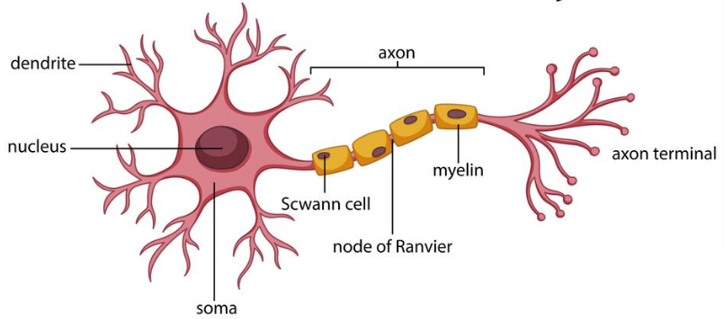
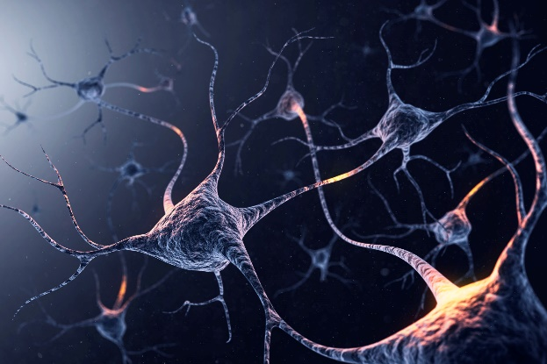
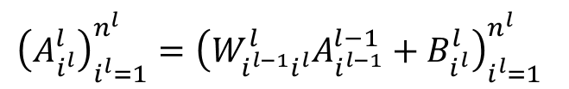

Neuron Model
$$A^{l}=W^{l}A^{l−1}+B^{l}$$
$${\left(A_{i^{l}}^{l}\right)}_{i^{l}=1}^{n^{l}}={\left(W_{i^{l−1}i^{l}}^{l}A_{i^{l−1}}^{l−1}+B_{i^{l}}^{l}\right)}_{i^{l}=1}^{n^{l}}$$

Slide 3
History
1943: McCulloch and Pitts model neural networks based on their understanding of neurology.
  Neurons embed simple logic functions:
    a or b
    a and b
1950s:
  Farley and Clark
    IBM group that tries to model biological behavior
    Consult neuro-scientists at McGill, whenever stuck
  Rochester, Holland, Haibit and Duda
Perceptron (Rosenblatt 1958)
  Three layer system:
    Input nodes
    Output node
    Association layer
  Can learn to connect or associate a given input to a random output unit

Slide 4
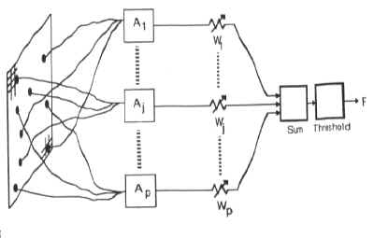
History
Minsky and Papert
  Showed that a single layer perceptron cannot learn the XOR of two binary inputs
  Lead to loss of interest (and funding) in the field
Perceptron (Rosenblatt 1958)
  Association units A₁, A₂, … extract features from user input
  Output is weighted and associated
  Function fires if weighted sum of input exceeds a threshold.

Slide 5
History
Back-propagation learning method (Werbos 1974)
  Three layers of neurons
    Input, Output, Hidden
  Better learning rule for generic three layer networks
  Regenerates interest in the 1980s
Successful applications in medicine, marketing, risk management, … (1990)
In need for another breakthrough.

Slide 6
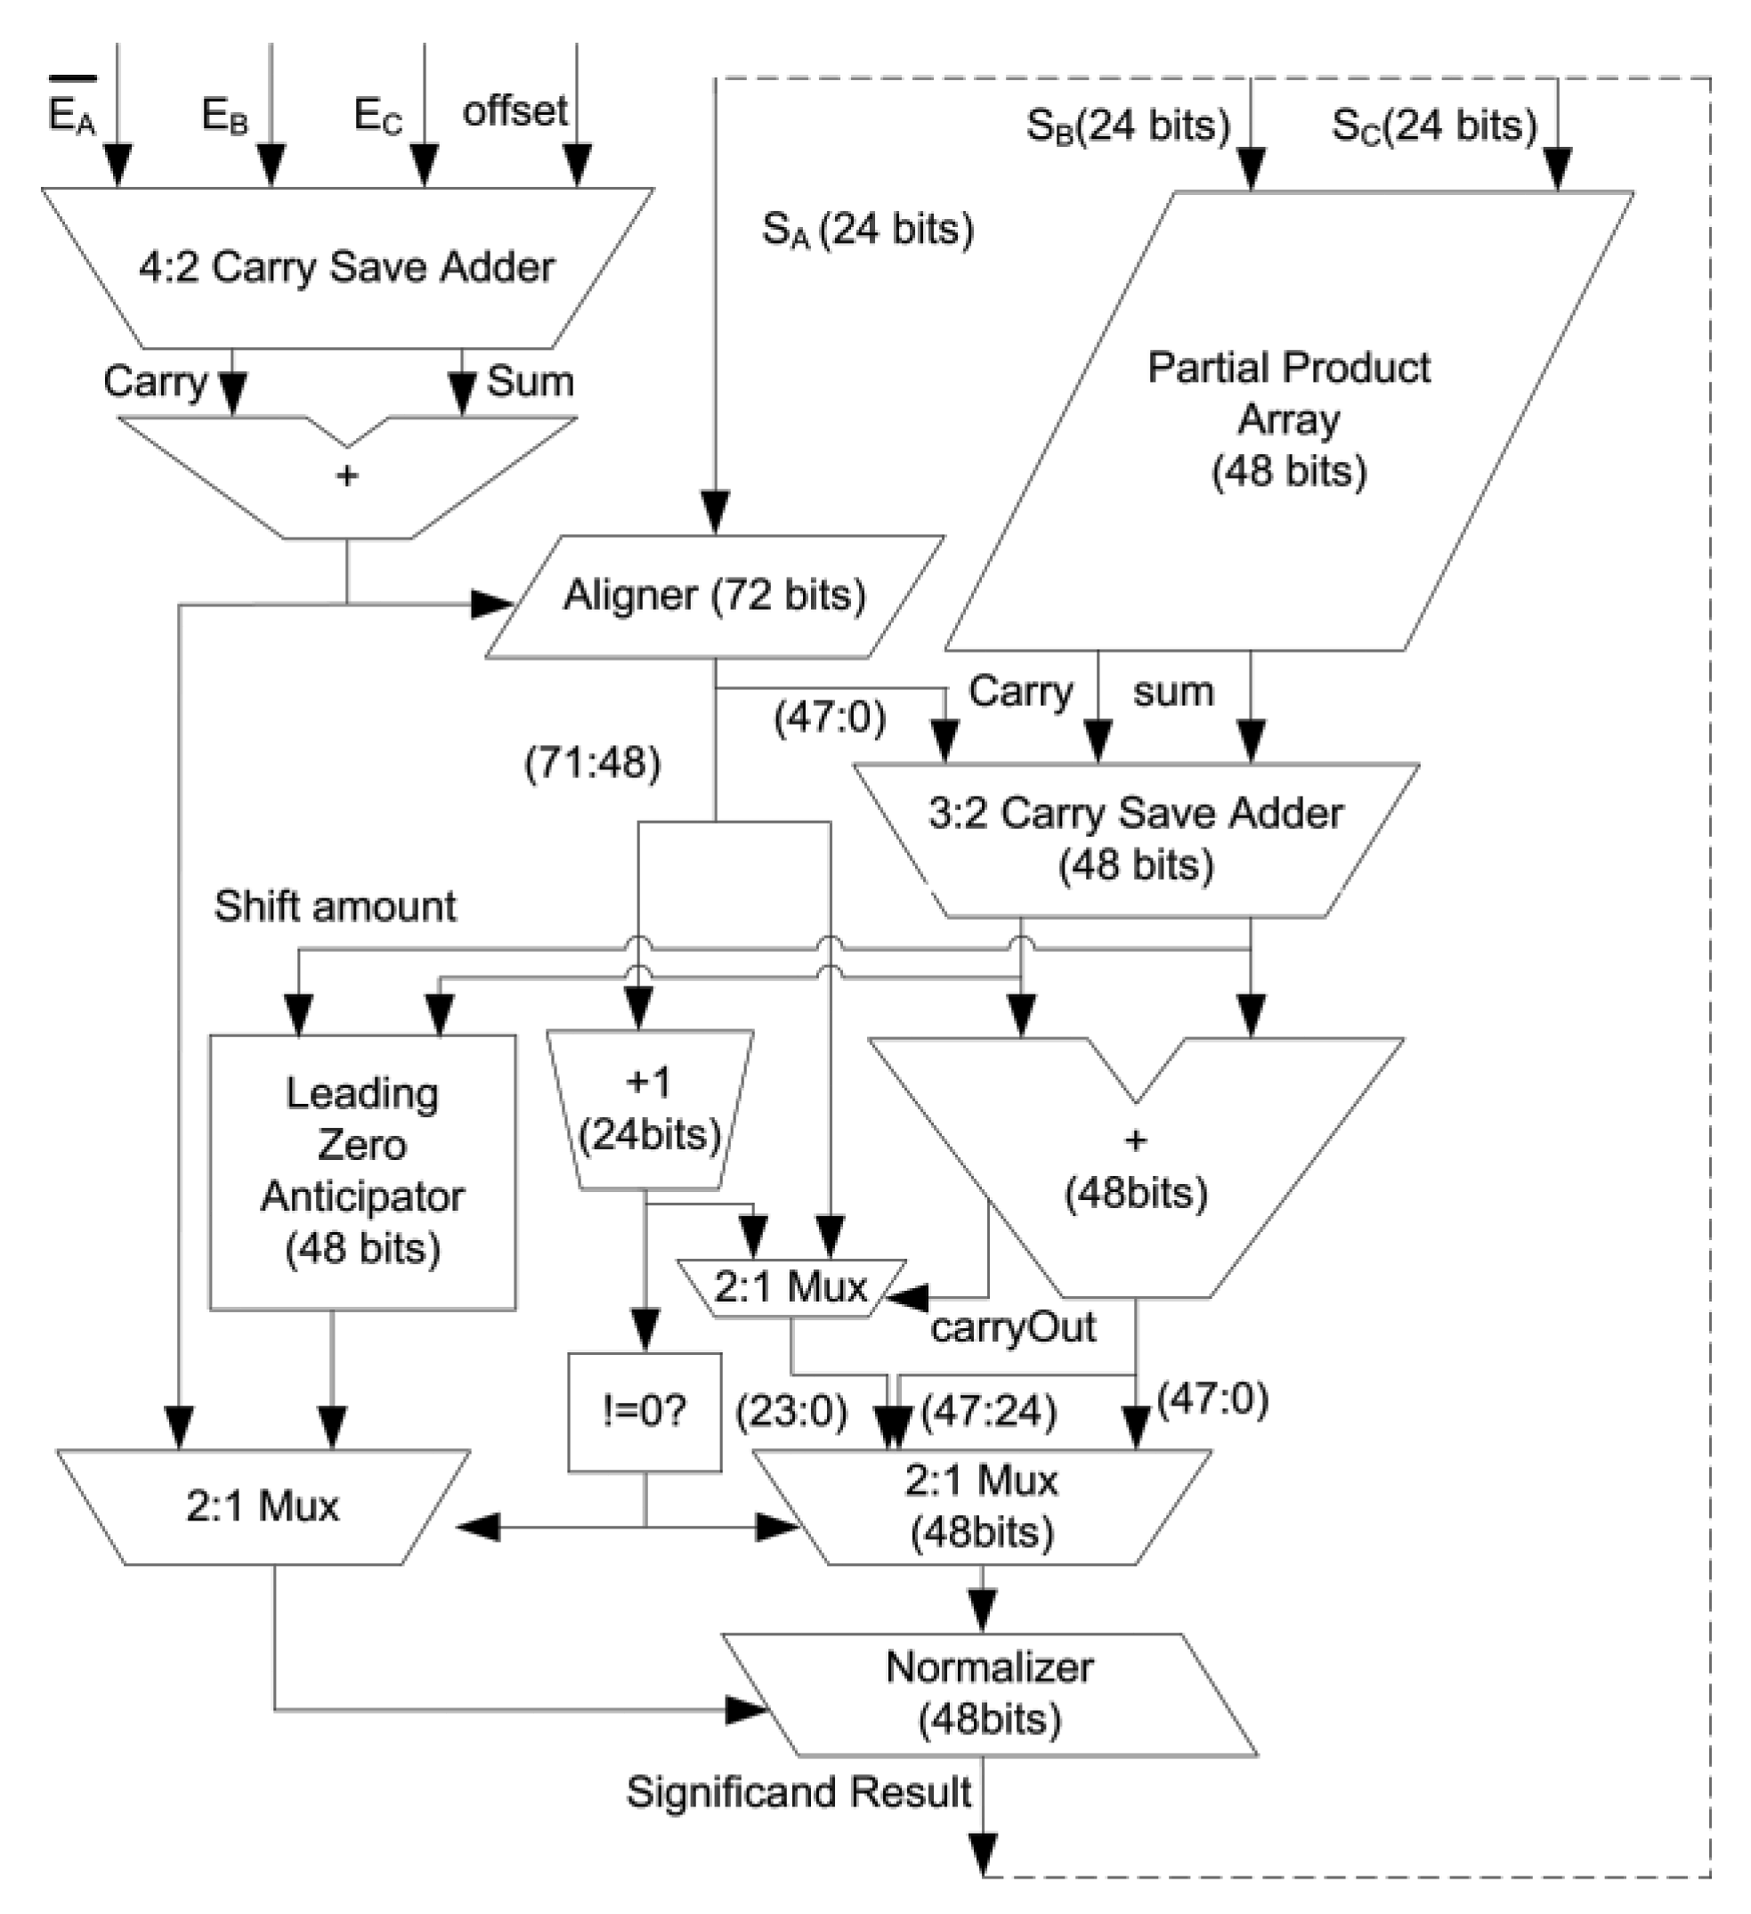
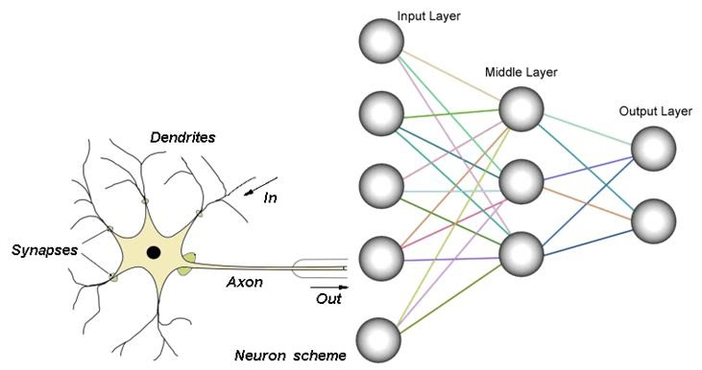
Introduction
Significance of Neural Network (NN)
PFLOPS Computation
  Acceleration
  Reliability
GPU or Vector Processors
Fused Multiply-Adder
Eg., NVIDIA 1080i: 8GFLOPS/256Watts/kcc

Slide 7














Basics of Neural Network
Hidden Layers $A^{1}, .., A^{L−1}$
1
1
1
1
1
Input Layer $A^{0}$
Output Layer $A^{L}$
2
2
2
2
2
$$n_{0}$$
$$n_{1}$$
$$n_{2}$$
$$n_{L−1}$$
$$n_{L}$$
1
Activation Functions:
$$x_{j}^{L}=Σ_{i=1}^{n_{L−1}}A_{i}^{L}W_{ij}^{L}$$
$$A_{j}^{L+1}$$
i
$$Σ$$
$$f(x_{j}^{L}+b_{j}^{L})$$
j
ReLU
erf(x)
tanh (x)
logistic (x)
softmax (x)
$$b$$
$$n_{L−1}$$
Sigmoidal

Slide 8
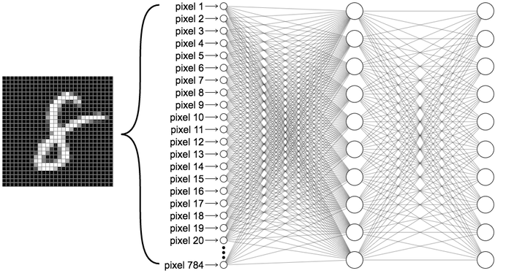


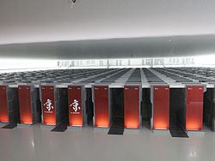
Introduction
Big-Data, Power-Consumpton
「Summit」, US, 215 PFLOPS/DP
3.3 EFLOPS/Tensor Cores
Liquid Inside, 1.5G Watts
「太湖之光」,China, 93 PFLOPS
「京」, Japan, 8.162 PFLOPS

Slide 9
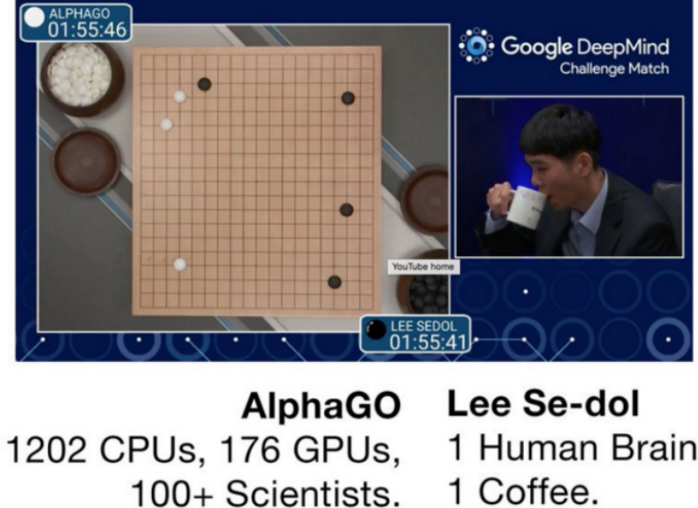
4 Major Issues of NN
Computing Acceleration
  10X/decade #processors for 50X/decade #computation during 2015-2025 ^{[Inst. Of Comp Design]}
Power Consumption
Area Overhead
Reliability
Security
Introduction
  Significance of NN in AI Era
  Major Issues
    Computing Acceleration
    Power Dissipation
    Area Overhead
    Reliability & Security
(source: Google)

Slide 10
Syllabus of Neural Network Acceleration
Overviews and Background (3hr)
  Installation and online platforms
  Simple NN examples
  Python/Tensorflow/Keras
  Terminology and Metrics
Basics and Reviews (3hr)
  programming and scripting
  linear algebra and number theory
  probability and statistics, differential
Model Types and Selection (3hr)
Computer Architecture and Hardware Accelerators (3hr)
  CPU, GPU, GPGPU, NPU, VPU, TPU
  FPGA, AI-SoPC
  Data Flow Graph and Optimization
Memory Access Techniques (3hr)
  Allocation of Conventional Memory
  Direct Memory Access
  CUDA
  Computing in Memory
Residue Number Systems (6hr)
  Linear Algebra and Number Theory
  Overflow-aware VPA
  Approximate RNS
Approximate Computing (6hr)
  Naturally approximating: analogue and binary truncation
  TCB/BCB Approximating for Batch Learning
  Range LUT using Range CAM
Pruning and Self-Healing (6hr)
  Random dropping
Labeling Acceleration: Generative Adversarial Networks (3hr)
Structure Mapping for Parallelization (3hr)
  Technology Mapping: Logic and Modular
  MAC, FMA
  Deep stacking network
Model Compression and Optimization (3hr)
Analogue Neural Networks (4hr)
  RRAM, MRAM, Charge Cap, OTA
Meta Learning (2hr)
  One-shot learning
  On-line Reconfiguration
  Kohonen Self-Organizing Machine
  NN Design Learning : learn to learn

Slide 11
Our Recent Works
Our Major SW/HW Accelerating Techniques
  Approximate Computing for Batch Learning
    Booth FMA, Adaptive Error Control
  Self-Checking Residue Number System for NN
    Sign Detection (-, /), Checking Rate Preserving, RNS Syntheses
  Error Resilience for Neuromorphic RRAM
    Precompensation, 1D/2D Analog Berger Codes
  Range CAM Based LUT for Any Function
  Focus: Approximate Computing with Dynamic Focus
  Scalable Booth Multipliers
  SAFERnSAFEST: Application in Failure Prediction
  LUT-based Reconfiguration for CIM
  Matrix-Reordering for Pruning
  AN-HRNS: AN-Coded Hierarchical RNS NN
  2DAN- and AN-TCBNN: Ternary-Coded BNN
  SPINDLE: Self-Pretrainable Insitu Normalizer

Slide 12
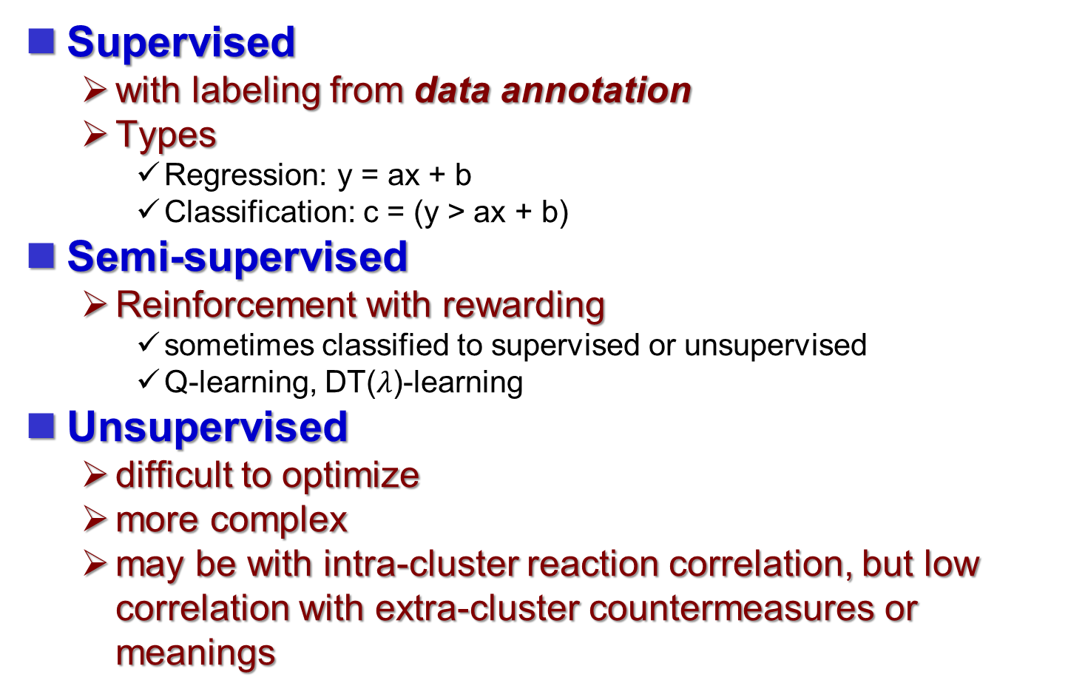
Categories on Supervision
Supervised
  with labeling from data annotation
  Types
    Regression: y = ax + b
    Classification: c = (y > ax + b)
Semi-supervised
  Reinforcement with rewarding
    sometimes classified to supervised or unsupervised
    Q-learning, DT($λ$)-learning
Unsupervised
  difficult to optimize
  more complex
  may be with intra-cluster reaction correlation, but low correlation with extra-cluster countermeasures or meanings

Slide 13
Data Annotation for Raw Datasets
Classification
Clustering
Data Annotation
  Transformation for convenience of human decision
  Tagged by more than one experts
Training

Slide 14
Neural Network Acceleration

Slide 15
Artificial Intelligence (AI)
Machine Learning
Problem Solving
Knowledge-based
Brain-Inspired Computation
Rule-based
Spiking
Neural Networks
Fuzzy Theory
Deep
Learning
Searching Algorithms
(Source: Efficient processing of deep neural networks: A tutorial and survey, IEEE Proc., 2017)

Slide 16
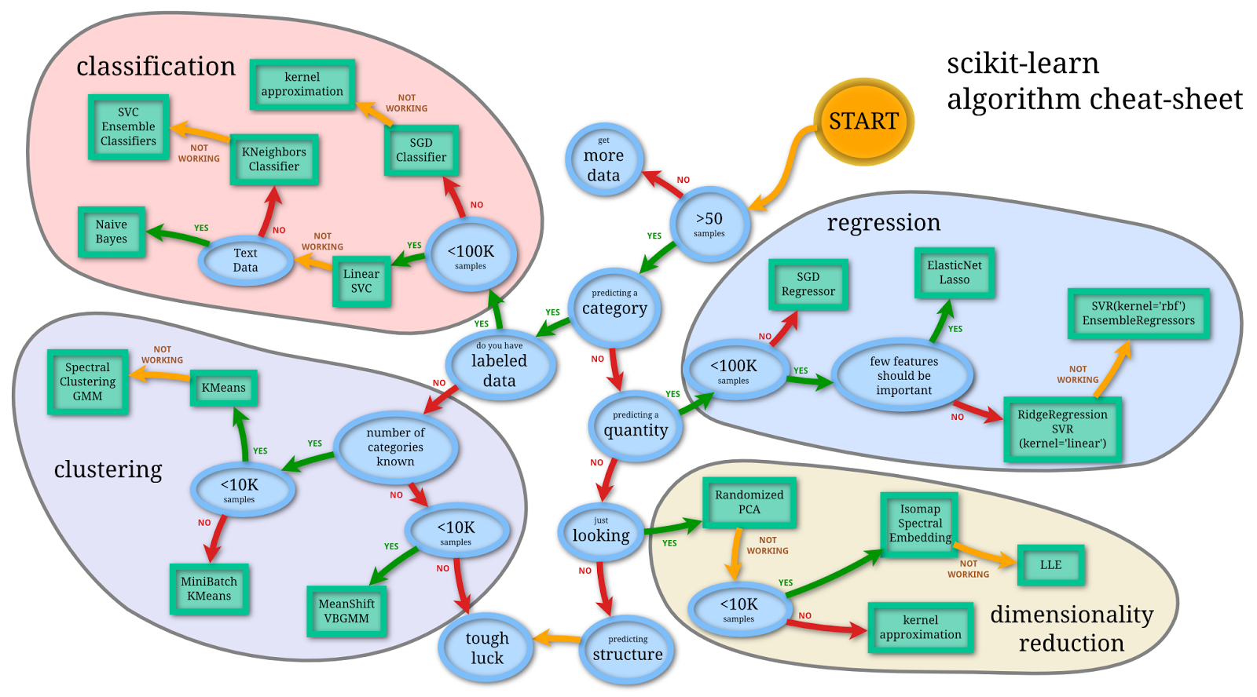
Basic NN’s Categories
(Source: https://miro.medium.com/max/1400/0*IAd6qfpRpfXa_Ifv.png)

Slide 17
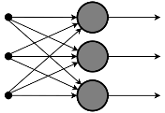
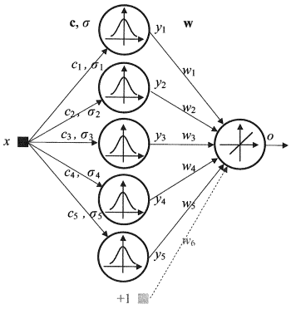
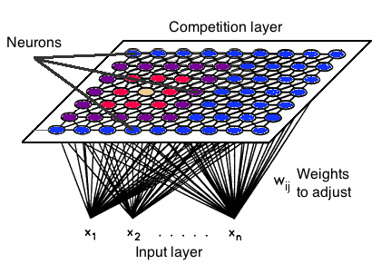
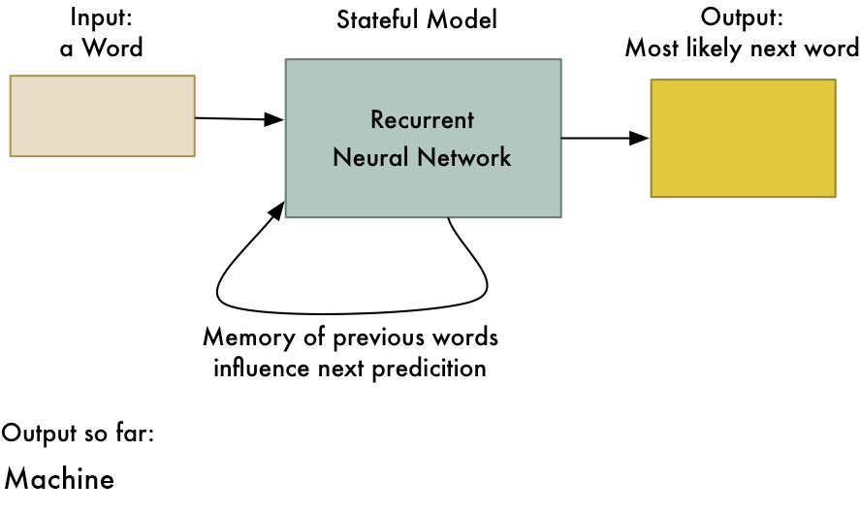
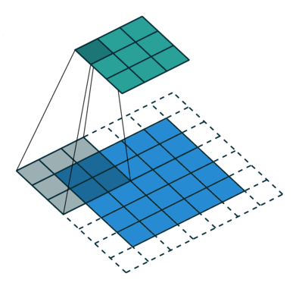
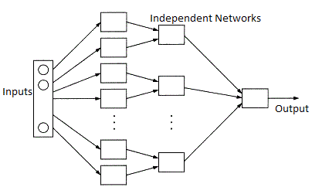
6 Types of Artificial Neural Networks Used in ML
Feedforward Neural Network – Artificial Neuron
Radial basis function Neural Network
Kohonen Self Organizing Neural Network
Recurrent Neural Network(RNN)
Convolutional Neural Network
Modular Neural Network:
Source: https://analyticsindiamag.com

Slide 18
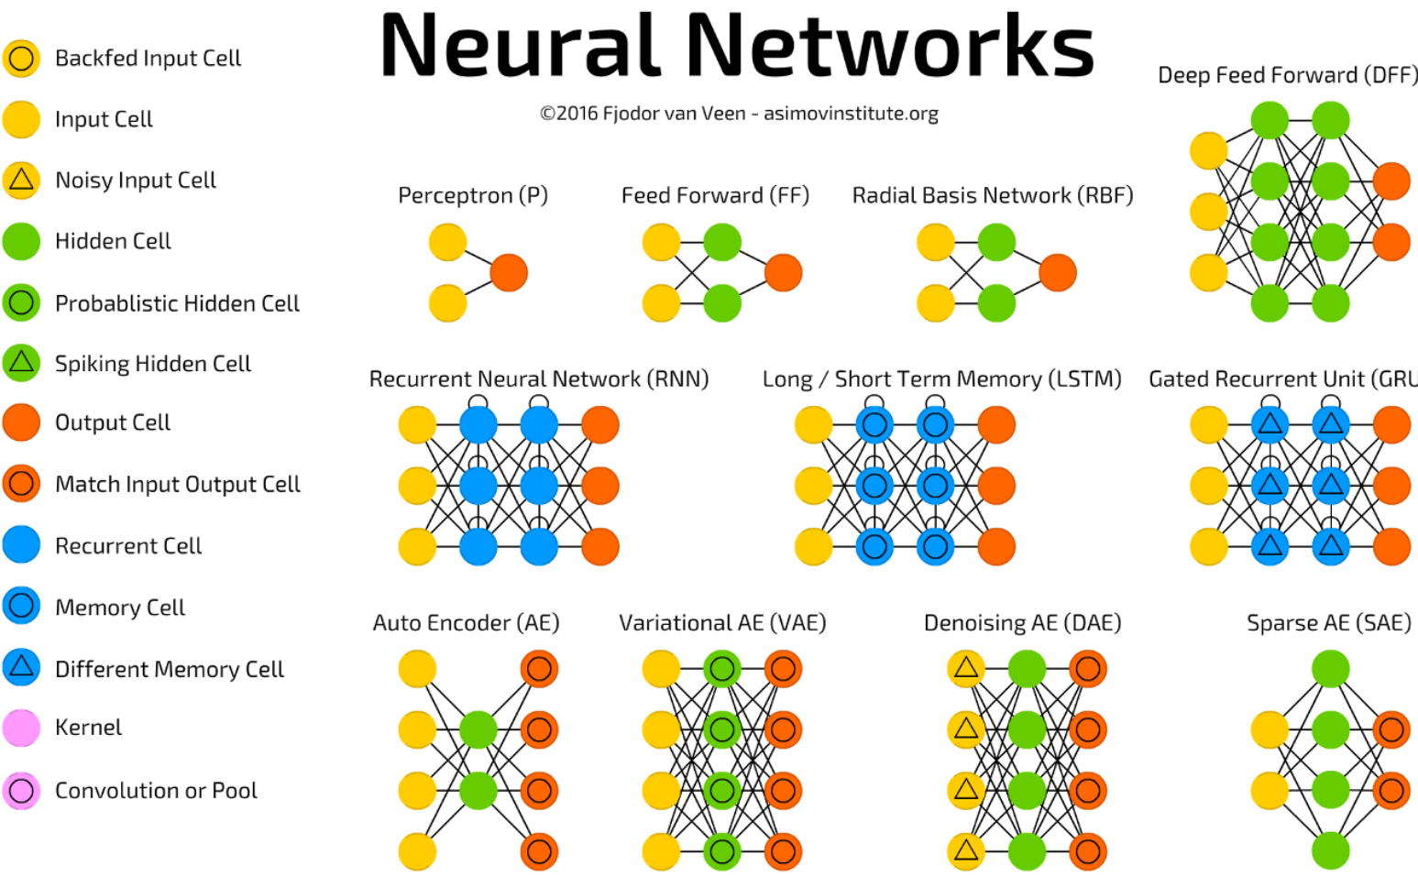
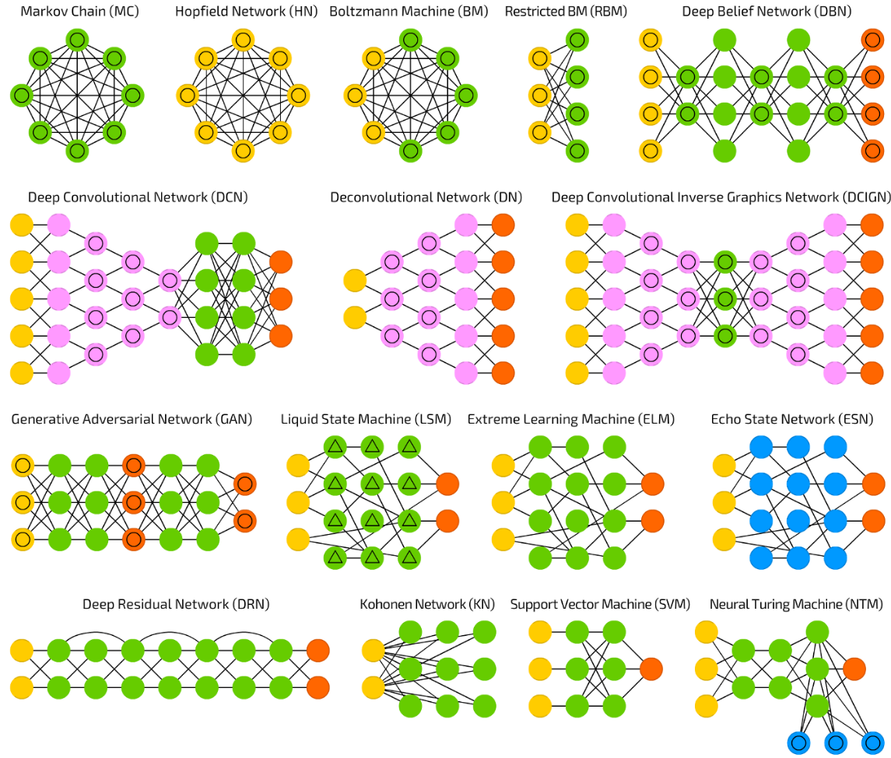
A Comprehensive Guide to
Types of Neural Networks
https://towardsdatascience.com/the-mostly-complete-chart-of-neural-networks-explained-3fb6f2367464

Slide 19
Types of artificial neural networks
Feedforward
  Group method of data handling
  Autoencoder
  Probabilistic
  Time delay
  Convolutional
  Deep stacking network
Regulatory feedback
Radial basis function (RBF)
  How RBF networks work
  General regression neural network
  Deep belief network
Recurrent neural network
  Fully recurrent
  Simple recurrent
  Reservoir computing
  Long short-term memory
  Bi-directional
  Hierarchical
  Stochastic
  Genetic Scale
Modular
  Committee of machines
  Associative
Physical
Other types
  Instantaneously trained
  Spiking
  Regulatory feedback
  Neocognitron
  Compound hierarchical-deep models
  Deep predictive coding networks
  Multilayer kernel machine
Dynamic
  Cascading
  Neuro-fuzzy
  Compositional pattern-producing
Memory networks
  One-shot associative memory
  Hierarchical temporal memory
  Holographic associative memory
  LSTM-related differentiable memory structures
  Neural Turing machines
  Semantic hashing
  Pointer networks
Hybrids
  Encoder–decoder networks
Source: Wikipedia

Slide 20
Types of Neural Networks
Perceptron
Feed Forward Neural Network
Multilayer Perception (MLP)
  extension of perception NNs
Convolutional Neural Network
Radial Basis Function Neural Network
Recurrent Neural Network
LSTM –Long Short-Term Memory
Sequence to Sequence models (S2S)
  a sequence-to-sequence model consists of two recurrent neural networks: an encoder that processes the input and a decoder that produces the output.
Modular Neural Network
https://www.mygreatlearning.com/blog/types-of-neural-networks/

Slide 21
Recursive NNs vs. Recurrent NNs
Acronym about RNN:
  Reinforcement:
    a semi-supervised category of NNs
  Recurrent:
    looped in some layers.
  Recursive:
    a kind of deep neural network
    applying the same set of weights, to produce a structured
    prediction over variable-size scalar input structures
    effective in learning sequence and tree structures in natural language processing, mainly phrase and sentence continuous representations

Slide 22
7 types of Artificial Neural Networks for Natural Language Processing
Multilayer perceptron (MLP)
Convolutional neural network (CNN)
Recursive neural network (RNN)
Recurrent neural network (RNN)
Long short-term memory (LSTM)
Sequence-to-sequence models
Shallow neural networks
  word2vec takes a large corpus of text as its input and produces a vector space
  for NLP (natural language perception)

Slide 23
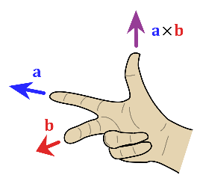
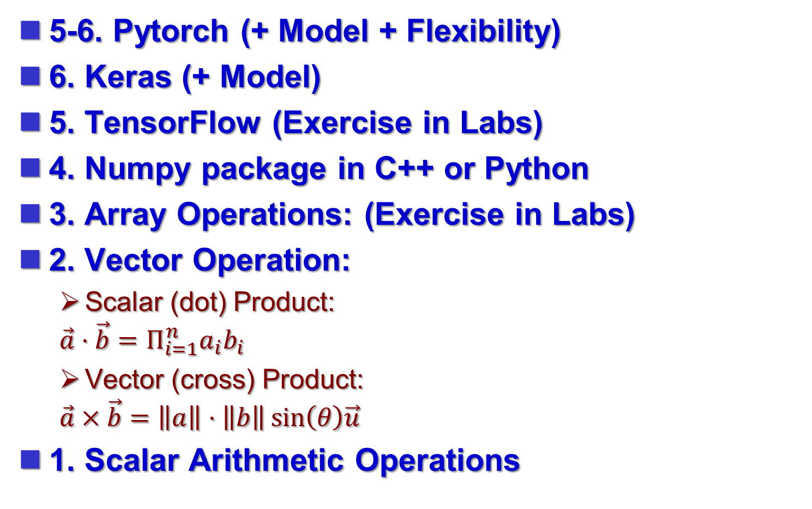
Levels of Computing Language
5-6. Pytorch (+ Model + Flexibility)
6. Keras (+ Model)
5. TensorFlow (Exercise in Labs)
4. Numpy package in C++ or Python
3. Array Operations: (Exercise in Labs)
2. Vector Operation:
  Scalar (dot) Product:
  $$\vec{a}⋅\vec{b}=Π_{i=1}^{n}a_{i}b_{i}$$
  Vector (cross) Product:
  $$\vec{a}×\vec{b}=\left\|a\right\|⋅\left\|b\right\|\sin\left(θ\right)\vec{u}$$
1. Scalar Arithmetic Operations

Slide 24
Parallelization across Machines
Deep Stacking Network
DBN (Deep belief network)
RNN➔ILA(Iterative Logic Array) Model➔ Flatten
Attention or Region of Interest (ROI) ⬅
➔ Transformer ➔ ViT ➔ Parallelization
Pipelining for Batch Process
CUDA-C /MAC Array in GPU

Slide 25
NN Accelerating Methodology
Parallelization
  deep stacking across machines
  layer folding
Approximate Computing
Analogue Neural Network
  RRAM
  MRAM
  Charge-capacitor
  OTA
Computation in Memory
  RRAM
  12T SRAM with shifting & logical operations
Pruning
(Source: Wikipedia)

Slide 26
Supervised Learning
Steps:
  clustering ➔ classification ➔ data annotation ➔ training
Algorithm choice
  Bias-variance tradeoff
  Function complexity and amount of training data
  Dimensionality of the input space
  Noise in the output values
  Other factors to consider (important)
  Algorithms
How supervised learning algorithms work
  Empirical risk minimization
  Structural risk minimization
Generative training
Generalizations
Approaches and algorithms
Applications
General issues
(Source: Wikipedia)

Slide 27
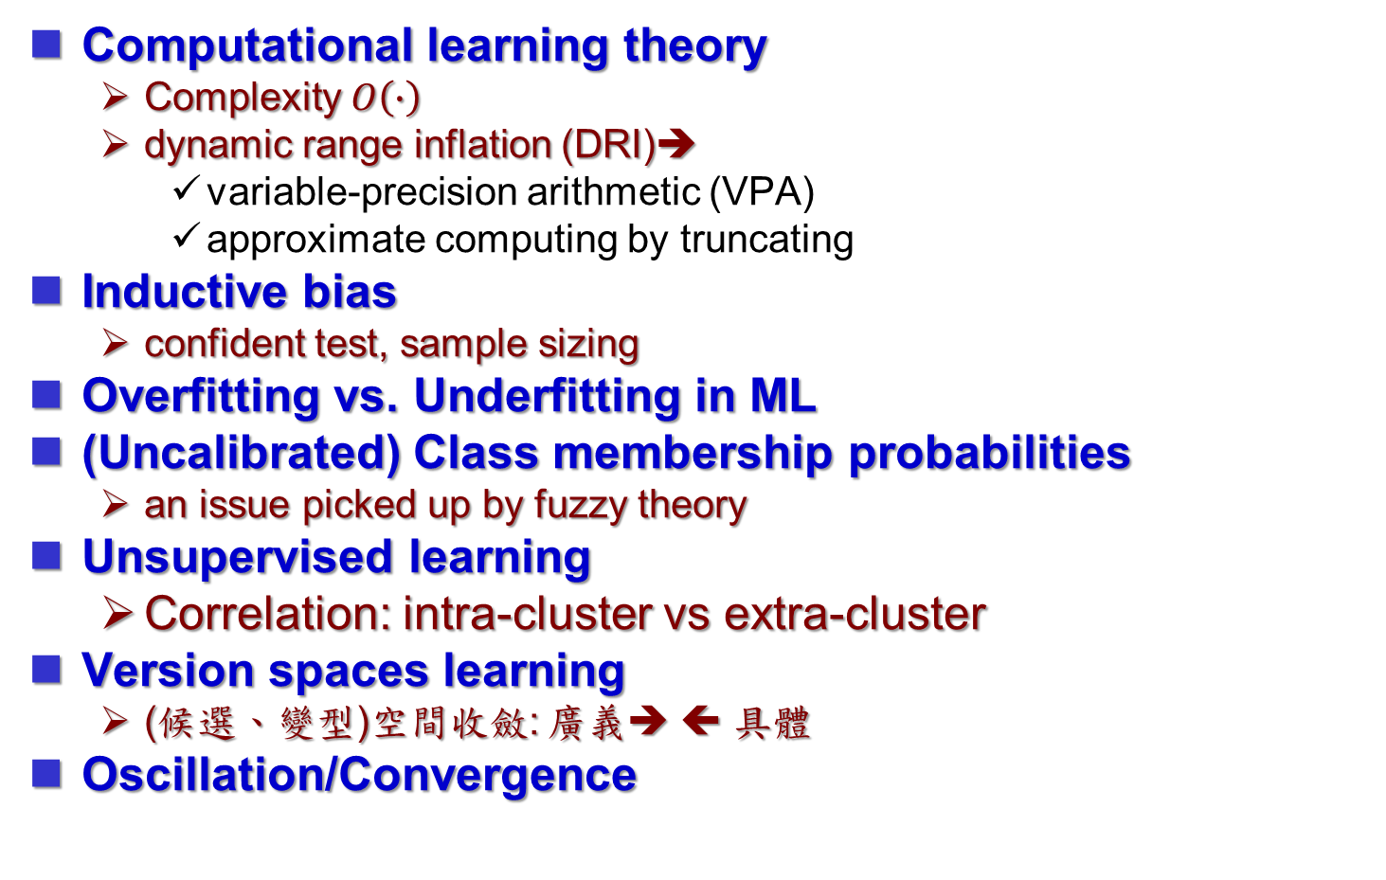
General Issues of Supervised Learning
Computational learning theory
  Complexity $O\left(∙\right)$
  dynamic range inflation (DRI)➔
    variable-precision arithmetic (VPA)
    approximate computing by truncating
Inductive bias
  confident test, sample sizing
Overfitting vs. Underfitting in ML
(Uncalibrated) Class membership probabilities
  an issue picked up by fuzzy theory
Unsupervised learning
  Correlation: intra-cluster vs extra-cluster
Version spaces learning
  (候選、變型)空間收斂: 廣義➔ ⬅ 具體
Oscillation/Convergence
underfitting
overfitting
general
boundary
specific
boundary
version space
(Source: Wikipedia)

Slide 28
Comparisons of Some Applications
in situ
ex situ
on-line / off-line
on-the-fly,
built-in / on-field / embedded

Slide 29
Unsupervised Learning
Clustering
  hierarchical clustering
  k-means[5]
  mixture models
  DBSCAN
  OPTICS algorithm
Anomaly detection
  Local Outlier Factor
Neural Networks
  Autoencoders
  Deep Belief Nets
  Hebbian Learning
  Generative adversarial networks
  Self-organizing map
Approaches for learning latent variable models such as
  Expectation–maximization algorithm (EM)
  Method of moments
  Blind signal separation techniques
    Principal component analysis
    Independent component analysis
    Non-negative matrix factorization
    Singular value decomposition
(Source: Wikipedia)

Slide 30
Semi-supervised learning
Assumptions
  Continuity assumption
  Cluster assumption
  Manifold assumption
Methods
  Generative models
  Low-density separation
  Graph-based methods
  Heuristic approaches

Slide 31
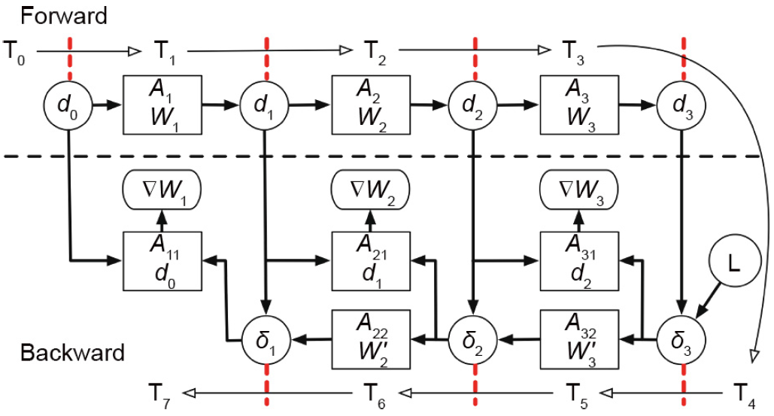
Pipeline per layer for Forward/Back Propagation
(source: HPCA2017PipeLayer)

Slide 32
Neural Functional Unit (NFU)
(source: ASPLOS2014DianNao)

Slide 33
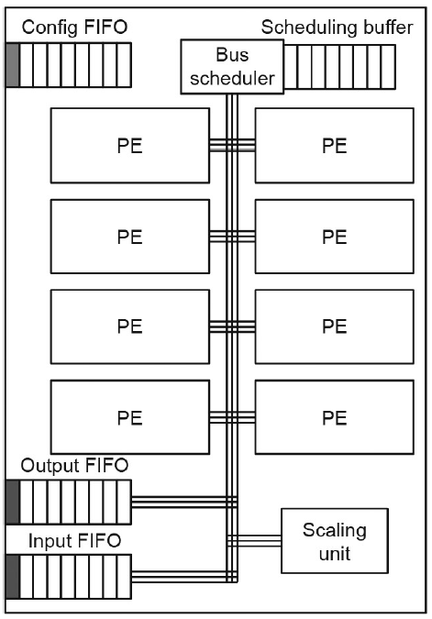
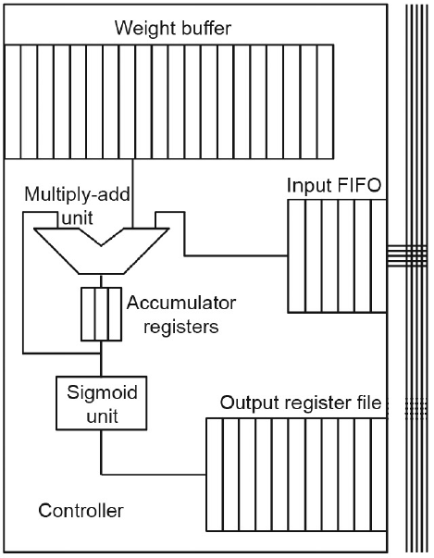
Neural Processing Unit (NPU)
The acronym NPU can also be Network processing unit.
(source: Micro2013Esmaeilzadeh)

Slide 34
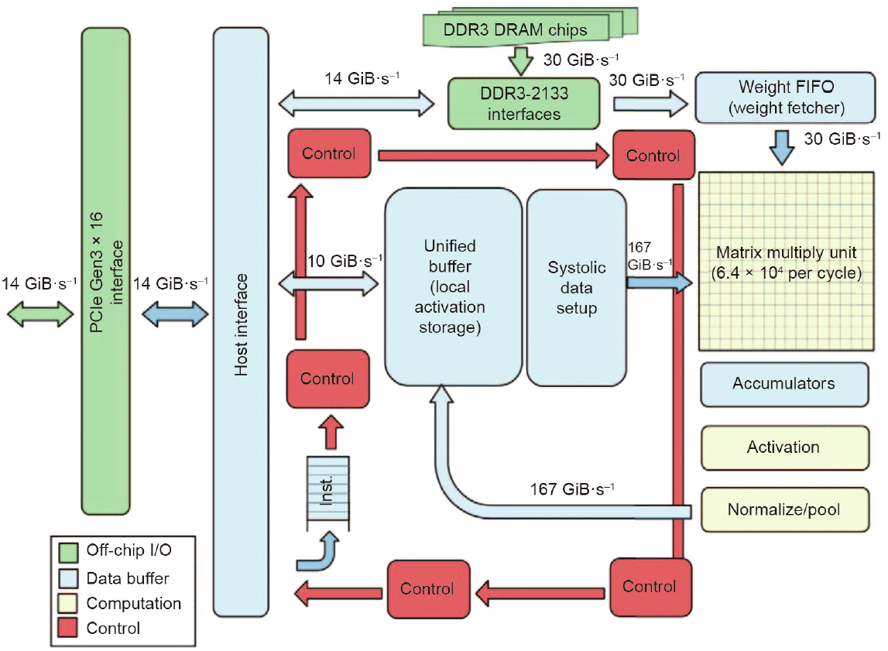
Tensor Processor Unit (TPU)
(source: ISCA2017Jouppi)

Slide 35
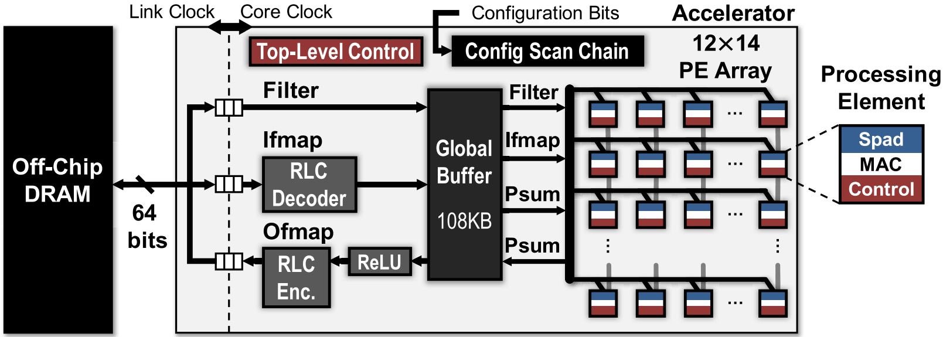
MIT Eyeriss System
(source: JSSCC2017Eyeriss)

Slide 36
10 Best Graphics Cards 2021-2
AMD Radeon RX 5700
Nvidia GeForce RTX 3090 Ti
AMD Radeon RX 5600 XT
Nvidia GeForce RTX 2070 Super
Nvidia GeForce GTX 1660 Super
AMD Radeon VII
Nvidia GeForce RTX 2080 Super
Zotac GeForce GTX 1080 Ti Mini
Gigabyte GeForce GTX 1660 OC 6G
PNY GeForce GTX 1660 Ti XLR8 Gaming OC
(source: https://www.techradar.com/news,
Also see https://benchmarks.ul.com/compare/best-gpus)

Slide 37
Cost functions: Loss, Energy, Error Func
Initialize the weights (w₀, w₁, …, w_{k})
Adjust the weights in such a way that the output of ANN is consistent with class labels of training examples
  Error function:
  Find the weights w_{i}’s that minimize the above error function
    e.g., gradient descent, backpropagation algorithm

Slide 38
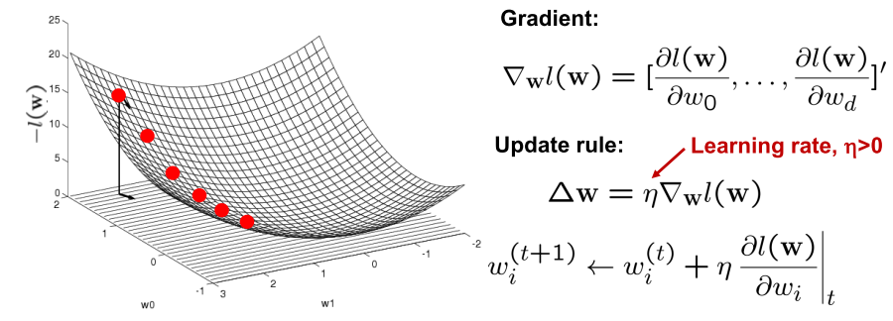
Gradient Descent Rule
Maximum of a concave function = minimum of a convex function
Gradient ascent (concave) / Gradient descent (convex)

Slide 39
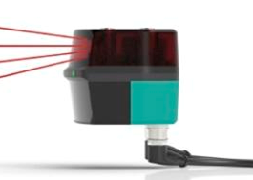
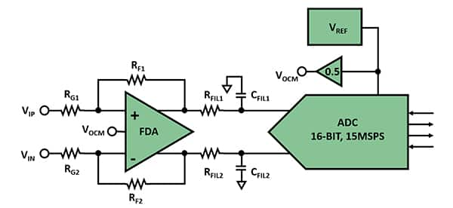
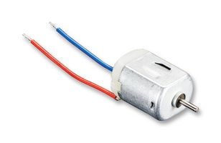
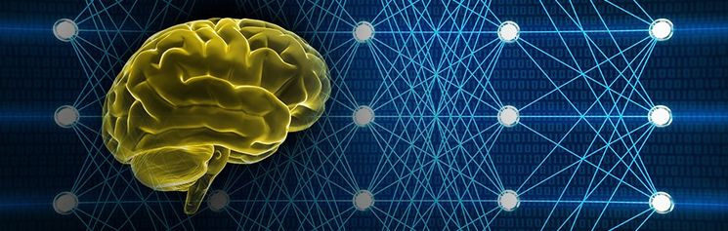
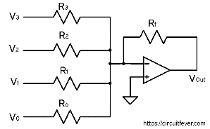

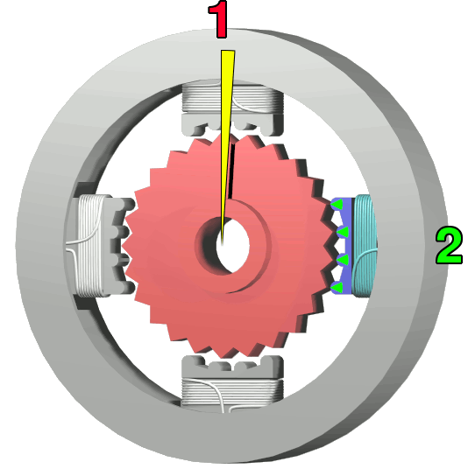
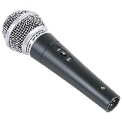
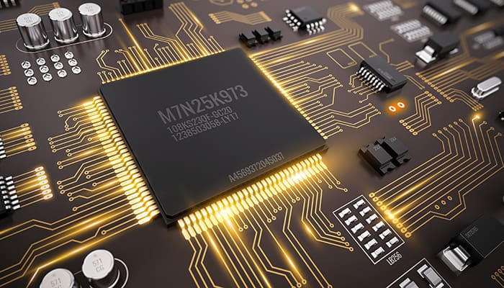
電子系學生看「人工智慧及其應用」
Sensors
Transducers
DSP
CNN
DNN
DecisionNet
Drivers
Human
LiDAR
Camera
Number Theory
Math
Linear Algebra
Microphone
IC Design

Slide 40
Syllabus of 109-1 NNA
Overviews and Background (3hr)
  Installation and online platforms
  Simple NN examples
  Python/Tensorflow/Keras
  Terminology and Metrics
Basics and Reviews (3hr)
  programming and scripting
  linear algebra and number theory
  probability and statistics, differential
Model Types and Selection (3hr)
Computer Architecture and Hardware Accelerators (3hr)
  CPU, GPU, GPGPU, NPU, VPU, TPU
  FPGA, AI-SoPC
  Data Flow Graph and Optimization
Memory Access Techniques (3hr)
  Allocation of Conventional Memory
  Direct Memory Access
  CUDA
  Computing in Memory
Residue Number Systems (6hr)
  Linear Algebra and Number Theory
  Overflow-aware VPA
  Approximate RNS
Approximate Computing (6hr)
  Naturally approximating: analogue and binary truncation
  TCB/BCB Approximating for Batch Learning
  Range LUT using Range CAM
Pruning and Self-Healing (6hr)
  Random dropping
Labeling Acceleration: Generative Adversarial Networks (3hr)
Structure Mapping for Parallelization (3hr)
  Technology Mapping: Logic and Modular
  MAC, FMA
  Deep stacking network
Model Compression and Optimization (3hr)
Analogue Neural Networks (4hr)
  RRAM, MRAM, Charge Cap, OTA
Meta Learning (2hr)
  One-shot learning
  On-line Reconfiguration
  Kohonen Self-Organizing Machine
  NN Design Learning : learn to learn

Slide 41
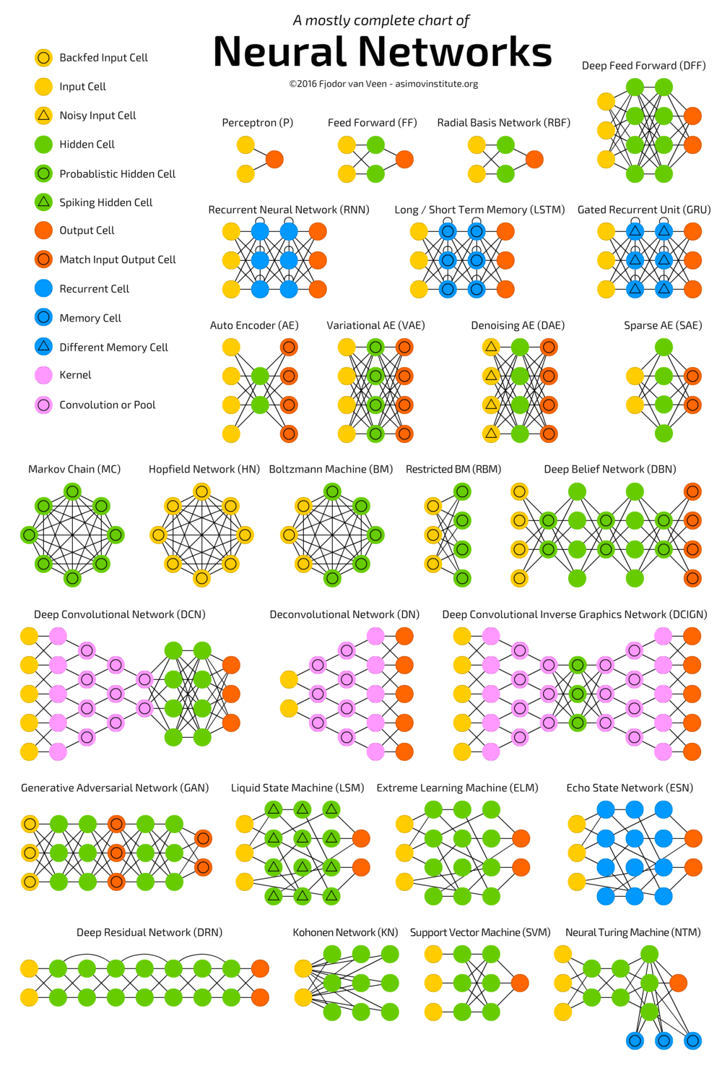
A Comprehensive Guide to NN Types
Perceptron
Feed Forward Neural Network
Multilayer Perception (MLP)
  extension of perception NNs
Convolutional Neural Network
  Faster Region-CNN
Radial Basis Function Neural Network
Recurrent Neural Network
LSTM –Long Short-Term Memory
Sequence to Sequence (S2S)
  a sequence-to-sequence model consists of two recurrent neural networks: an encoder that processes the input and a decoder that produces the output.
Modular Neural Network
https://towardsdatascience.com/the-mostly-complete-chart-of-neural-networks-explained-3fb6f2367464

Slide 42
109-1 本課程基礎與發展工具
AISOC Automotive Chips
Xilinx Vitis
Synposys HLS
Vivado
HLS
Cell-based
Design
Pynq-z2
Jupyter Lab
Spyder
神經網路
加速技術
C-程式設計
EDA Script
Python程式
FPGA
Verilog HDL
邏輯設計
Computer
Vision
演算法
Digital Image
Process
數論
線性代數
機率與統計學

Slide 43
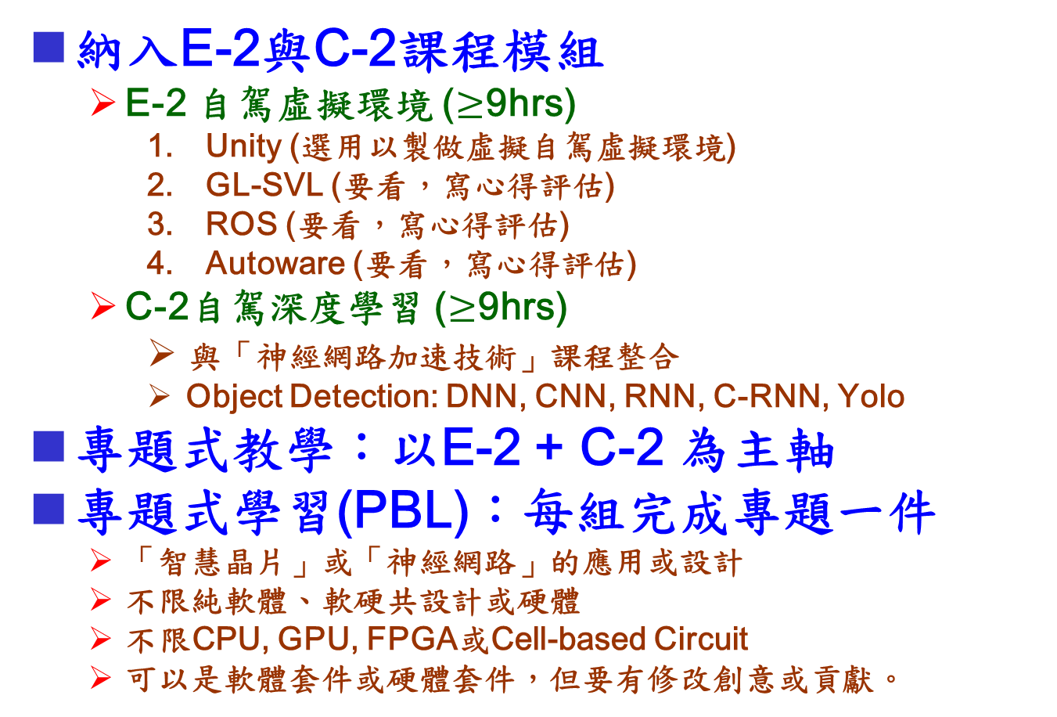
推廣課程規定
納入E-2與C-2課程模組
  E-2 自駕虛擬環境 ($≥$9hrs)
    Unity (選用以製做虛擬自駕虛擬環境)
    GL-SVL (要看，寫心得評估)
    ROS (要看，寫心得評估)
    Autoware (要看，寫心得評估)
  C-2自駕深度學習 ($≥$9hrs)
    與「神經網路加速技術」課程整合
    Object Detection: DNN, CNN, RNN, C-RNN, Yolo
專題式教學：以E-2 + C-2 為主軸
專題式學習(PBL)：每組完成專題一件
  「智慧晶片」或「神經網路」的應用或設計
  不限純軟體、軟硬共設計或硬體
  不限CPU, GPU, FPGA或Cell-based Circuit
  可以是軟體套件或硬體套件，但要有修改創意或貢獻。

Slide 44
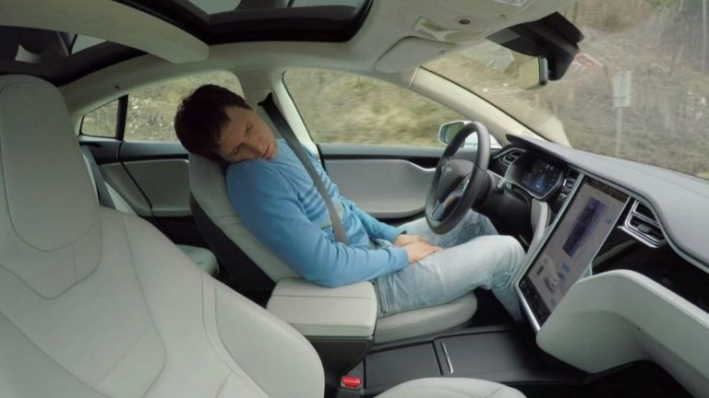
Autopilot
Man Caught Sleeping In Tesla Autopilot Mode Speeding At 90mph
(Source: https://fossbytes.com)

Slide 45
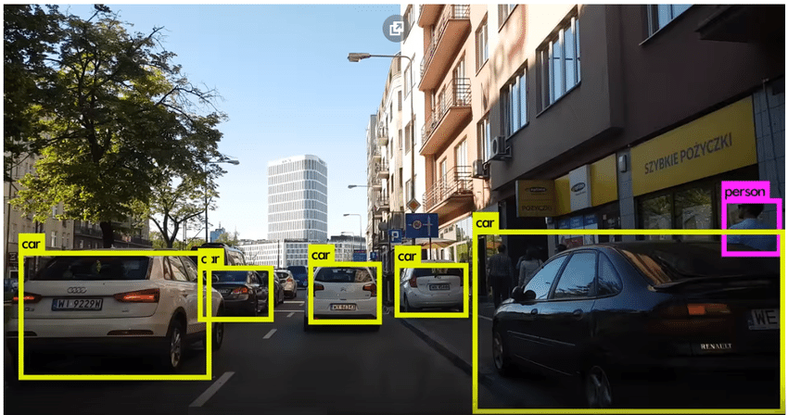
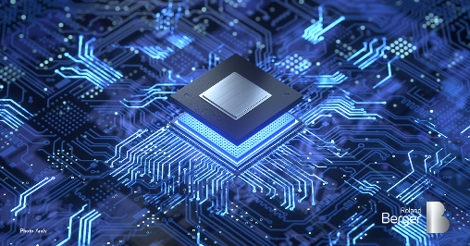
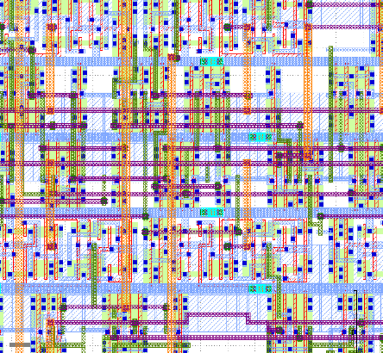
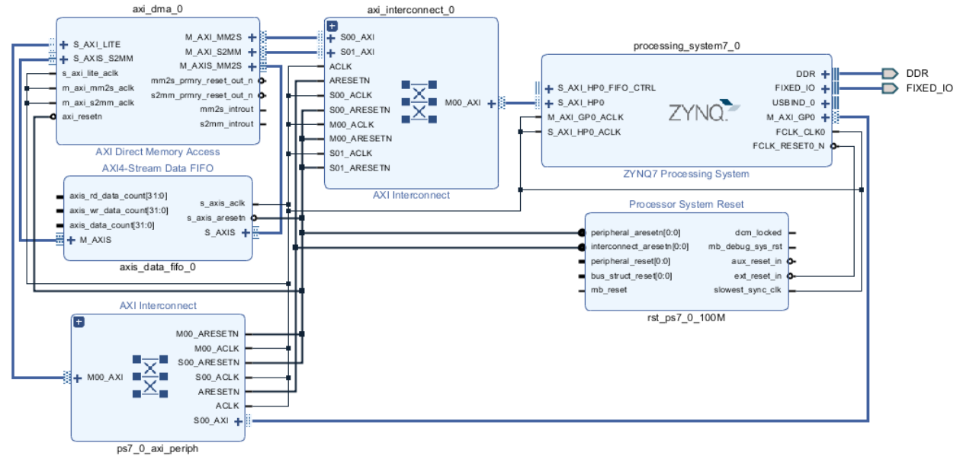
高階應用Tutorials以激發學生興趣
感謝校長和王可文老師的教材，第1-2週用以激發學生興趣。
挑選與自動駕駛相關的YOLO4, SSD做人臉辨識、車輛辨識等。
第1-2週
`
第19週
model = keras.Sequential( )
Keras
AISoC
tf.multiply(x,y,name)
tf.Session().run()
Tensorflow
Cell-Based
np.outer(W, A)
np.matmjul(X, Y)
Numpy
HLS Verification
#include “systemc.h”
#include “ap_fixed.h”
x = a x w + b
y = f(x)
Arithmetics
Vivado IP Design
assign x = a * w + b;
Logistic U1(Y, X);
RTL Codes
Digital VLSI Design

Slide 46
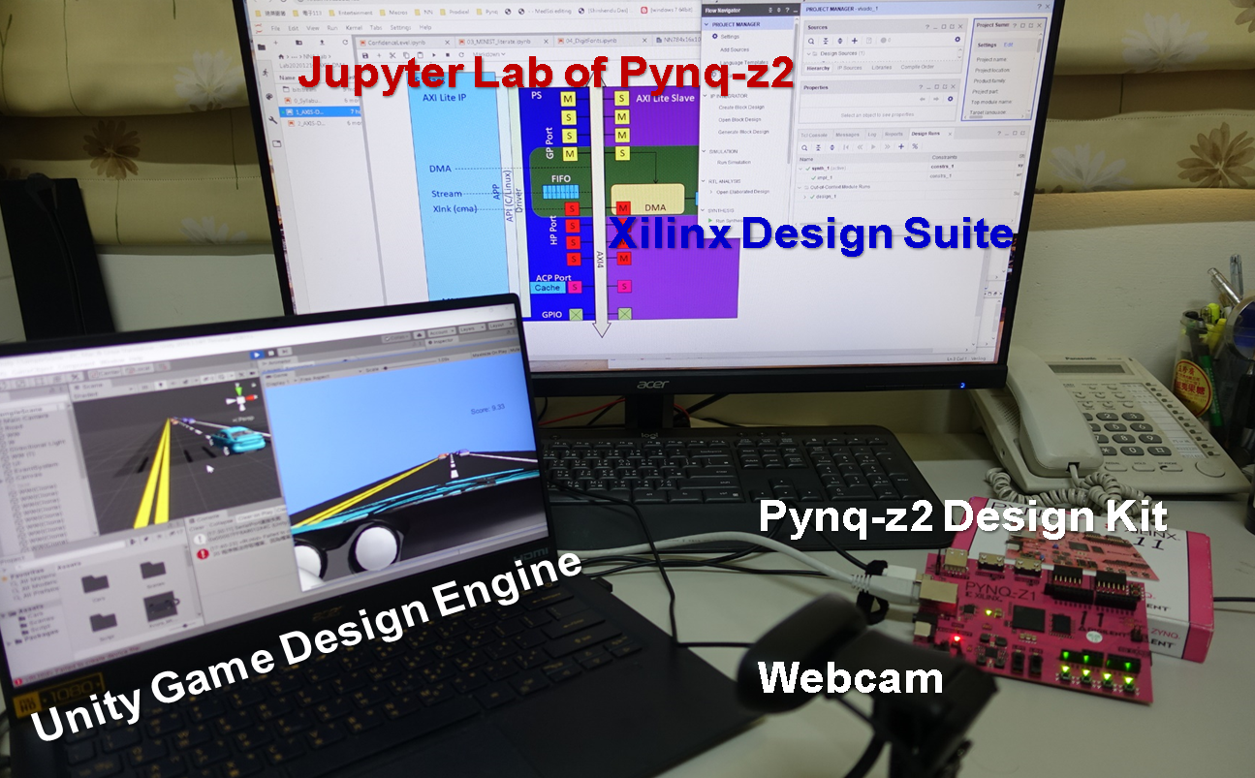
110-2 NNA基本實驗環境

