Slide 1
Pynq System Installation
Tsung-Chu Huang (黃宗柱)
Electronics Eng., NCUE
TestLab, NCUE
2022/1/8

Slide 2
Outline
Installation of Xilinx PYNQ System
Pynq-z1/2 Setup
USB-COM Installation
for Zynq-7020 (FPGA) Bitstream Programming
Using ISE or SDK
for A9 + Pynq (Embedded System) Bitstream Downloading
Terminal for Linux with Kernel Python/C
Vivado (+SDK) Bitstream Downloading library
RJ45-CAT5e-RJ45 Ethernet Installation
Desktop of Ubuntu 18.04 (Heavy)
Jupyter Lab (Light) with File Upload/Download
Terminal
SAMBA (SMB)
FTP through File Manager in Windows

Slide 3
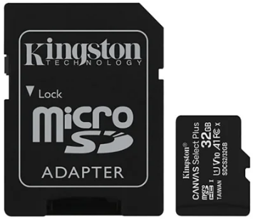
Installation of Xilinx PYNQ System
download files
https://drive.google.com/drive/folders/1EZG40mE2-NDZH9r5QzjHjP5nreGNSJvw?usp=sharing
Image file:
https://digilent.com/reference/programmable-logic/pynq-z1/start
http://www.e-elements.com.tw/products/fpga_system/xup_pynq/pynq-z2/
Image writer:
https://sourceforge.net/projects/win32diskimager
Steps:
For Formatted SD
Unzip the image
Write to a blank MicroSD (>8G, looked as a FAT32 USB HD) using
For Unformatted SD with the same partition
Click SD in File Manager, Format to FAT32 in Content
For SD with wrong partition:
Enter DOS by cmd, > DISKPART
help
list disk (e.g., disk 4)
select disk 4
clear
create partition primary
format fs=fat32
exit

Slide 4
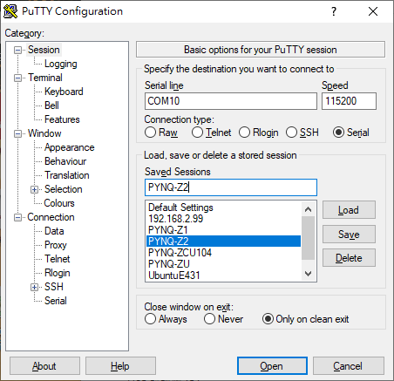
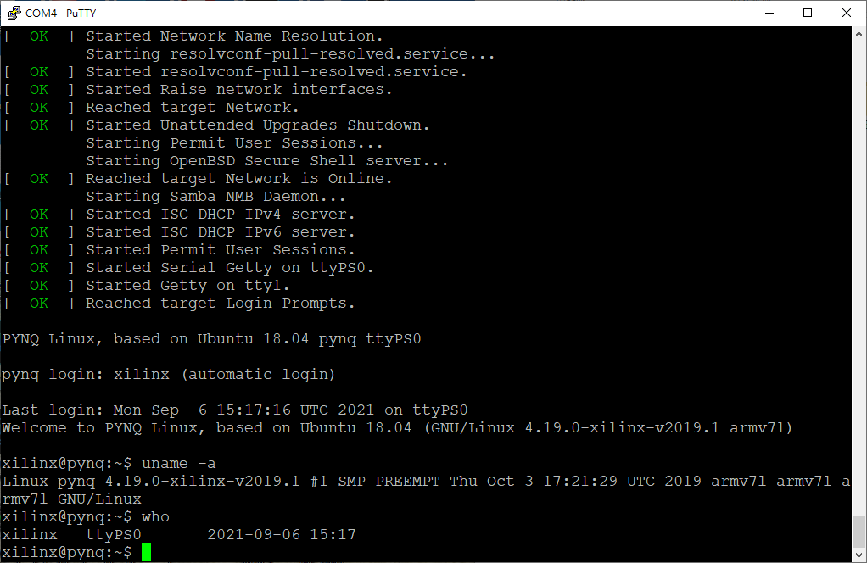
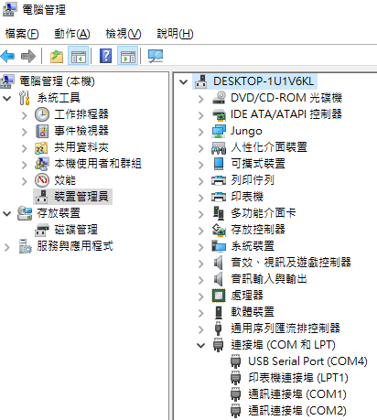
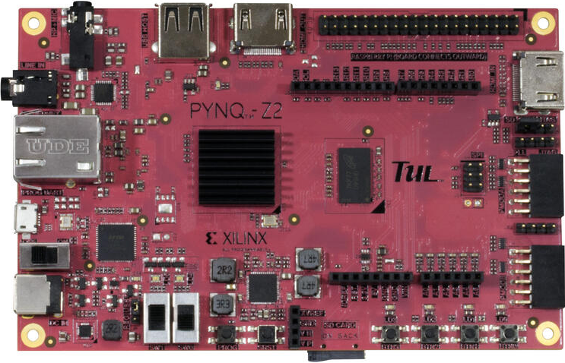
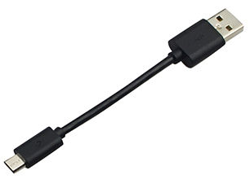
Pynq-z1/2 Setup
Configure PuTTY Terminal in PC:
Turn off/on and PuTTY to browse Booting:
Activating Ethernet
SAMBA
DCHP Server
Open Device Manager
> uname –a
> who
ttyPS0 ⬄ COM4 connected
Check COM#
SD ⬅ JTAG
Boot from SD,
or program from JATAG
Check iNet IPv4
Connect microUSB
COM PuTTY
xilinx@pynq:~$ ifconfig
eth0: flags=4099<UP,BROADCAST,MULTICAST> mtu 1500
. . . .
eth0:1: flags=4099<UP,BROADCAST,MULTICAST> mtu 1500
inet 192.168.2.99 netmask 255.255.255.0 broadcast
Turn On
Power from USB/REGulator
Insert microSD

Slide 5
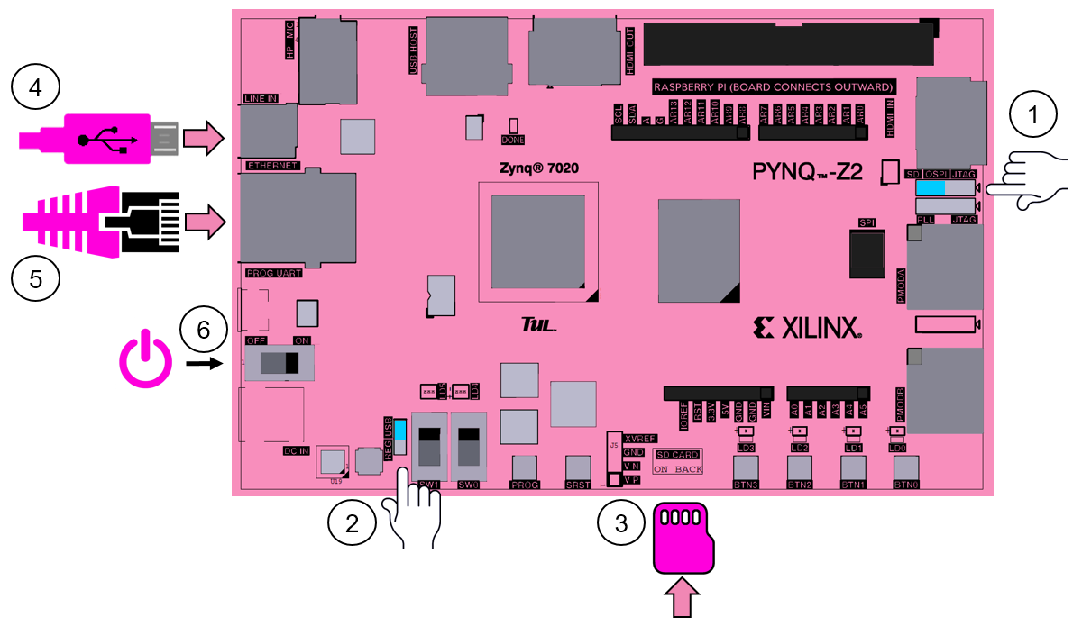
Review on Typical Settings
Micro-USB
Booted from SD
COM
LAN
RJ45
Power On
Power
source:
USB
SD

Slide 6
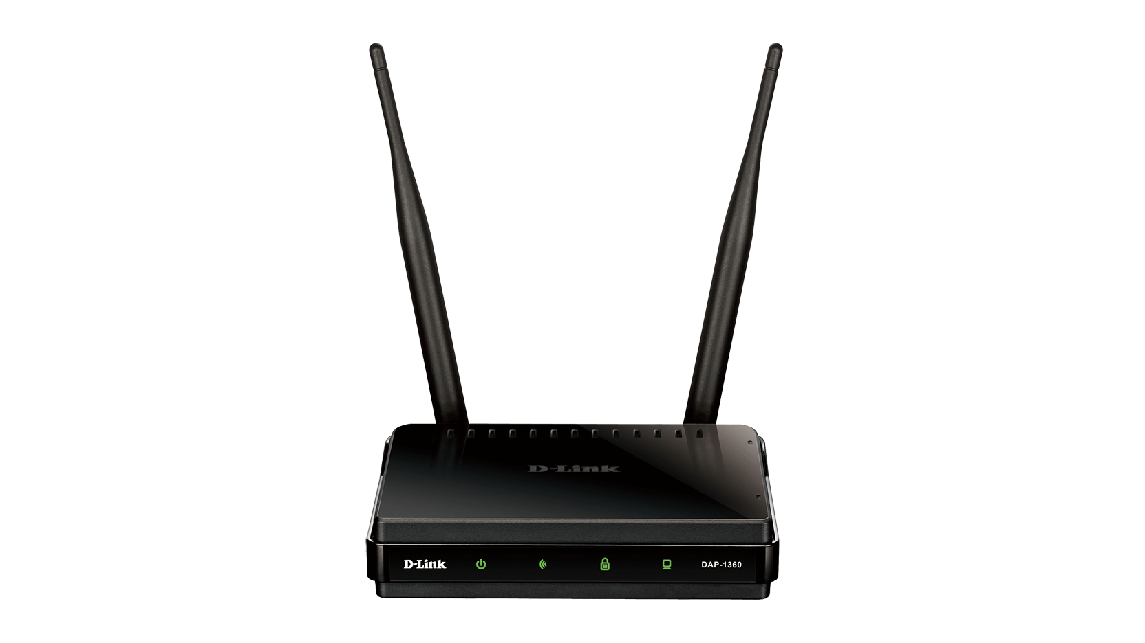
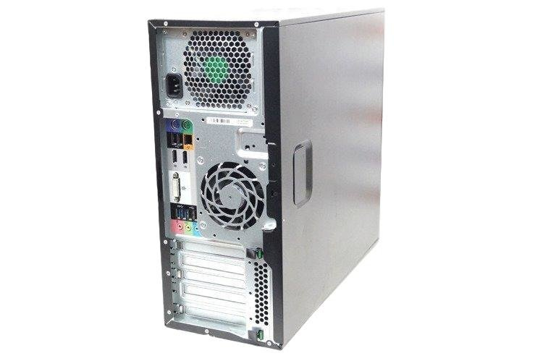
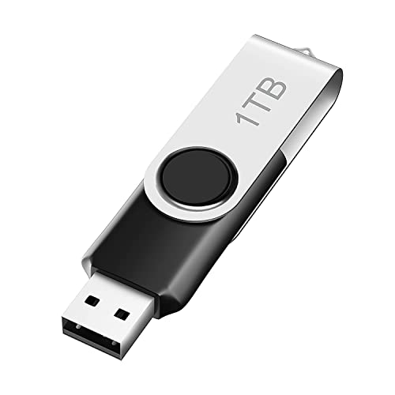
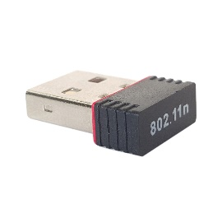
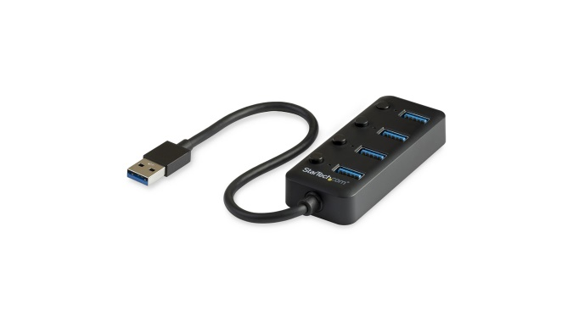
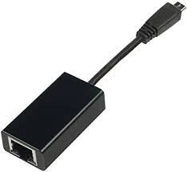
Connect the Internet for File Transfer
RJ45
③
Manual
switch
②
RALink WiFi RT5370
④
USB Hub
RJ45
USB
①
USB-RJ45 LAN

Slide 7
High-Level Embedded System Design
Pynq
PC
Python
SW
HW
SDK
PC
C++
HLS
FPGA
Vivado
HW
Verilog
IPI
FPGA

