Slide 1
Setting SMB 1.0
Reporter: Jyun-Xin Ke
Professor: Tsung-Chu Huang

Slide 2
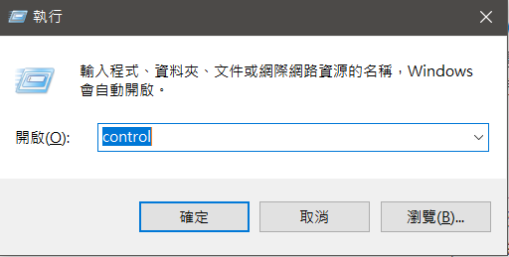
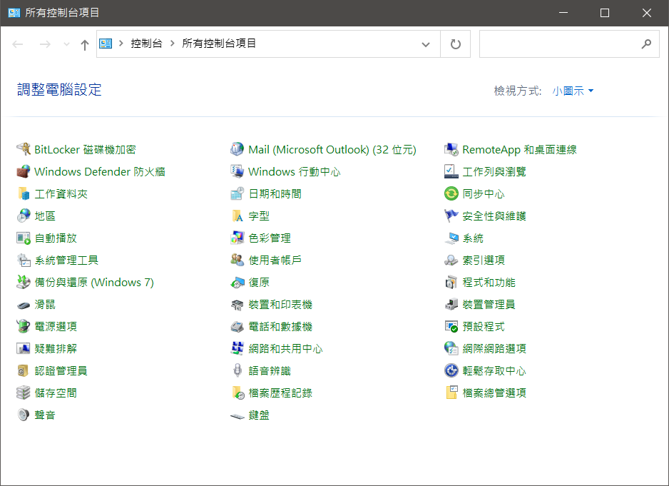
Fix1:Check the Sharing Settings
Use Windows Key+R to Quickly Launch Apps As Administrator, and then enter “control”.

Slide 3
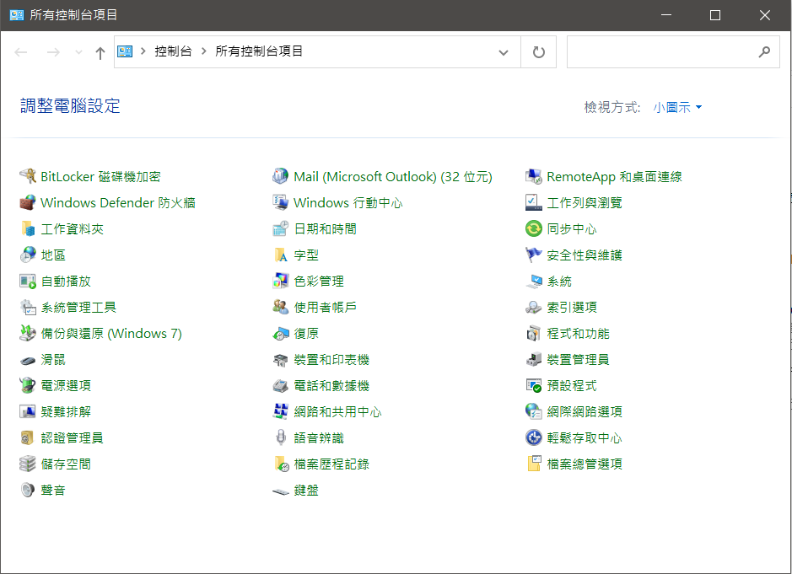
Fix1:Check the Sharing Settings
Navigate to “Control Panel -> Network and Internet -> Network and Sharing Center -> Advanced sharing settings.”

Slide 4
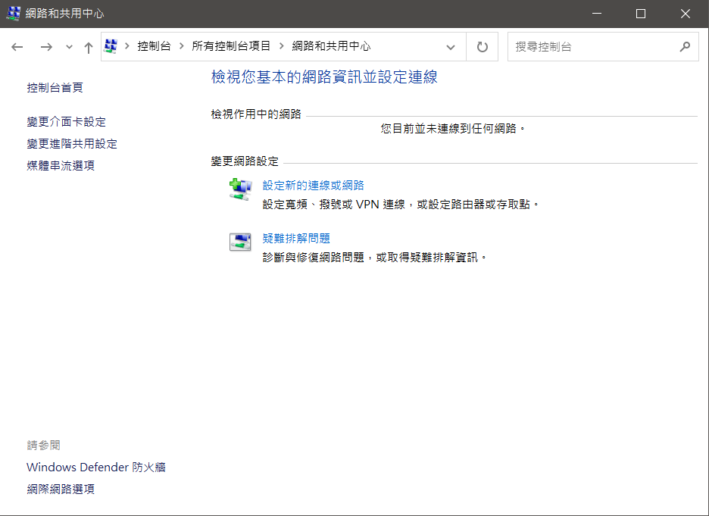
Fix1:Check the Sharing Settings
Navigate to “Control Panel -> Network and Internet -> Network and Sharing Center -> Advanced sharing settings.”

Slide 5
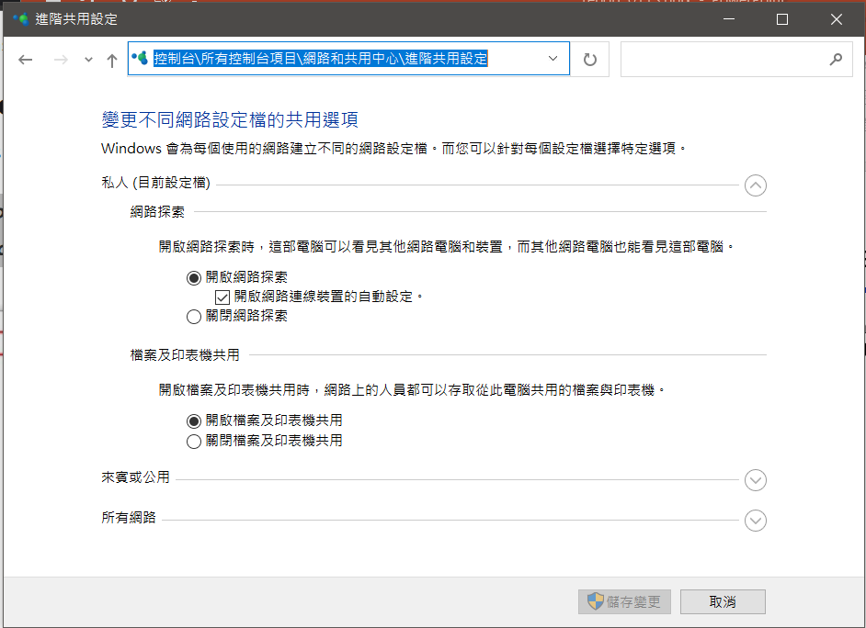
Fix1:Check the Sharing Settings
Navigate to “Control Panel -> Network and Internet -> Network and Sharing Center -> Advanced sharing settings.”

Slide 6
Fix1:Check the Sharing Settings
Click the “Private” network and ensure that “Turn on file and printer sharing” is also activated.

Slide 7
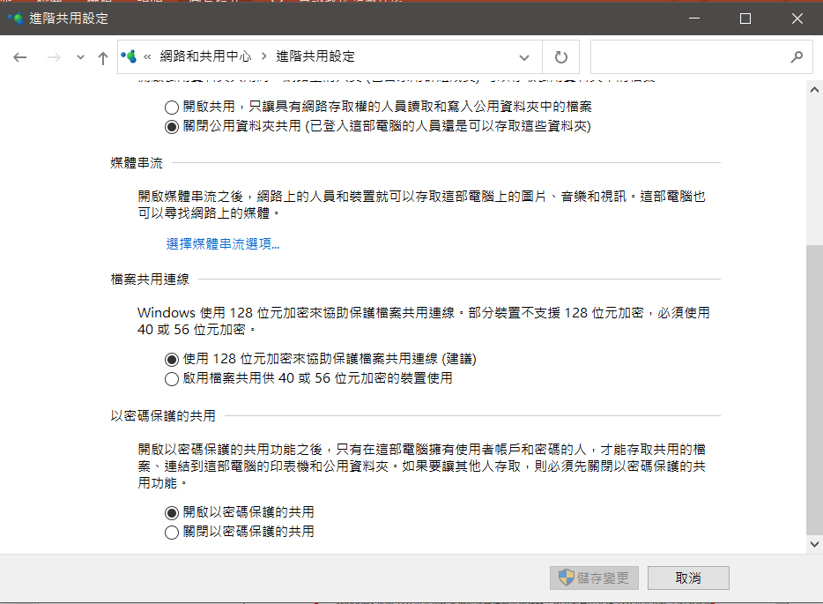
Fix1:Check the Sharing Settings
Click “All Networks” and ensure the “Turn off password-protected network sharing” option is enabled.

Slide 8
Fix2: Enable SMB 1.0/CIFS File Sharing Support
In the search box, type “control panel,” then select “Programs and Features.”

Slide 9
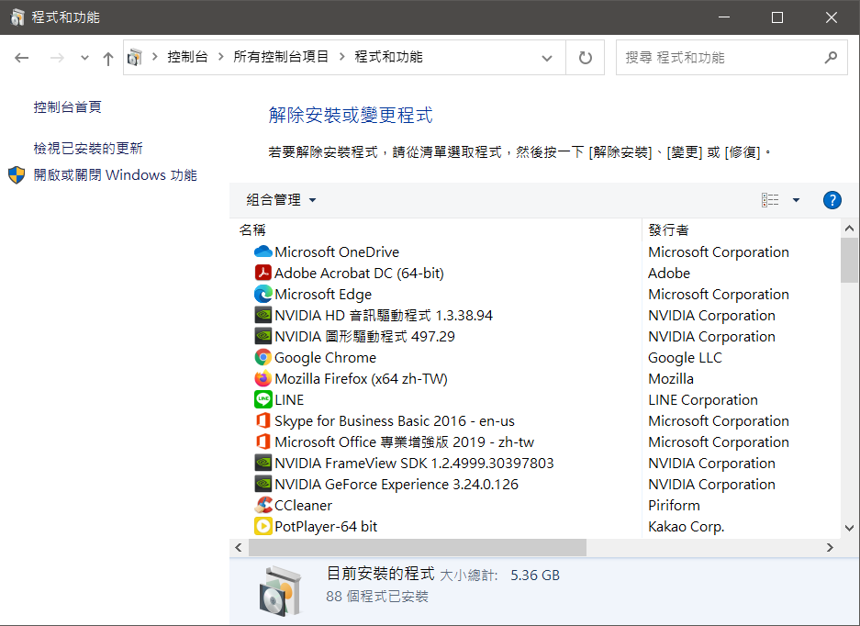
Fix2: Enable SMB 1.0/CIFS File Sharing Support
In the left-hand task pane, click on “Turn Windows features on or off.”

Slide 10
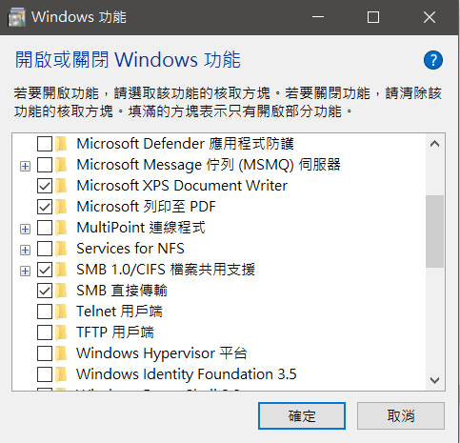
Fix2: Enable SMB 1.0/CIFS File Sharing Support
In the dialog that comes up, scroll down and find “SMB 1.0/CIFS File Sharing Support.”

Slide 11
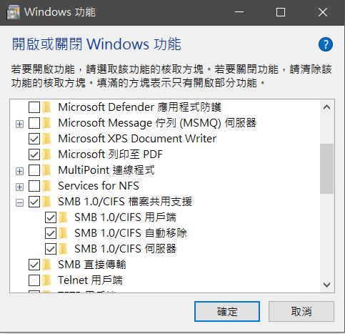
Fix2: Enable SMB 1.0/CIFS File Sharing Support
Ensure the checkbox next to “SMB 1.0/CIFS File Sharing Support“ displays as checked, and then Click “OK.”

Slide 12
Fix3: Error code 0x80004005
注意:由於安全性疑慮，若是前兩個修復能夠順利開啟SMB傳輸，就不用再做此步驟，此步驟含有一定的資安風險，使用前請三思。
微軟解釋此機碼的用途:AllowInsecureGuestAuth
簡述:因為不安全的來賓登入未經過驗證，所以會停用 SMB 簽章和 SMB 加密等重要的安全性功能。 如此一來，允許不安全的來賓登入的用戶端很容易受到各種攔截式攻擊，而造成資料遺失、資料損毀，以及暴露于惡意程式碼。這也是為何在之後的更新，微軟會直接拿掉此機碼。
https://docs.microsoft.com/en-us/windows-hardware/customize/desktop/unattend/microsoft-windows-workstationservice-allowinsecureguestauth

Slide 13
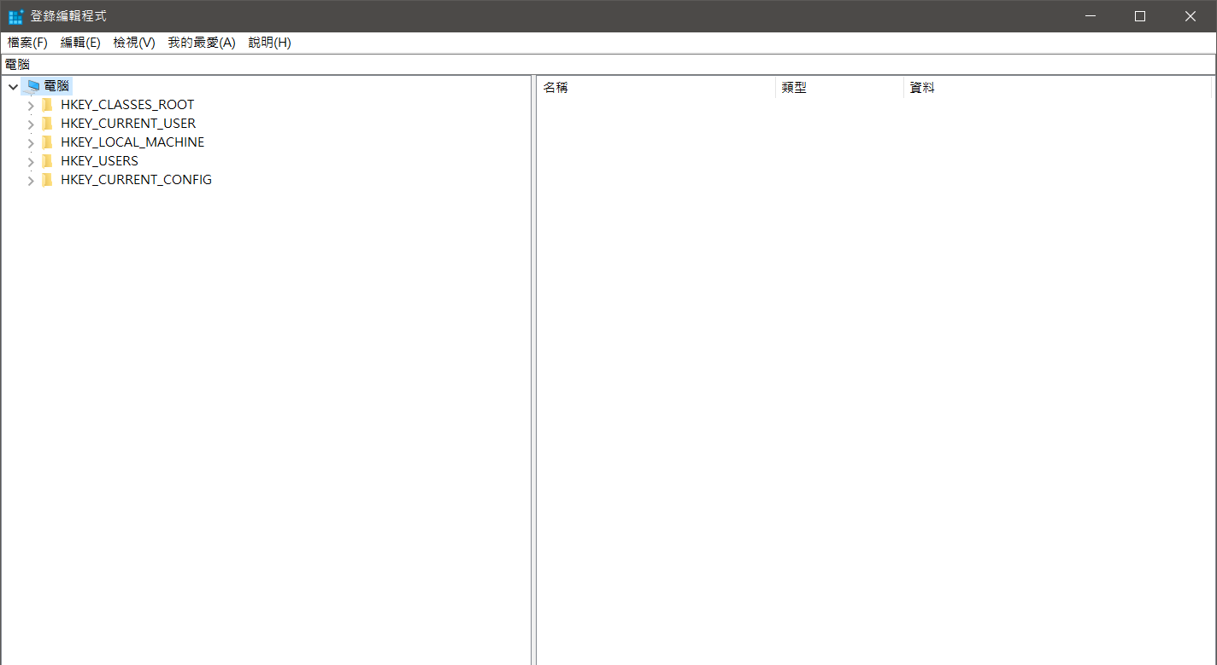
Fix3: Error code 0x80004005
Use Windows Key+R to Quickly Launch Apps As Administrator, and then enter “regedit”.

Slide 14
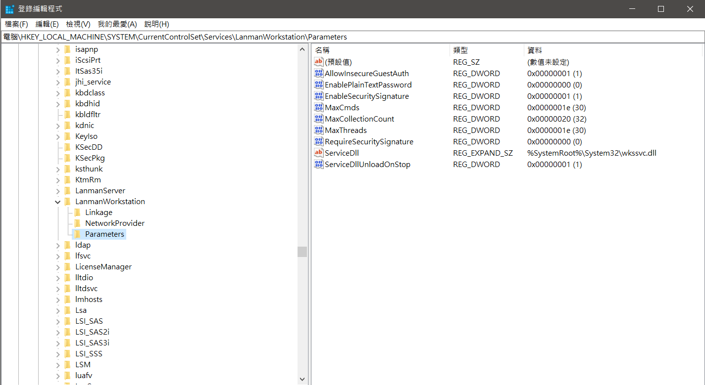
Fix3: Error code 0x80004005
Go to HKEY_LOCAL_MACHINE\SYSTEM\CurrentControlSet
\Services\LanmanWorkstation, click on the Parameters file.”

Slide 15
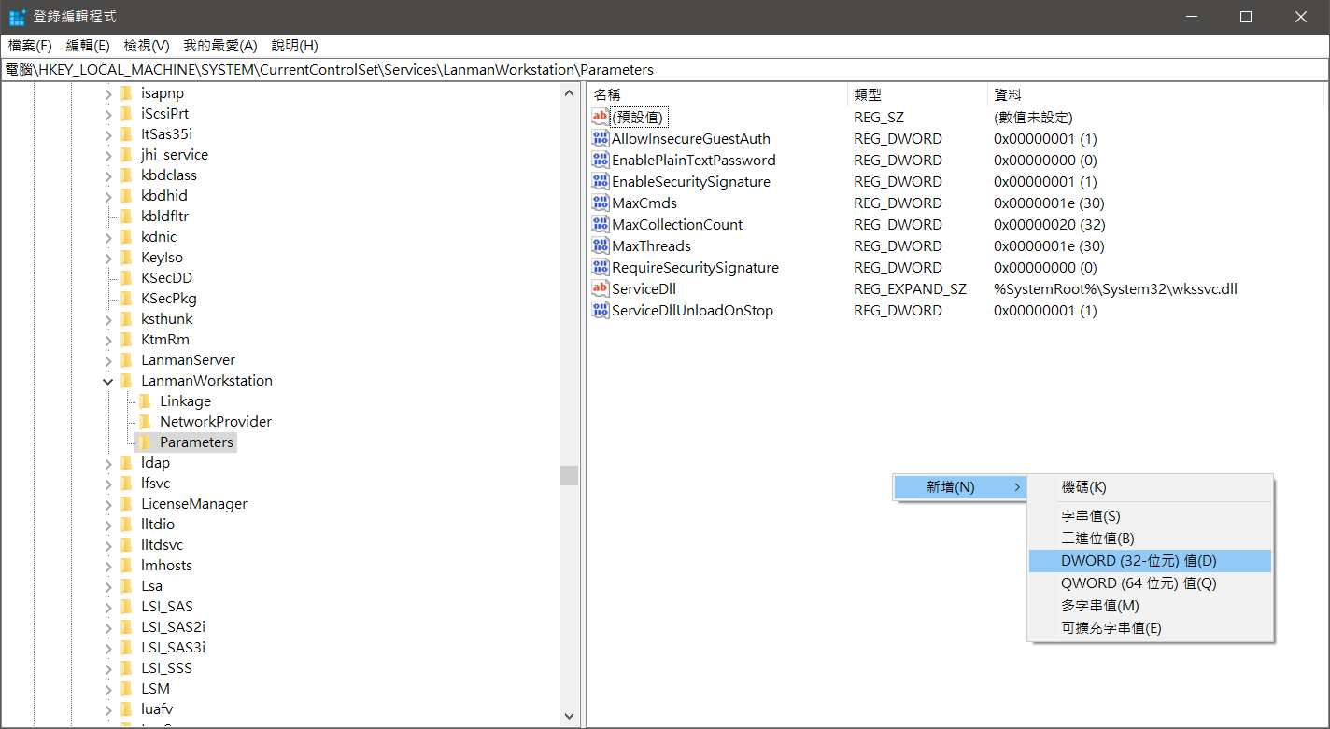
Fix3: Error code 0x80004005
Right click, and add a new DWORD On a 32-bit system.
If it already exists, don't add it again.

Slide 16
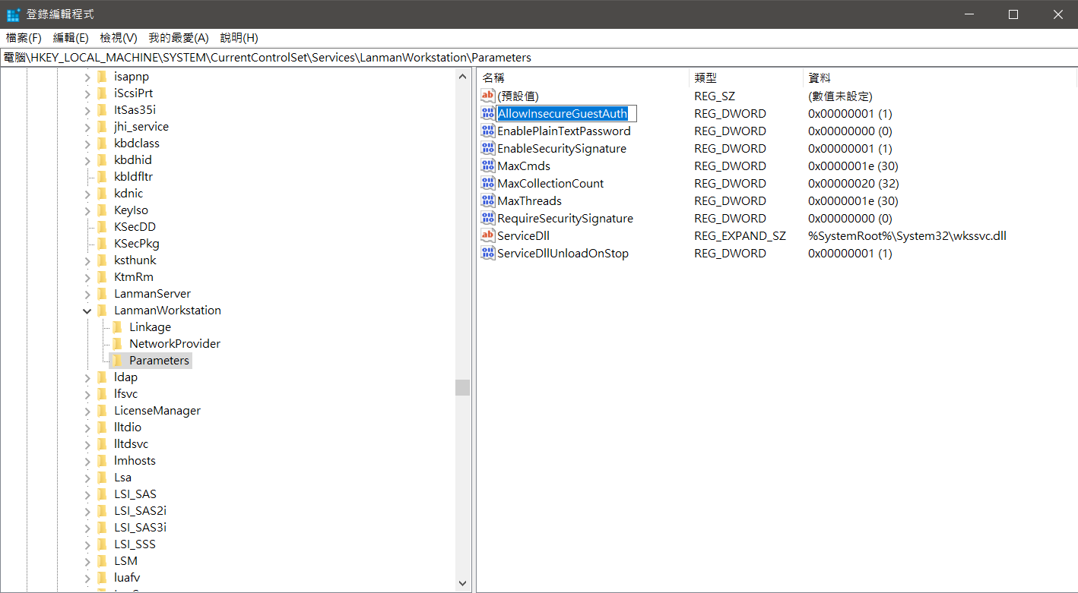
Fix3: Error code 0x80004005
Right click, and rename “LocalAccountTokenFilterPolicy”.

Slide 17
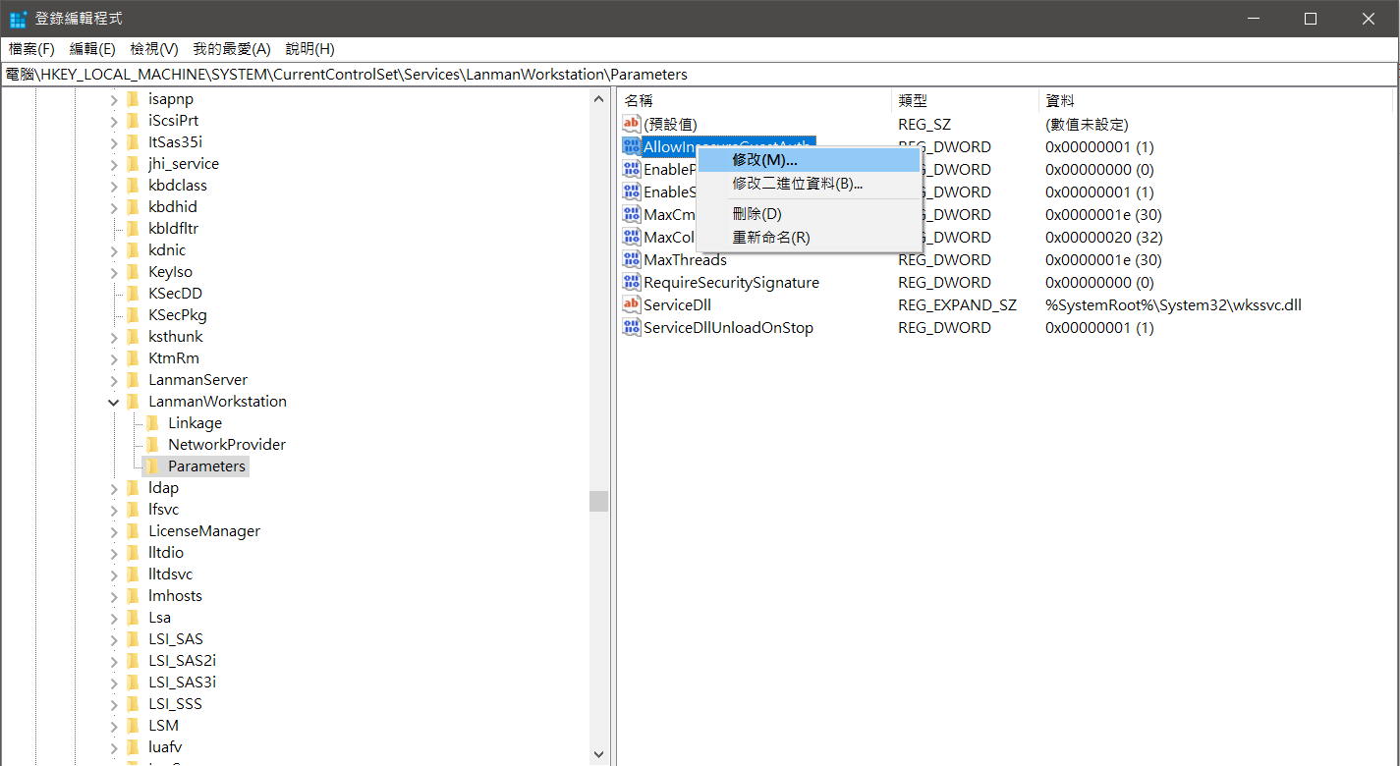
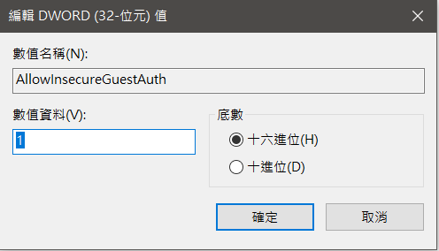
Fix3: Error code 0x80004005
Right click, and modify value to numeric 1 , then select OK.
After that, restart the Windows PC to see if the problem is fixed.

Slide 18
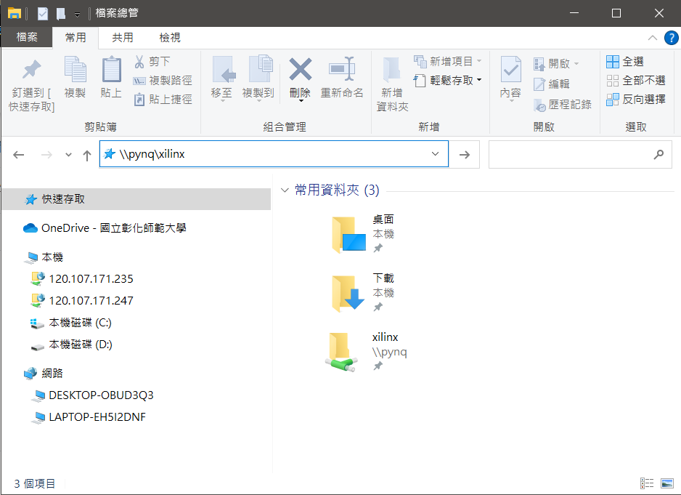
Test: using SMB 1.0
Go to file manager, and enter “ \\pynq\xilinx ”.
“ \\pynq\xilinx ” can be added to shortcuts.

Slide 19
Reference
1. How To Fix ‘Windows Cannot Access Computer’ Error Code 0x80004005
https://www.alphr.com/windows-cannot-access-computer-error-0x80004005/?fbclid=IwAR2z-PnNbwC0YiQKBvhZlr1ALzhECJr3vK3x3S86eP_7q3obdo9Qzq1gwxk
2. Error Code 0x80004005: What It Is and How to Fix It
https://www.lifewire.com/how-to-fix-error-code-0x80004005-4689559

Slide 20
Thank you for your attention !

