Slide 1
Residue Codes for CORDIC and Neural Network
Tsung-Chu Huang
2019/04/06
VTTF@NCHU

Slide 2
Outline
Introduction
  Why Residue? Why Neural Network?
  Modulo-based Codes:
    AN Codes
    Residue Number System
    Residue Codes
Previous Work
Proposed Techniques
  Low-cost & Fast Design of Logistic Function
  Design Rules for optimizing checking/cost
  Low-cost BRC for Conjugate Residue Codes
  Hybrid RNSC Based Neural Network for Self-Healing and Acceleration
Evaluations
Conclusions

Slide 3
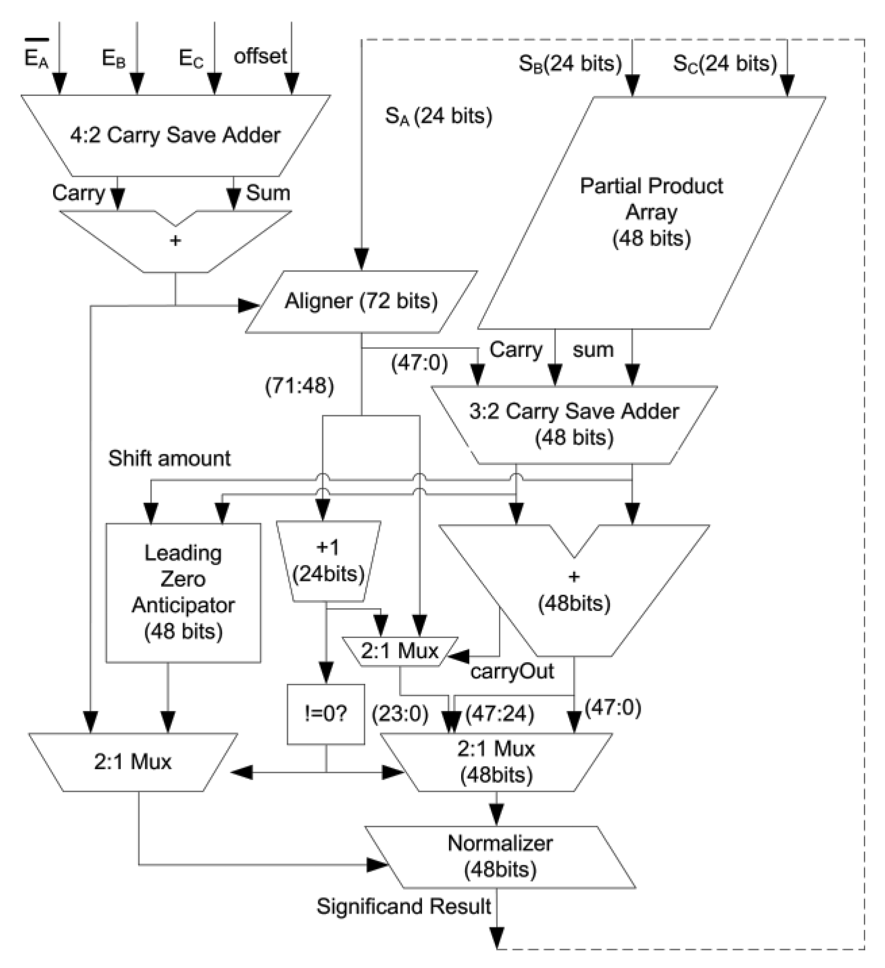
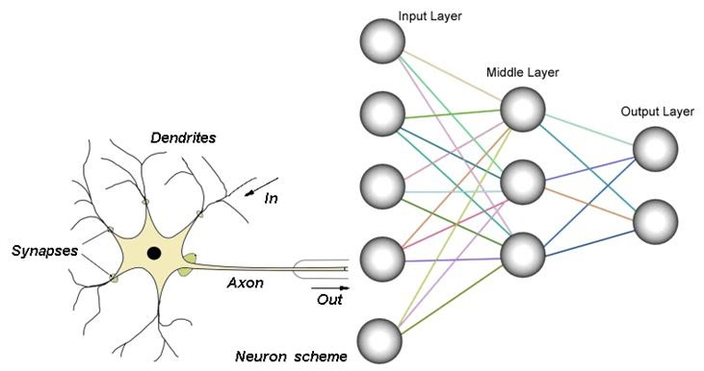
Introduction
Significance of Neural Network
PFLOPS Computation
  Acceleration
  Reliability
GPU or Vector Processors
Fused Multiply-Adder

Slide 4
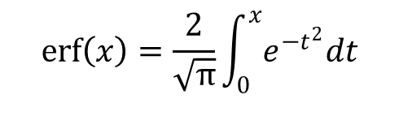
Arithmetic Operations in NN
Floating-Point Numbers can be easily represented by Fixed-Point Numbers with an Exponent.
Fixed-Point Numbers are isomorphic to 2’s Complement Integers.
Operations: Addition/Subtraction/Multiplication/Logistic
$$\operatorname{erf}\left(x\right)=\frac{2}{\sqrt{π}}\int_{0}^{x}{e^{−t^{2}}dt}$$
[1] J. Bouvrie. Notes on Convolutional Neural Networks. May 2014. http://people.csail.mit.edu/jvb/papers/cnn_tutorial.pdf.

Slide 5
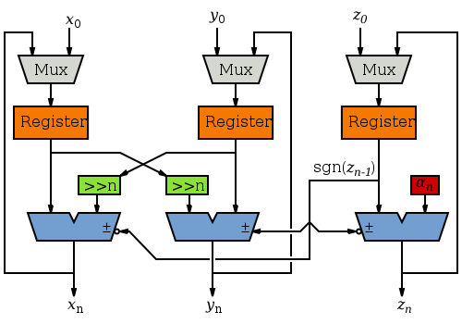
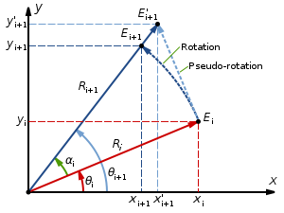
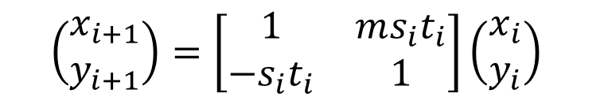

Introduction to CORDIC
Combinational Circuit without Buffer Registers
Adders with Buffer Registers
  Area reduction
  Detection Rate
$$\left(\begin{matrix}x_{i+1} \\ y_{i+1}\end{matrix}\right)=\left[\begin{matrix}1 & ms_{i}t_{i} \\ −s_{i}t_{i} & 1\end{matrix}\right]\left(\begin{matrix}x_{i} \\ y_{i}\end{matrix}\right)$$
$$z_{i+1}=z_{i}+s_{i}θ_{i}$$

Slide 6
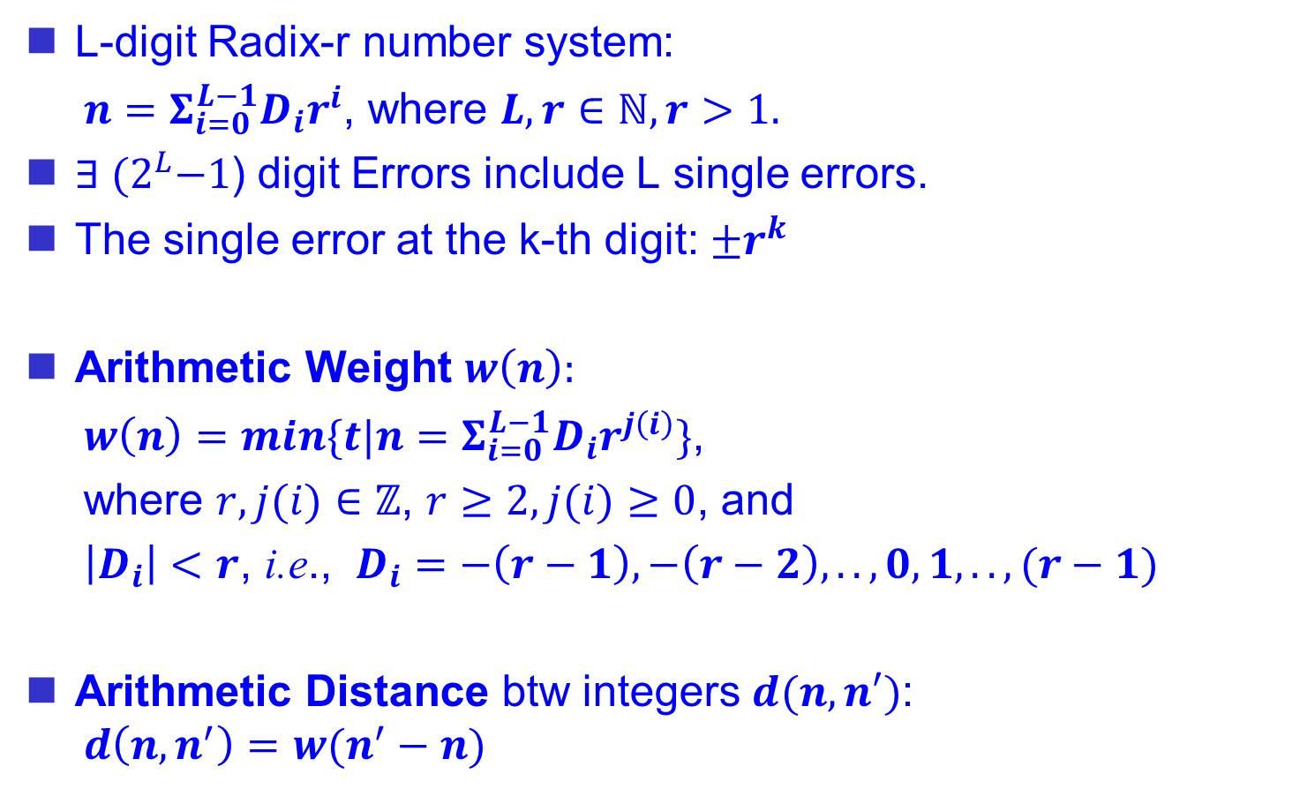
Digit Error (Fault) Model
L-digit Radix-r number system:
  $n=Σ_{i=0}^{L−1}D_{i}r^{i}$, where $L, r∈ℕ, r>1.$
$∃ {(2}^{L}−1$) digit Errors include L single errors.
The single error at the k-th digit: $±r^{k}$
Arithmetic Weight $w\left(n\right):$
  $w\left(n\right)=min\{t|n=Σ_{i=0}^{L−1}D_{i}r^{j\left(i\right)}\}$,
  where $r, j(i)∈ℤ$, $r≥2, j(i)≥0$, and
  $\left|D_{i}\right|<r$, i.e., $D_{i}=−\left(r−1\right), −\left(r−2\right), .., 0, 1, .., (r−1)$
Arithmetic Distance btw integers $d(n, n′)$:
  $$d\left(n, n^{′}\right)=w(n^{′}−n)$$
Example:
309
-) 190
= 299
= 119

Slide 7
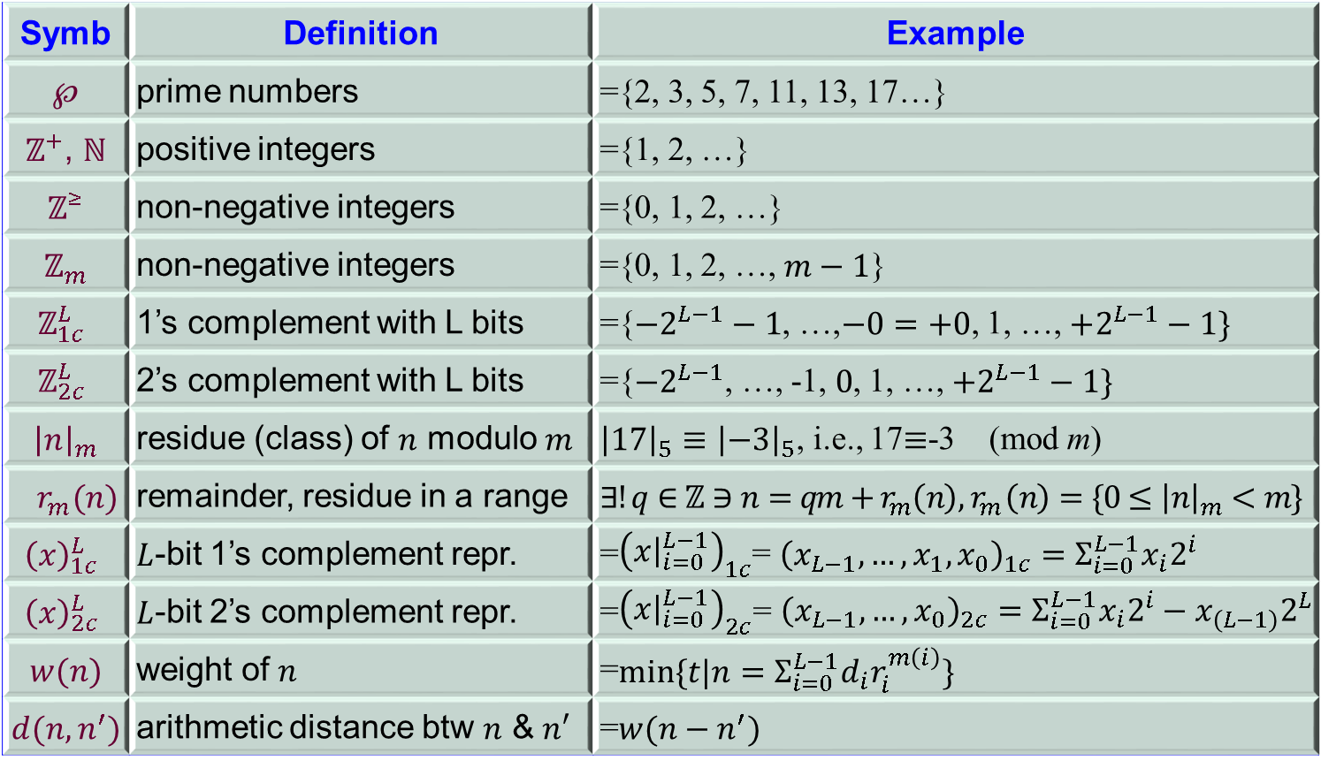
Symbol Table and Definitions
Symb | Definition | Example
$℘$ | prime numbers | ={2, 3, 5, 7, 11, 13, 17…}
$ℤ^{+}$, $ℕ$ | positive integers | ={1, 2, …}
$ℤ^{≥}$ | non-negative integers | ={0, 1, 2, …}
$ℤ_{m}$ | non-negative integers | ={0, 1, 2, …, $m−1$}
$$ℤ_{1c}^{L}$$ | 1’s complement with L bits | ={$−2^{L−1}−1$, …,$−0=+0$, 1, …, $+2^{L−1}−1\}$
$$ℤ_{2c}^{L}$$ | 2’s complement with L bits | ={$−2^{L−1}$, …, -1,$0$, 1, …, $+2^{L−1}−1\}$
$${\left|n\right|}_{m}$$ | residue (class) of $n$ modulo $m$ | ${\left|17\right|}_{5}≡{\left|−3\right|}_{5}$, i.e., 17$≡$-3 (mod m)
$r_{m}(n)$ | remainder, residue in a range | $$∃!q∈ℤ∋n=qm+r_{m}\left(n\right), { r}_{m}\left(n\right)=\{0≤{\left|n\right|}_{m}<m\}$$
$${\left(x\right)}_{1c}^{L}$$ | $L$-bit 1’s complement repr. | =${\left(x{\left.​\right|}_{i=0}^{L−1}\right)}_{1c}$= ${\left(x_{L−1}, …, x_{1}, x_{0}\right)}_{1c}=Σ_{i=0}^{L−1}x_{i}2^{i}$
$${\left(x\right)}_{2c}^{L}$$ | $L$-bit 2’s complement repr. | =${\left(x{\left.​\right|}_{i=0}^{L−1}\right)}_{2c}$= ${\left(x_{L−1}, …, x_{0}\right)}_{2c}=Σ_{i=0}^{L−1}x_{i}2^{i}−x_{\left(L−1\right)}2^{L}$
$$w(n)$$ | weight of $n$ | =$min⁡\{t|n=Σ_{i=0}^{L−1}d_{i}r_{i}^{m\left(i\right)}\}$
$$d(n, n^{′})$$ | arithmetic distance btw $n$ & $n′$ | =$w(n−n^{′})$

Slide 8




Philosophy
CORDIC
Inverse
Field
multiplicative space
linear space
$$x∗/y$$
Identity
$$x±y$$
Commutative
Commutative Ring
Associative
Ring
Closure
Group
Distributive
Closure
Identity
Inverse
Associative
Commutative
RNS

Slide 9
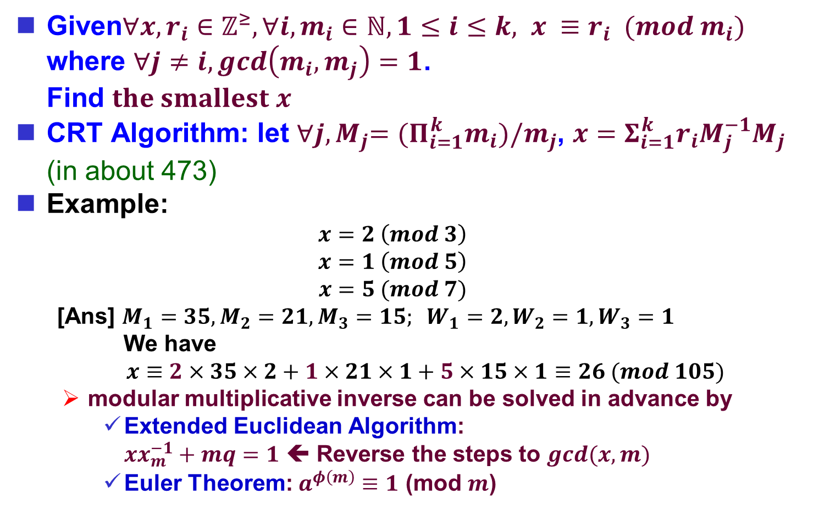
CRT: Chinese Residue Theorem
Given$∀x, r_{i}∈ℤ^{≥},∀i, m_{i}∈ℕ,1≤i≤k, x ≡r_{i} (mod m_{i})$
where $∀j≠i, gcd\left(m_{i}, m_{j}\right)=1$.
Find $the smallest x$
CRT Algorithm: let ${∀j, M}_{j}={(Π}_{i=1}^{k}m_{i})/m_{j}$, $x=Σ_{i=1}^{k}r_{i}M_{j}^{−1}M_{j}$
(in about 473)
Example:
  $$x=2 \left(mod 3\right)$$
  $$x=1 \left(mod 5\right)$$
  $$x=5 (mod 7)$$
  [Ans] $M_{1}=35, M_{2}=21, M_{3}=15; W_{1}=2, W_{2}=1, W_{3}=1$
  We have
  $x≡2×35×2+1×21×1+5×15×1≡26 (mod 105)$
  modular multiplicative inverse can be solved in advance by
    Extended Euclidean Algorithm:
    $xx_{m}^{−1}+mq=1$ ⬅ Reverse the steps to $gcd(x, m)$
    Euler Theorem: $a^{φ\left(m\right)}≡1$ (mod $m$)

Slide 10

Garner’s Classification
Diamond conjectured the form for arithmetic should be an+b in 1955 ^{[2]}.
Garner classified residue-related codes into
  Nonseparate codes: $x=an+b∈ℤ^{≥}$
  Separate codes: $n=qm+r∈ℤ^{≥}$
  Include RNS
  ( )_{m} means (mod m)
[2] J. M. Diamond, “Checking codes for digital computers,” IRE Correspondence, vol. 43, pp.487-488, Apr. 1955.
[3] H. L. Garner, "The residue number system," IRE Trans. Electronic Computers. vol. EC-8, pp.140-147, June 1959.
[4] H. L. Garner, "Error codes for arithmetic operations," IEEE Trans. Electronic Computers, vol. EC-15, pp. 763-770, Oct. 1966.

Slide 11
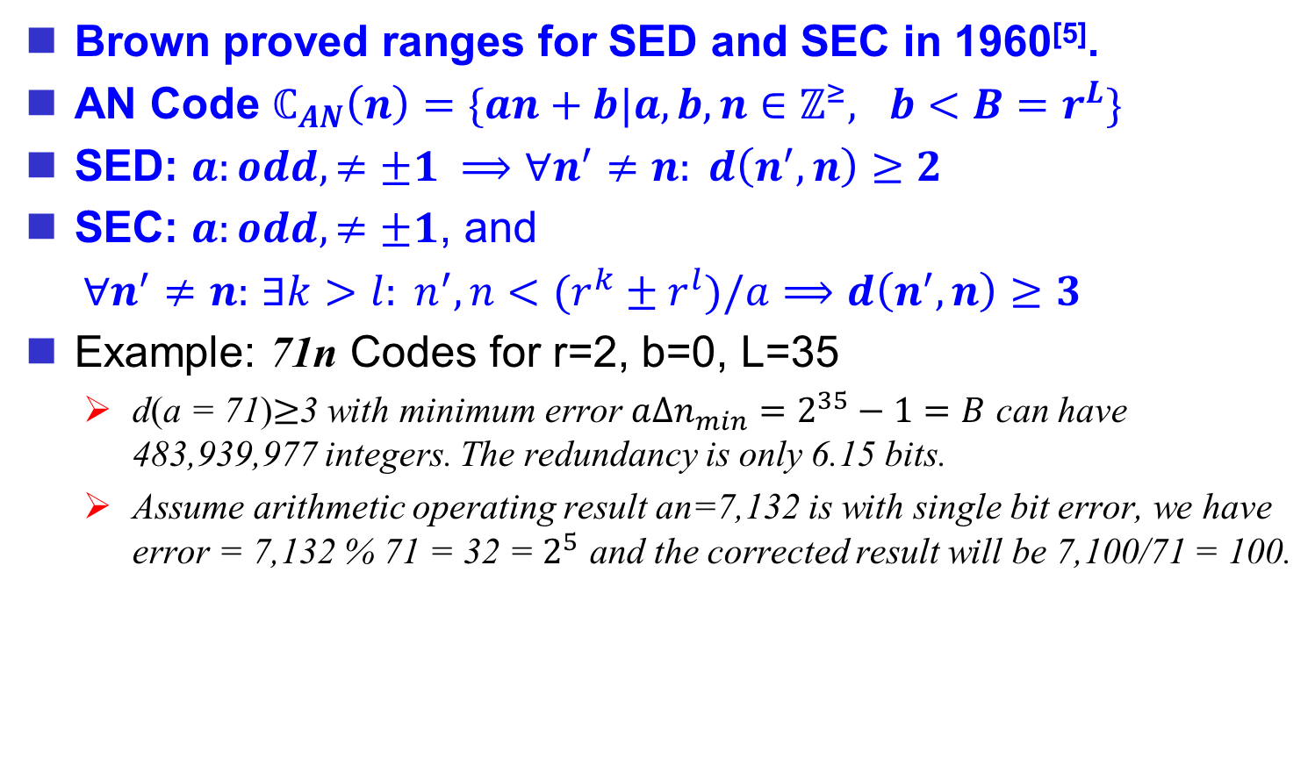
Brown’s AN Codes for Adders
Brown proved ranges for SED and SEC in 1960^{[5]}.
AN Code $ℂ_{AN}\left(n\right)=\{an+b|a, b, n∈ℤ^{≥}, b<B=r^{L}\}$
SED: $a:odd, ≠±1 ⟹∀n^{′}≠n: d\left(n^{′}, n\right)≥2$
SEC: $a:odd, ≠±1$, and
  $∀n^{′}≠n:$ $∃k>l: n^{′}, n<(r^{k}±r^{l})/a⟹$ $d\left(n^{′}, n\right)≥3$
Example: 71n Codes for r=2, b=0, L=35
  d(a = 71)$≥$3 with minimum error $a{Δn}_{min}=2^{35}−1=B$ can have 483,939,977 integers. The redundancy is only 6.15 bits.
  Assume arithmetic operating result an=7,132 is with single bit error, we have error = 7,132 % 71 = 32 = $2^{5}$ and the corrected result will be 7,100/71 = 100.
[5] D. T. Brown, "Error detecting and correcting binary codes for arithmetic operations," IRE Trans. Electronic Computers, vol. EC-9, pp. 333-337, September 1960.
[6] W. W. Peterson, Error-Correcting Codes. New York: Wiley, and Cambridge, Mass.: M.I.T. Press, 1961

Slide 12

Mandelbaum-Barrows Codes
A cyclic AN codes
Let radix $r=2$, bound B=$2^{sL}$,
$p$ is prime, $ap=m=2^{L}−1$, and
$\left(a, m\right)=1$, $n∈ℤ^{≥}$ can represented
as $n=Σ_{i=0}^{sL−1}d_{i}2^{i}$ and split into s
segments $n=Σ_{i=0}^{s−1}n_{i}2^{Li}$, then
$n≡Σ_{i=0}^{s−1}n_{i} (mod m)$
If s=2, the residue
generator will be
B-1=ap=2^{L}-1
Residue
Codes
Checksum
Codes
p
/p
(mod 2^{L}-1)
[7] D. Mandelbaum, "Arithmetic codes with large distance," IEEE Trans. Information Theory, vol. IT-13, pp. 237-242, April 1967.
[8] Massey, J. L. and Garcia, O. N.: Error-correcting codes in computer arithmetic. In: Advances in Information Systems Science, Vol. 4, Ch. 5. (Edited by J. T. Ton). New York: Plenum Press, 1972.

Slide 13

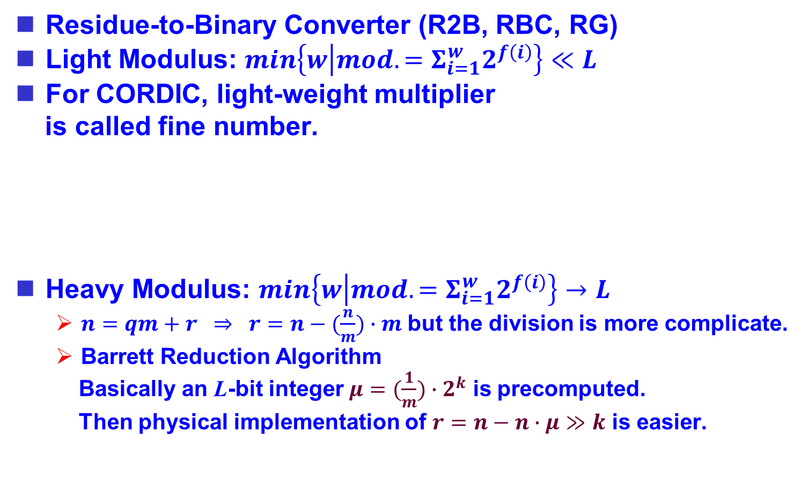
Residue Generators
Residue-to-Binary Converter (R2B, RBC, RG)
Light Modulus: $min\left\{w | mod. =Σ_{i=1}^{w}2^{f\left(i\right)}\right\}≪L$
For CORDIC, light-weight multiplier
is called fine number.
Heavy Modulus: $min\left\{w | mod. =Σ_{i=1}^{w}2^{f\left(i\right)}\right\}→L$
  $n=qm+r ⇒ r=n−(\frac{n}{m})∙m$ but the division is more complicate.
  Barrett Reduction Algorithm
  Basically an L-bit integer $μ=(\frac{1}{m})∙2^{k}$ is precomputed.
  Then physical implementation of $r=n−n∙μ≫k$ is easier.
$$n∈ℤ^{≥}$$
[9] P. Barrett, “Implementing the Rivest Shamir and Adleman public key encryption algorithm on a standard digital signal processor,” Lecture Notes in Computer Science, Springer. (263)311–323, 1987.

Slide 14
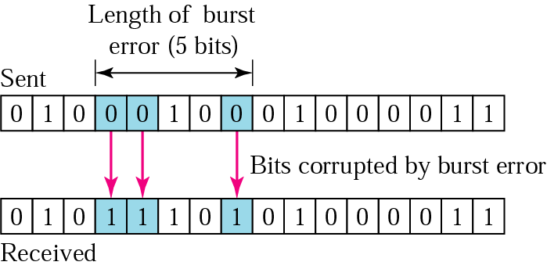

Burst Error Correction
k-Burst Errors:
  Eg. carry generating error for a series of contagious propagations
  Error $e={±2}^{i}ε$,
  were $0≤ε<2^{k}$
Henderson Codes:
  $a=2^{k+1}−1⇒ℂ_{AN}\left(n\right)≜an+b≢0 (mod a)$ detects k-burst errors
[10] D. S. Henderson, "Residue class error checking codes," Proc. 16th Natl. Meeting of the Association for Computing Machinery, Los Angeles, Calif., September 1961.
[11] R. T. Chien, "On linear residue codes for burst-error correction," in IEEE Transactions on Information Theory, vol. 10, no. 2, pp. 127-133, April 1964.

Slide 15
Checksum vs. Residue Codes
Usas demoed pros/residue codes in inversion.
Aviz proposed 2D and cmp'd 2DxInvx(XS, Res)
Bose detailed 2D Residue Codes.
Inversion
Checksum/Residue
?
Dimensions
[12] Alan M. Usas, "Checksum Versus Residue Codes For Multiple Error Detection", IEEE Computer Society, Digest of Papers on the Eighth Annual International Conference on Fault-Tolerant Computing, p.224 (1978).
[13] T.-C. Huang. A Low-Power Dependable Berger Code for Fully Asymmetric Communication. IEEE Communications Letters, vol. 12, no. 10, pp.773-775, Oct. 2008.
[14] A. Avizienis and C. S. Raghavendra, "Applications for arithmetic error codes in large, high-performance computers," 1983 IEEE 6th Symposium on Computer Arithmetic, Aarhus, Denmark, 1983, pp. 169-173.
[15] B. Bose. 2-Dimensional Arithmetic Residue Check Codes. Comput. Math. Applic. Vol. 13, No. 5/6, pp. 547-554, 1987.

Slide 16

Rao’s Biresidue Codes
Rao^{[16]} proposed separate residue codes for $± and$shift($≪$) in $ℤ^{1c}$
Tuazon proposed ${\left(r_{m_{i}}(n)\right)}_{i=1}^{k}$as a number system.
Double separate residues (Biresidues)^{[18]} were proposed.
  $n⟶\left(n, r_{m_{1}}\left(n\right), r_{m_{2}}\left(n\right)\right)⟶\left(±, ≪\right) operations ⟶error checking$
  $gcd\left(m_{1}, m_{2}\right)=1 ⇒gcd(2^{m_{1}}−1, 2^{m_{2}}−1)$
  Single Bit Error Correctable for $0≤n<m_{1}m_{2}$
[16] T. R. N. Rao, "Error-checking logic for arithmetic-type operations of a processor," IEEE Trans. Computers, vol. C-17, pp.845-849, Sep. 1968.
[17] J. O. Tuazon. Residue number system in computer arithmetic. Dissertation, Iowa State U., 1969.
[18] T. R. N. Rao, “Biresidue Error-Correcting Codes for Computer Arithmetic,” Computers, IEEE Transactions on, vol. C-19, pp. 398–402, May 1970.
[19] D. K. Banerji, "On the Use of Residue Arithmetic for Computation," in IEEE Transactions on Computers, vol. C-23, no. 12, pp. 1315-1317, Dec. 1974.

Slide 17
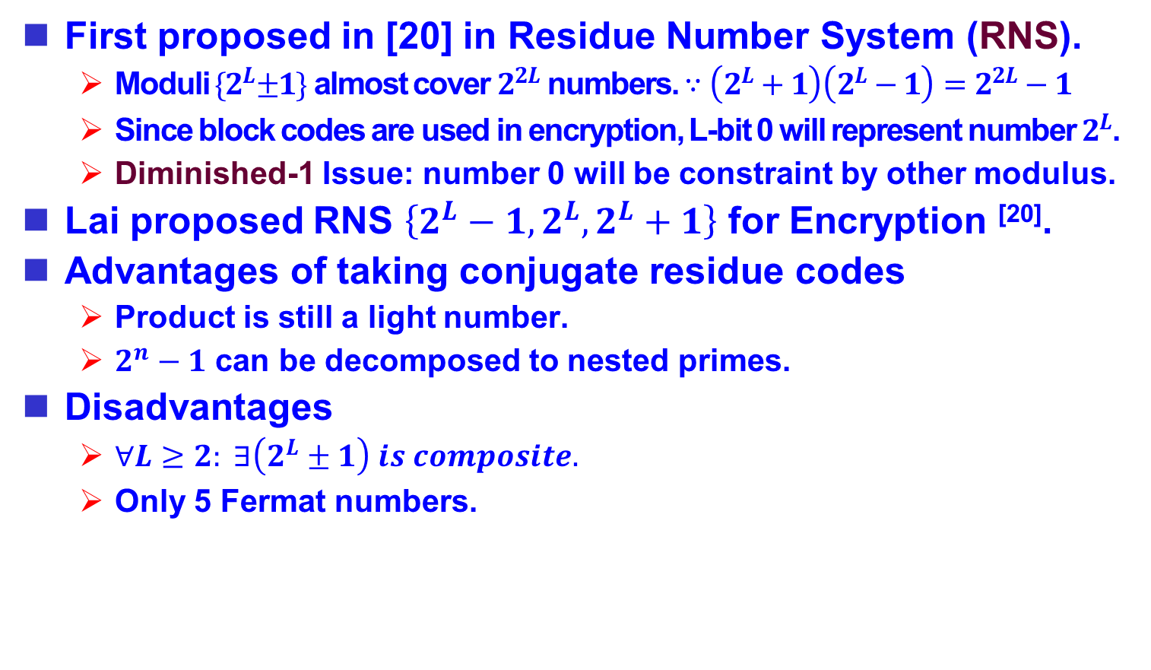
Conjugate-Type Biresidues
First proposed in [20] in Residue Number System (RNS).
  Moduli ${\{2}^{L}±1\}$ almost cover $2^{2L}$ numbers. $∵\left(2^{L}+1\right)\left(2^{L}−1\right)=2^{2L}−1$
  Since block codes are used in encryption, L-bit 0 will represent number $2^{L}$.
  Diminished-1 Issue: number 0 will be constraint by other modulus.
Lai proposed RNS $\left\{2^{L}−1, 2^{L}, 2^{L}+1\right\}$ for Encryption ^{[20]}.
Advantages of taking conjugate residue codes
  Product is still a light number.
  $2^{n}−1$ can be decomposed to nested primes.
Disadvantages
  $∀L≥2: ∃\left(2^{L}±1\right) is composite.$
  Only 5 Fermat numbers.
[20] M. A. Soderstrand, W. K. Jenkins, G. A. Jullien, and F. J. Taylor. Residue Number System Arithmetic: Modern Applications in Digital Signal Processing. IEEE Press, New York, 1986.
[21] X. Lai and J. L.Massey. A proposal for a new block encryption standard. In Advances in Cryptology – EUROCRYPT’90, pages 389–404, Berlin, Germany: SpringerVerlag, 1990.

Slide 18
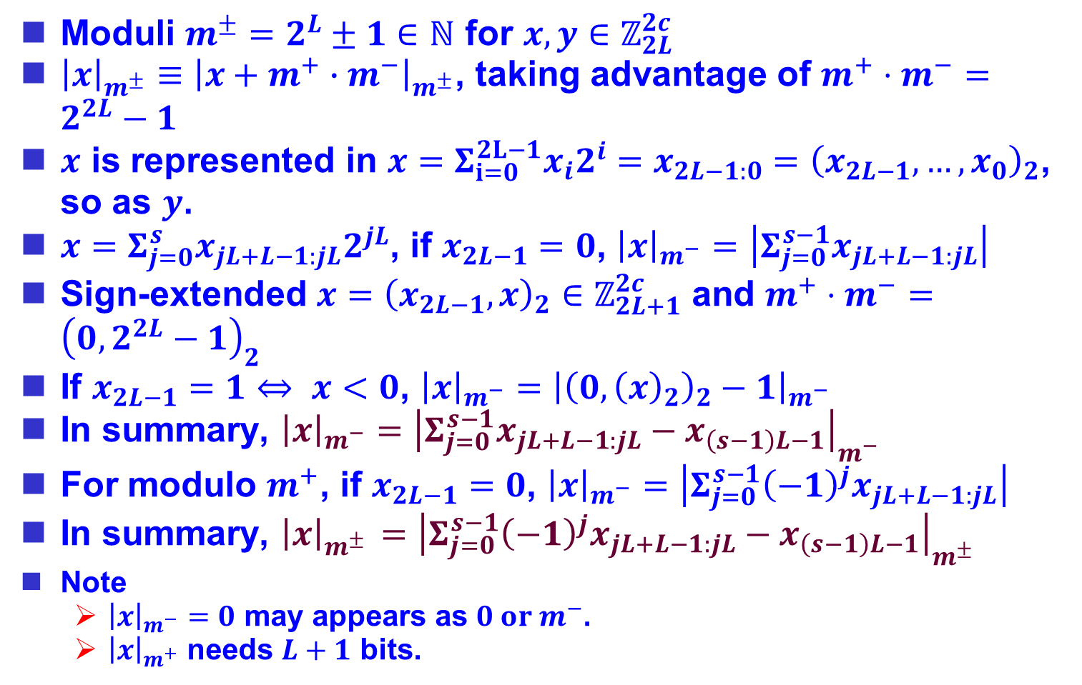
2’s Complement Residue Generators
Moduli $m^{±}=2^{L}±1∈ℕ$ for $x, y{∈ℤ}_{2L}^{2c}$
${{\left|x\right|}_{m^{±}}≡\left|x+m^{+}∙m^{−}\right|}_{m^{±}}$, taking advantage of $m^{+}⋅m^{−}=2^{2L}−1$
$x$ is represented in $x=Σ_{i=0}^{2L−1}x_{i}2^{i}=x_{2L−1:0}={\left(x_{2L−1}, …, x_{0}\right)}_{2}$, so as $y$.
$x=Σ_{j=0}^{s}x_{jL+L−1:jL}2^{jL}$, if $x_{2L−1}=0$, ${\left|x\right|}_{m^{−}}=\left|Σ_{j=0}^{s−1}x_{jL+L−1:jL}\right|$
Sign-extended $x={\left(x_{2L−1}, x\right)}_{2}∈ℤ_{2L+1}^{2c}$ and $m^{+}⋅m^{−}={\left(0, 2^{2L}−1\right)}_{2}$
If $x_{2L−1}=1⇔ x<0$, ${\left|x\right|}_{m^{−}}={\left|{\left(0, {\left(x\right)}_{2}\right)}_{2}−1\right|}_{m^{−}}$
In summary, ${\left|x\right|}_{m^{−}}={\left|Σ_{j=0}^{s−1}x_{jL+L−1:jL}−x_{\left(s−1\right)L−1}\right|}_{m^{−}}$
For modulo $m^{+}$, if $x_{2L−1}=0$, ${\left|x\right|}_{m^{−}}=\left|Σ_{j=0}^{s−1}{{\left(−1\right)}^{j}x}_{jL+L−1:jL}\right|$
In summary, ${\left|x\right|}_{m^{± }}={\left|Σ_{j=0}^{s−1}{{\left(−1\right)}^{j}x}_{jL+L−1:jL}−x_{\left(s−1\right)L−1}\right|}_{m^{±}}$
Note
  ${\left|x\right|}_{m^{−}}=0$ may appears as $0 or m^{−}$.
  ${\left|x\right|}_{m^{+}}$ needs $L+1$ bits.

Slide 19




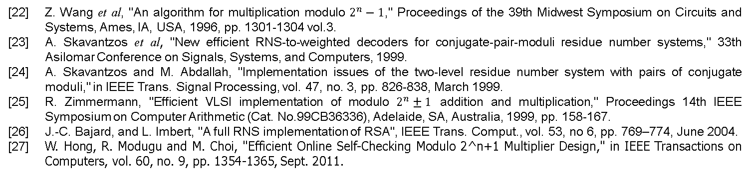
RNS for DSP/Encry with only $±/×$
ALU with only $\{±, ×, ≪\}$
$${\left({\left|x_{i}⊡y_{i}\right|}_{m_{i}}\right)}_{i}=\left({\left|x_{i}\right|}_{m_{i}}\right)⊡\left({\left|y_{i}\right|}_{m_{i}}\right)$$
Memory
BRC
$${\left({\left|x_{i}\right|}_{m_{i}}\right)}_{i}$$
RBC
CU
[22] Z. Wang et al, "An algorithm for multiplication modulo $2^{n}−1$," Proceedings of the 39th Midwest Symposium on Circuits and Systems, Ames, IA, USA, 1996, pp. 1301-1304 vol.3.
[23] A. Skavantzos et al, "New efficient RNS-to-weighted decoders for conjugate-pair-moduli residue number systems," 33th Asilomar Conference on Signals, Systems, and Computers, 1999.
[24] A. Skavantzos and M. Abdallah, "Implementation issues of the two-level residue number system with pairs of conjugate moduli," in IEEE Trans. Signal Processing, vol. 47, no. 3, pp. 826-838, March 1999.
[25] R. Zimmermann, "Efficient VLSI implementation of modulo $2^{n}±1$ addition and multiplication," Proceedings 14th IEEE Symposium on Computer Arithmetic (Cat. No.99CB36336), Adelaide, SA, Australia, 1999, pp. 158-167.
[26] J.-C. Bajard, and L. Imbert, "A full RNS implementation of RSA", IEEE Trans. Comput., vol. 53, no 6, pp. 769–774, June 2004.
[27] W. Hong, R. Modugu and M. Choi, "Efficient Online Self-Checking Modulo 2^n+1 Multiplier Design," in IEEE Transactions on Computers, vol. 60, no. 9, pp. 1354-1365, Sept. 2011.

Slide 20



RNS for Neural Network
Modular
Multiplier
Residue
Adder
(Assume separated to s segments)
Residue
Generator
Binary
Residue
Converter
Residue
Binary
Converter
$$O(s^{−2})$$
$$O(s^{−1})$$
$$O({s(s−1)}^{2})$$
No residue-related technique applied in the activation function in the literature so far.
[28] H. Nakahara and T. Sasao. "A deep convolutional neural network based on nested residue number system," 25th Int'l Conf. on Field Programmable Logic and Applications (FPL), London, 2015, pp.1-6.
[29] N. I. Chervyakov et al, "Increasing of convolutional neural network performance using residue number system," Int'l Multi-Conf. on Engineering, Computer and Information Sciences (SIBIRCON), Novosibirsk, 2017, pp. 135-140.
[30] S. Salamat, M. Imani, S. Gupta and T. Rosing, "RNSnet: In-Memory Neural Network Acceleration Using Residue Number System," 2018 IEEE International Conference on Rebooting Computing (ICRC), McLean, VA, USA, 2018, pp. 1-12.
[31] K. Phalakarn and A. Surarerks, "Alternative Redundant Residue Number System Construction with Redundant Residue Representations," 3rd Int'l Conf. on Computer and Communication Systems (ICCCS), Nagoya, 2018, pp. 457-461.

Slide 21
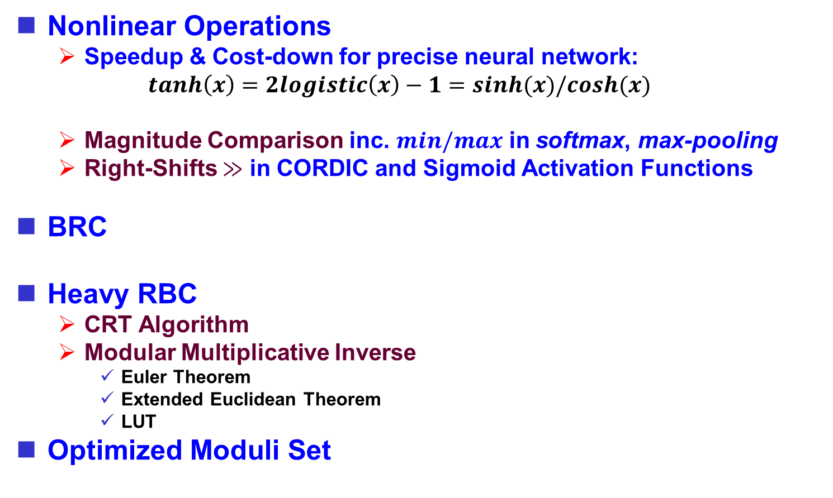
Target Issues & Proposed Solutions
Nonlinear Operations
  Speedup & Cost-down for precise neural network:
  $tanh\left(x\right)=2logistic\left(x\right)−1=sinh(x)/cosh(x)$
  Magnitude Comparison inc. $min/max$ in softmax, max-pooling
  Right-Shifts $≫$ in CORDIC and Sigmoid Activation Functions
BRC
Heavy RBC
  CRT Algorithm
  Modular Multiplicative Inverse
    Euler Theorem
    Extended Euclidean Theorem
    LUT
Optimized Moduli Set
➔ (1) Low-cost & Fast Design of Logistic Function
➔ (2) Design Rules for optimizing checking/cost
➔ (3) Low-cost BRC for Conjugate Residue Codes
➔ (4) Hybrid RNSC NN Architecture

Slide 22






Low-Cost & Fast S. Activation Functions
(1)
Arithmetic for calculating $tanh(x)$
Taylor Series (1712)
Remez Algorithm (1934)
CORDIC (1956)
$$exp(x)$$
>1971
$$sinh(x)/cosh(x)$$
$$tanh(x)$$
$$softmax(x)$$
$$logistic(x)$$
[32] J. E. Volder. Binary Computation Algorithms for Coordinate Ro-tation and Function Generation, Convair, Aeroelectronics group, IAR-1.148, 1956.
[33] NetLib Project. Freely Distributable C Math Library Supporting IEEE 754. http://www.netlib.org/fdlibm/, 2004.
[34] GNU. C Math Library. May 2018. https://code.woboq.org/us-erspace/glibc/sysdeps/ieee754/dbl-64/e_exp.c.html.
[35] J.S. Walther. A Unified Algorithm for Elementary Functions. in Proc. Spring Joint Computation Conference, 1971, pp.379-385.
[36] Quinapalus Inc. Calculate exp() and log() without Multiplications. https://www.quinapalus.com/efunc.html, 2018.

Slide 23
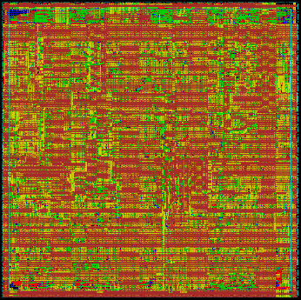
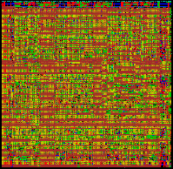

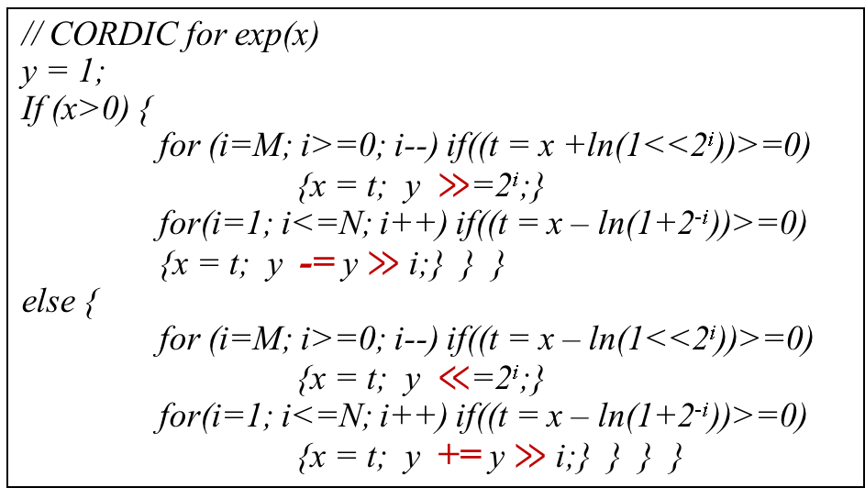
(1)
Low-Cost & Fast S. Activation Functions
// CORDIC for exp(x)
y = 1;
If (x>0) {
for (i=M; i>=0; i--) if((t = x +ln(1<<2^{i}))>=0)
{x = t; y $≫$=2^{i};}
for(i=1; i<=N; i++) if((t = x – ln(1+2^{-i}))>=0)
{x = t; y -= y $≫$i;} } }
else {
for (i=M; i>=0; i--) if((t = x – ln(1<<2^{i}))>=0)
{x = t; y $≪$=2^{i};}
for(i=1; i<=N; i++) if((t = x – ln(1+2^{-i}))>=0)
{x = t; y += y $≫$i;} } } }
Columbus's egg!
y = logistic(x) = $\left\{\begin{matrix}\frac{1}{1+e^{−x}} & x≥0 \\ \frac{e^{x}}{1+e^{x}} & x<0\end{matrix}\right.$
← Conventional $tanh\left(x\right)=sinh(x)/cosh(x)$
← Proposed in ICCE-TW2019
[37] T.-C. Huang et al. “Low-Cost and Fast Design of Precise Activation Functions in Neural Network” ICCE-TW2019, May 2019.

Slide 24









Considerations for Moduli Selection
(2)
Motivation: to promote checking rate and to cost down
Observation & Considerations:
  Light-Weight ($w≤3$) Moduli $m_{i}$ make generating and checking easy.
  BRC: Light-Weight Moduli
  RBC: Light-Weight LCM of Moduli
  Conjugate formula: $\left(u+v\right)\left(u−v\right)=u^{2}−v^{2}$, $i.e.$, eq. $2^{2L}−1=\left(2^{L}+1\right)\left(2^{L}−1\right).$ can potentially reduce the hardware cost and/or promote the detection rate.
  $∀L∈ℕ: gcd\left(2^{L}+1, 2^{L}−1\right)=1$
$$2^{6L}−1$$
$$2^{2L}−2^{L}+1$$
$$w=3$$
$$2^{2L}+1$$
$$w=2$$
$$2^{2L}−1$$
$$w=2$$
$$w=2$$
$$2^{2L}$$
$$w=1$$
$$2^{2L}+2^{L}+1$$
$$w=3$$
$$w=2$$

Slide 25
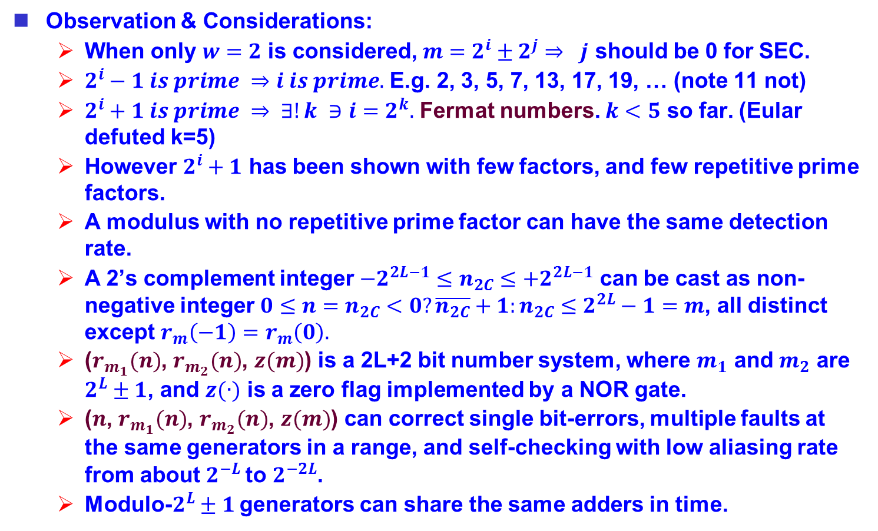
Considerations for Moduli Selection
(2)
Observation & Considerations:
  When only $w=2$ is considered, $m=2^{i}±2^{j}⇒ j$ should be 0 for SEC.
  $2^{i}−1 is prime ⇒i is prime.$ E.g. 2, 3, 5, 7, 13, 17, 19, … (note 11 not)
  $2^{i}+1 is prime ⇒ ∃!k ∋i=2^{k}.$ Fermat numbers. $k<5$ so far. (Eular defuted k=5)
  However $2^{i}+1$ has been shown with few factors, and few repetitive prime factors.
  A modulus with no repetitive prime factor can have the same detection rate.
  A 2’s complement integer $−2^{2L−1}≤n_{2C}≤+2^{2L−1}$ can be cast as non-negative integer $0≤n=n_{2C}<0?\overline{n_{2C}}+1:n_{2C}≤2^{2L}−1=m$, all distinct except $r_{m}\left(−1\right)=r_{m}\left(0\right).$
  ($r_{m_{1}}(n)$, $r_{m_{2}}(n)$, $z(m)$) is a 2L+2 bit number system, where $m_{1}$ and $m_{2}$ are $2^{L}±1$, and $z(∙)$ is a zero flag implemented by a NOR gate.
  ($n$, $r_{m_{1}}(n)$, $r_{m_{2}}(n)$, $z(m)$) can correct single bit-errors, multiple faults at the same generators in a range, and self-checking with low aliasing rate from about $2^{−L}$to $2^{−2L}$.
  Modulo-$2^{L}±1$ generators can share the same adders in time.

Slide 26
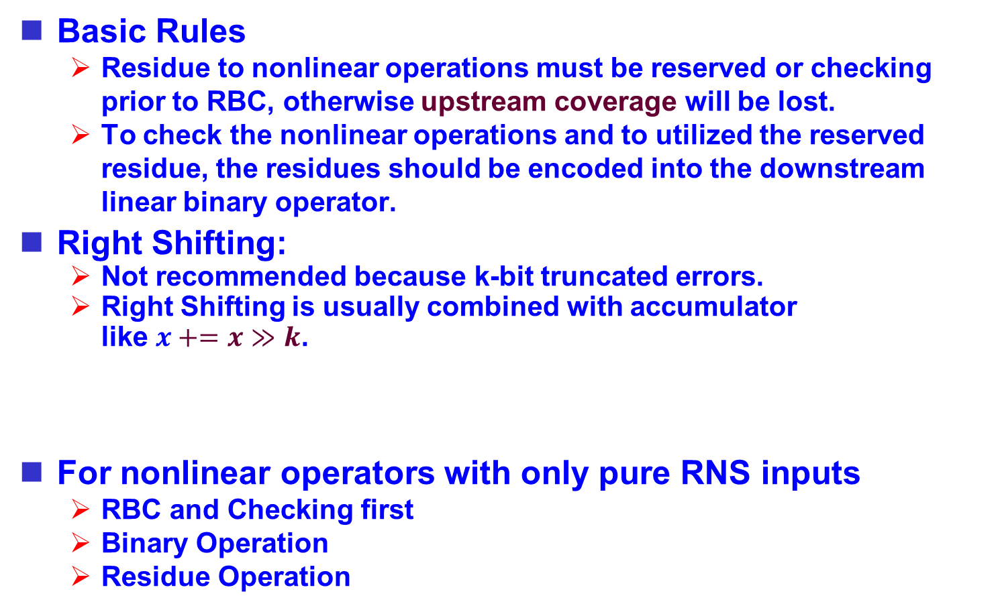
Design Rules for optimizing checking/cost
(2)
Basic Rules
  Residue to nonlinear operations must be reserved or checking prior to RBC, otherwise upstream coverage will be lost.
  To check the nonlinear operations and to utilized the reserved residue, the residues should be encoded into the downstream linear binary operator.
Right Shifting:
  Not recommended because k-bit truncated errors.
  Right Shifting is usually combined with accumulator
  like $x+=x≫k$.
For nonlinear operators with only pure RNS inputs
  RBC and Checking first
  Binary Operation
  Residue Operation
remained
or abandoned
redundant
shiftable

Slide 27














Right-Shifter and Adder
(2)
Independent Arithmetic for Left Shifting:
  $r_{m}\left(x±x≪k\right)=r_{m}(r_{m}\left(x\right)±r_{m}\left(x\right)≪k)$
Shifted-Message Borrowed for Right Shifting:
  Although $L−k$bits can be still self-shifted with $k$ discarded bits,
  when $k≥L$, all residue will be discarded.
  $r_{m}\left(x±x≫k\right)=r_{m}(r_{m}\left(x\right)±x≫k)$
  The last stage and the shifter are still under monitoring for checking.
$$x$$
$$r_{m}(x)$$
$$x$$
$$r_{m}(x)$$
$$x≫k$$
RG
$$±$$
$$±$$
$$±$$
$$±$$
$$x+x≪k$$
$$r_{m}(x+x≪k)$$
$$x+x≫k$$
$$r_{m}(x+x≫k)$$

Slide 28


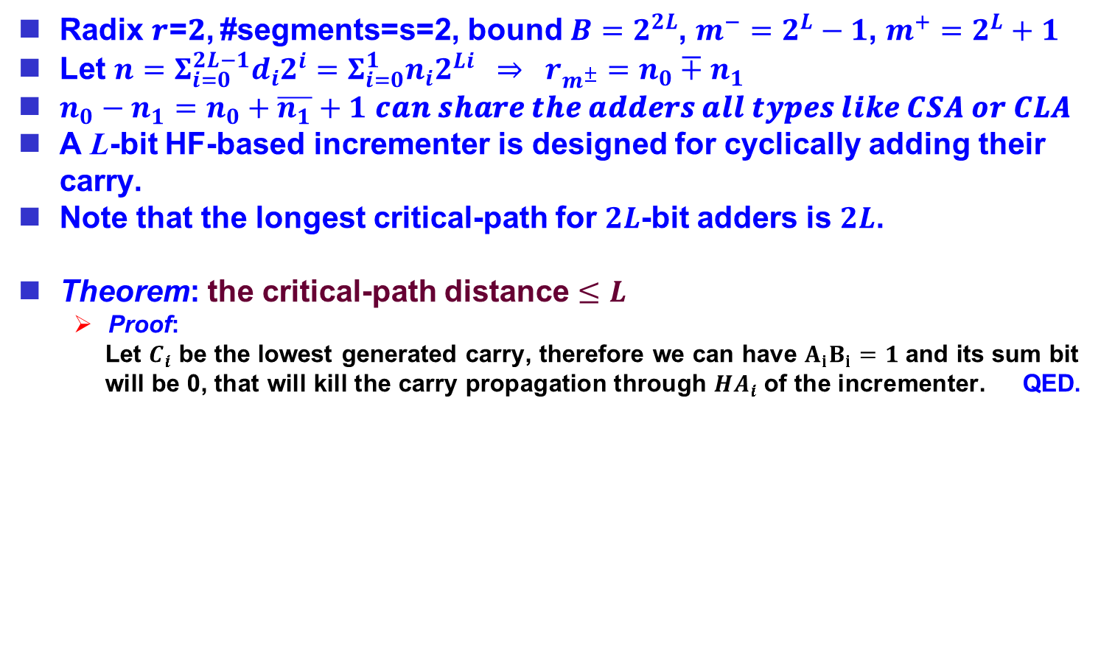
Low-Cost BRC for Conjugate Residues
(3)
Radix 𝒓=𝟐, #segments=s=2, bound $B=2^{2L}$, $m^{−}=2^{L}−1$, $m^{+}=2^{L}+1$
Let $n=Σ_{i=0}^{2L−1}d_{i}2^{i}=Σ_{i=0}^{1}n_{i}2^{Li} ⇒ r_{m^{±}}=n_{0}∓n_{1}$
$n_{0}−n_{1}=n_{0}+\overline{n_{1}}+1$ 𝒄𝒂𝒏 𝒔𝒉𝒂𝒓𝒆 𝒕𝒉𝒆 𝒂𝒅𝒅𝒆𝒓𝒔 𝒂𝒍𝒍 𝒕𝒚𝒑𝒆𝒔 𝒍𝒊𝒌𝒆 𝑪𝑺𝑨 𝒐𝒓 𝑪𝑳𝑨
A L-bit HF-based incrementer is designed for cyclically adding their carry.
Note that the longest critical-path for $2L$-bit adders is $2L$.
Theorem: the critical-path distance $≤L$
  Proof:
  Let $C_{i}$ be the lowest generated carry, therefore we can have $A_{i}B_{i}=1$ and its sum bit will be 0, that will kill the carry propagation through $HA_{i}$ of the incrementer. QED.
$$A_{i}$$
$$B_{i}$$
C
FA
FA
FA
FA
FA
FA
FA
FA
0
HA
HA
HA
HA
HA
HA
HA
HA

Slide 29











Proposed BRC for Reidue System
(3)
$$n$$
$$+$$
$$+$$
$$φ$$
$$±$$
$$φ$$
$$HA$$
$$φ$$
$${\left|n\right|}_{2^{L}−1}$$
$${\left|n\right|}_{2^{L}+1}$$
$${\left|n\right|}_{2^{L}}$$

Slide 30












Proposed RBC for 4-Reidue System
(3)
$${\left|n\right|}_{2^{L}−1}$$
$${\left|n\right|}_{2^{L}+1}$$
$${\left|n\right|}_{2^{L}}$$
$${\left|n\right|}_{2^{L}+3}$$
$$W_{2^{L}−1}^{−1}$$
$$W_{2^{L}+1}^{−1}$$
$$W_{2^{L}}^{−1}$$
$$×$$
$$×$$
$$×$$
$$+$$
$$+$$
BRC
Note: $W^{−1}$ are constant numbers
$$n$$

Slide 31
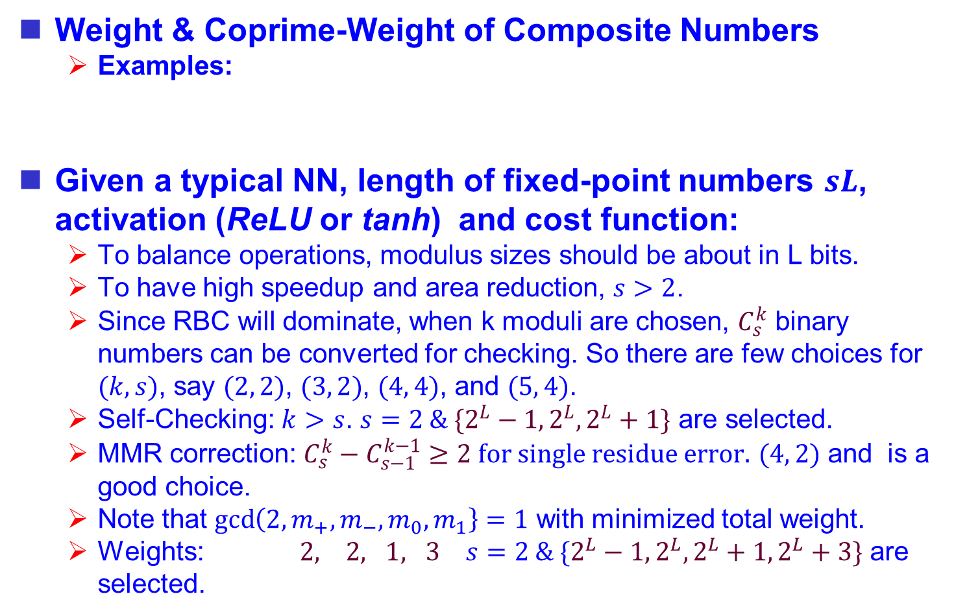
Heuristics for Searching Optimized Moduli
(4)
Weight & Coprime-Weight of Composite Numbers
  Examples:
Given a typical NN, length of fixed-point numbers $sL$, activation (ReLU or tanh) and cost function:
  To balance operations, modulus sizes should be about in L bits.
  To have high speedup and area reduction, $s>2$.
  Since RBC will dominate, when k moduli are chosen, $C_{s}^{k}$ binary numbers can be converted for checking. So there are few choices for $(k, s)$, say $(2, 2)$, $(3, 2)$, $(4, 4)$, and $(5, 4)$.
  Self-Checking: $k>s$. $s=2 \& \{2^{L}−1, 2^{L}, 2^{L}+1\}$ are selected.
  MMR correction: $C_{s}^{k}−C_{s−1}^{k−1}≥2 for single residue error.$ $(4, 2)$ and is a good choice.
  Note that $\gcd\left(2, m_{+}, m_{−}, m_{0}, m_{1}\right\}=1$ with minimized total weight.
  Weights: $2, 2, 1, 3$ $s=2 \& \{2^{L}−1, 2^{L}, 2^{L}+1, 2^{L}+3\}$ are selected.

Slide 32
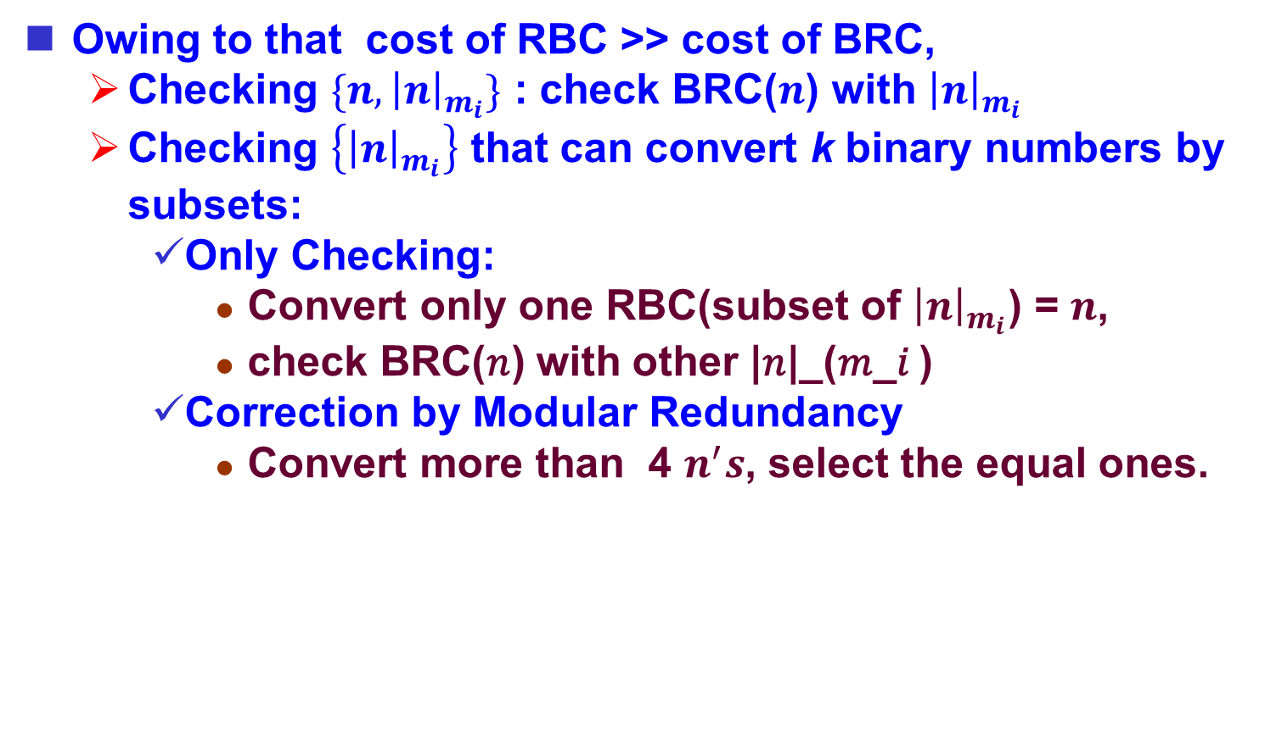
Consideration: Checking Schemes
(4)
Owing to that cost of RBC >> cost of BRC,
  Checking $\{n, {\left|n\right|}_{m_{i}}\}$ : check BRC($n$) with ${\left|n\right|}_{m_{i}}$
  Checking $\left\{{\left|n\right|}_{m_{i}}\right\}$ that can convert k binary numbers by subsets:
    Only Checking:
      Convert only one RBC(subset of ${\left|n\right|}_{m_{i}}$) = $n$,
      check BRC(𝑛) with other |𝑛|_(𝑚_𝑖 )
    Correction by Modular Redundancy
      Convert more than 4 $n^{′}s$, select the equal ones.

Slide 33
(4)
Hybrid Residue Number System for NN
BRC
Σ
RBC
tanh
CHK
BRC
Σ
RBC
tanh
CHK
Binary Number System
Σ
RBC
tanh
CHK
Binary Number System
BRC
Σ
RBC
tanh
CHK
BRC
Σ
RBC
tanh
CHK
BRC
Residue Number System

Slide 34
(4)
Impact-Relaxing Self-Healing Approach
upstream
soft error
RBC
tanh
CHK
Σ
downstream
soft error
0
1
AVG
Error

Slide 35
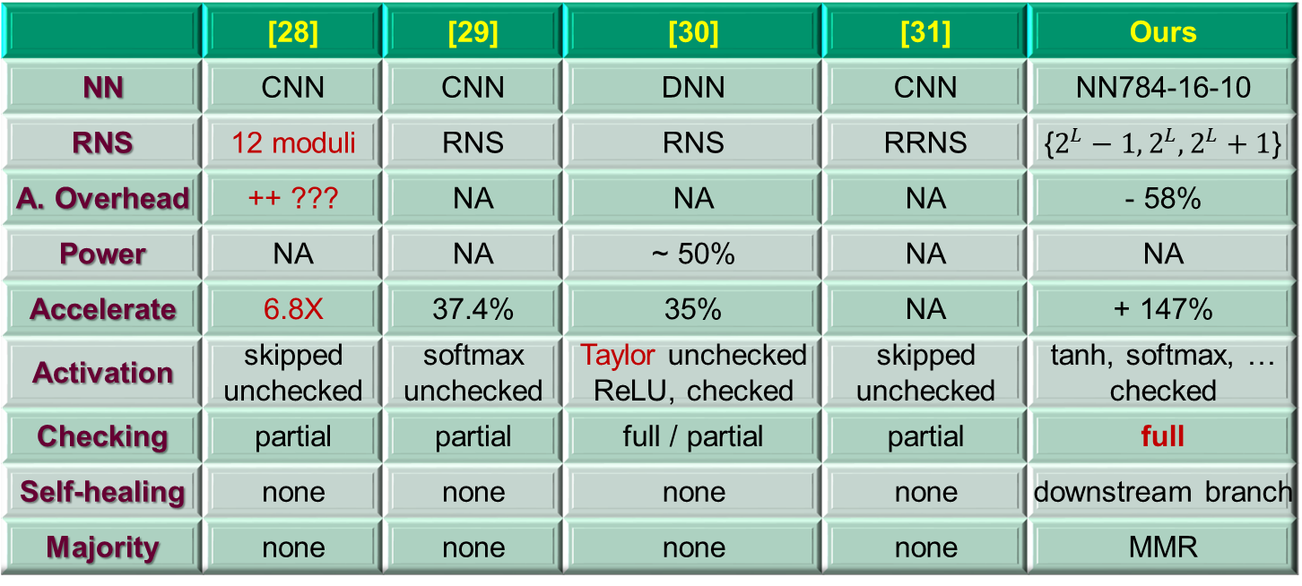
Comparison
 | [28] | [29] | [30] | [31] | Ours
NN | CNN | CNN | DNN | CNN | NN784-16-10
RNS | 12 moduli | RNS | RNS | RRNS | {$2^{L}−1, 2^{L}, 2^{L}+1$}
A. Overhead | ++ ??? | NA | NA | NA | - 58%
Power | NA | NA | ~ 50% | NA | NA
Accelerate | 6.8X | 37.4% | 35% | NA | + 147%
Activation | skipped unchecked | softmax unchecked | Taylor unchecked ReLU, checked | skipped unchecked | tanh, softmax, … checked
Checking | partial | partial | full / partial | partial | full
Self-healing | none | none | none | none | downstream branch
Majority | none | none | none | none | MMR
[28] H. Nakahara and T. Sasao. "A deep convolutional neural network based on nested residue number system," 25th Int'l Conf. on Field Programmable Logic and Applications (FPL), London, 2015, pp.1-6.
[29] N. I. Chervyakov et al, "Increasing of convolutional neural network performance using residue number system," Int'l Multi-Conf. on Engineering, Computer and Information Sciences (SIBIRCON), Novosibirsk, 2017, pp. 135-140.
[30] S. Salamat, M. Imani, S. Gupta and T. Rosing, "RNSnet: In-Memory Neural Network Acceleration Using Residue Number System," 2018 IEEE International Conference on Rebooting Computing (ICRC), McLean, VA, USA, 2018, pp. 1-12.
[31] K. Phalakarn and A. Surarerks, "Alternative Redundant Residue Number System Construction with Redundant Residue Representations," 3rd Int'l Conf. on Computer and Communication Systems (ICCCS), Nagoya, 2018, pp. 457-461.

Slide 36
Conclusions
We analyzed the cause/effect and pros/cons of the AN/RNS/Residues Codes
We proposed
  Low-cost & Fast Design of Logistic Function: 2/3 area & time saved.
  Design Rules for optimizing checking/cost
  Low-cost BRC/RBC for Light-Weight Residue Codes
  Hybrid RNSC Based Neural Network for Self-Healing and Acceleration
Future Work:
  Analysis and Synthesis Automation.
  RNS/VPA for High-Precision Application

