Slide 1
Hardware Description Language Case Study of HDL CPU SAP444 & Assembler
Tsung-Chu Huang
IC-TestLab NCUE, Taiwan
2022/12/29

Slide 2
Outline
CPU Models
ISA Model
5 Categories of Op Types
Instruction Formats
Addressing Modes
Instruction Cycles
Case Study 1: SAP3X5
Case Study 2: SAP444
Register Transfer Language/Level
Memory
Hierarchy & Simulation
Mnemonics & Timing
Assembler
Practice & Timing Closure

Slide 3
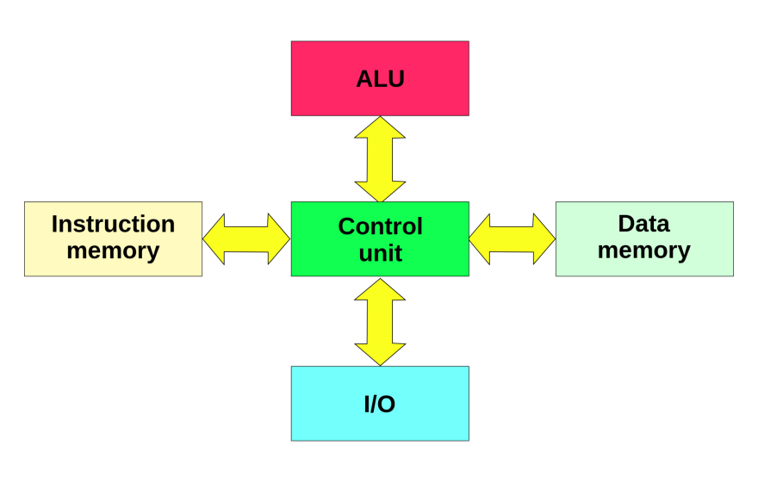
3 Major CPU Models
Two Major Flows
Control Flow Computers
Data Flow Computers
Von Neumann (5U)
Harvard Model
Datapath Model
CU
Sequencer
+
shift
MU
IU
OU
x
ALU

Slide 4
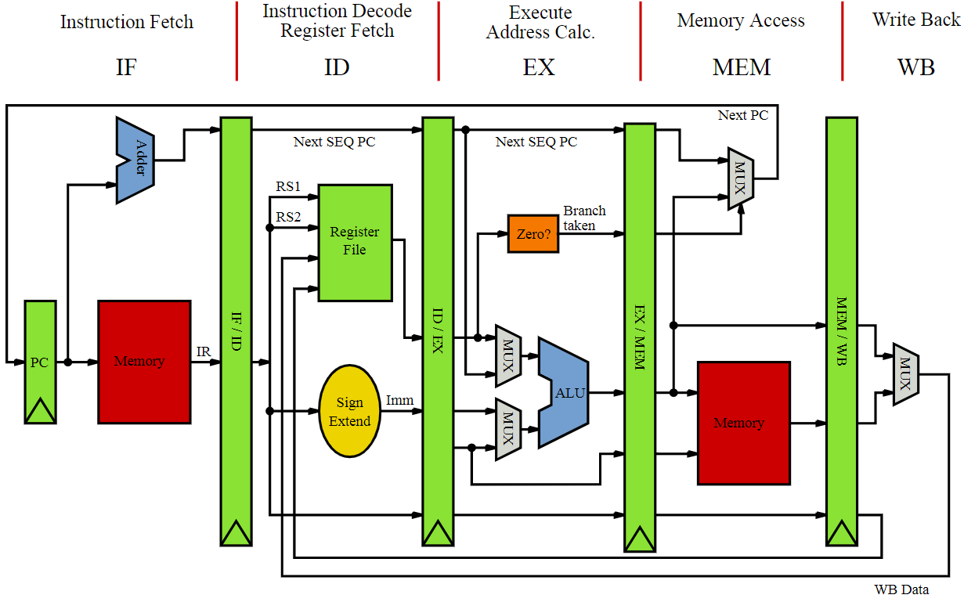
MIPS: Hybrid with Harvard + Datapath

Slide 5
3 Categories of Parallel Computers
Pipeline Computers:
Expiration in Time-Space Diagram
Multiple-pipelines multiple instruction forwarding for superscalar computers
Array Processors:
Processors X N + Control
Multiprocessor Systems:
P1+P2+…+Control
A
B
C
Time
Space
A
B
C
A
B
C

Slide 6
Instruction Set Architecture (ISA)
Model View: an abstract model of a computer
Classified by Complexity:
RISC: Reduced Instruction Set Computers
CISC: Complex Instruction Set Computers
(VLIW: Very-Long-Instruction-Word Computers)
5 Instruction Categories (Types)
ALU-related Instructions:
ADD/SUB, MUL/DIV, SHL/SHR, RLC/RRC, AND/OR/NOT
BUS-related Instructions:
MOV R1, R2; LDA/STA
CU-related Instructions:
Jmp, JNC, JNZ, branch, Call, return
Data I/O related Instructions
IN, OUT
Environmental/System related Instructions
INT, HLT, sleep, mode
(Note: a little modified from textbooks for convenience of mnemonics)

Slide 7
Instruction Format
OP Code: operation code
m bits can encode $2^{m}$ instructions
If one code is used to extend x bits: $2^{m}−1+2^{x}$
Categorized by #operands - #implied_opernads
0. no operand, or implied to A, C, or special register
single operand, or with implied opernand
two operands
VLIW: Very Long Instruction Word
OP1
Ext
OP2
OP Code
OP1
Operand
OP1
Destination
Source
OP1
Opd1
Opd2
Opd3
Opd4

Slide 8
Addressing Modes
Immediate Data
ADD R1, #03FA
Direct Address Mode
ADD R1, 03FA
Indirect Address Mode
ADD R1, @R2
Indexing Mode
LDA R1, X
Register Mode
ADD R1, R2

Slide 9
Instruction Cycles

Slide 10
Case Study 1: SAP3X5
My undergraduate work in NTUEE in 1985

Slide 11
Instruction Set of SAP3X5
000 00000 NOP ; (no operation),↓
000 00001 NOT A ; A←~A,↓
000 00010 SHL A ; A[n-2:0]←A[n-1:1], A[n-1]←A[0] ,↓
000 00011 SHR A ; A[n-1:1]←A[n-2:0], A[0]←A[n-1] ,↓
000 00100 IN A ; A←KBD,↓
000 00101 OUT A ; LED←A,↓
000 00110 CLR A ; A←0,↓
000 00111 CLR C ; C←0,↓
000 01000 INC A ; A←A+1,↓
000 01001 DEC A ; A←A-1,↓
000 01010 RET ; PC←STK
000 11111 HLT ; (halt)
001 aaaaa STA aaaaa ; M[a]←A,↓
010 aaaaa AND aaaaa ; A←A&M[a],↓
011 aaaaa ADC aaaaa ; A←A+M[a]+C,↓
100 aaaaa JC aaaaa ; ↓,C=1:PC←a
101 aaaaa JNZ aaaaa ; ↓,Z=0:PC←a
110 aaaaa CALL aaaaa ; STK←PC+1, ADR←a
111 aaaaa LDA aaaaa ; A←M[a],↓

Slide 12
Assembly Code Example of SAP3X5
BEGIN LDA ONE 00000:111 01111
STA I 00001:001 10000
LOOP LDA SUM 00010:111 01110
ADC I 00011:
STA SUM 00100:
LDA I 00101:
INC A 00110:
STA I 00111:
NOT A 01000:
ADD TWENTY 01001:
JNZ LOOP 01010:
LDA SUM 01011: 111 01110
OUT A 01100:
STOP HLT 01101:
SUM DB 0 01110: 000 00000
ONE DB 1 01111: 000 00001
I DB 10000: ??? ?????
TWENTY DB 20 10001: 000 10100

Slide 13
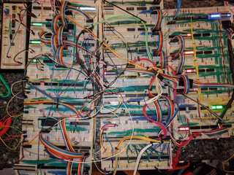
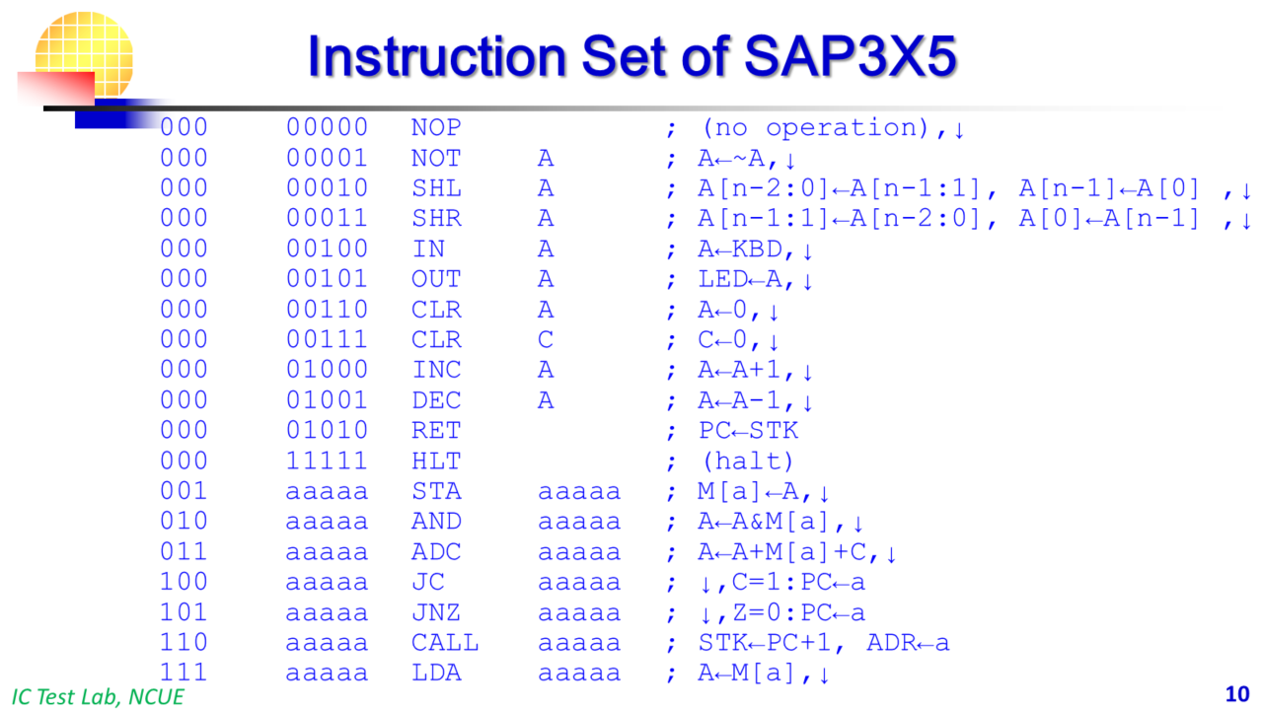
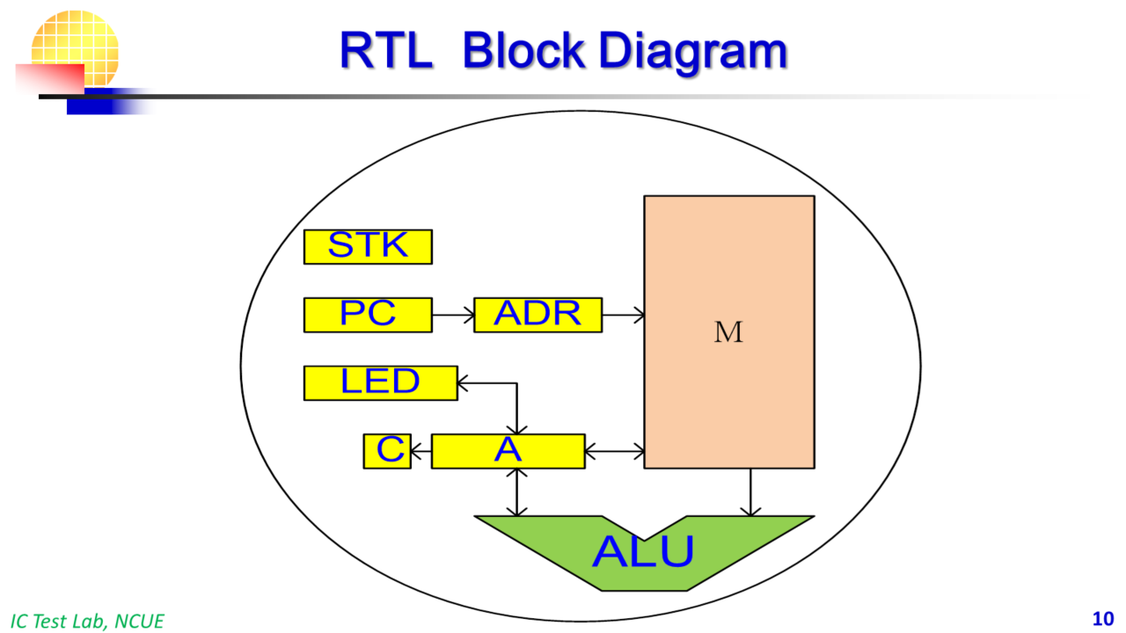
Abstracts of Computer Architecture
(source: web)

Slide 14
Case Study 2: SAP444
RF
Morse
0
ALU
C
A
15
INA/OUT
LDA/STA
Z
11
0
MU
7
0
PC
STK

Slide 15
Instruction Format and Instruction Set
ALU
Bus
Ctrl
DIO
Env/sys
0000
0000
Code
NOP
CLC
SEC
SWP
RET
INA
OUT
HLT
implied mode
0000
Code
RRRR
NOT Ri
RRC Ri
RLC Ri
INC Ri
DEC Ri
CLR Ri
register mode
immediate mode
Code
########
LDI #Opd
Code
aaaaaaaa
LDA addr
STA addr
JMP addr
JNC addr
JNZ addr
CAL addr
direct mode
Code
Rd
Rs
AND Rd, Rs
LOR Rd, Rs
ADD Rd, Rs
SUB Rd, Rs
ADC Rd, Rs
SBC Rd, Rs
XOR Rd, Rs
MOV Rd, Rs
register mode

Slide 16
Simple Memory Management
Instruction & Data share the same RAM
11 10 9 8 7 6 5 4 3 2 1 0
00
MU
PC is reset to 0
01
Instruction Code
02
Data Code
Declared a byte:
Label DB (initial value)
FF

Slide 17
Structural Synthesis: Efficient but Glue
Control of MUX is decoded first.

Slide 18
Behavioral Style Synthesis: Simple but Inefficient
instruction cycle = t-1
always@(posedge Clk)
case(PS)
case(OP1)
case(OP2)
case(OP3)
code1: A = A + R1;
code2:
code3: A = A << 1;
code4:
endcase
endcase
endcase
endcase
instruction cycle = t-1
A
+
*
*
+
*
*
ALU not sharable
Decoder
Last &
Complex
0 1
0 1
0 1
instruction cycle = t
A
instruction cycle = t

Slide 19
Instruction Cycles
Fetch
(Virtual) Decode
LOAD
INA/HALT
Execution
(and Practical Decode)

Slide 20
RTL
Register-Transfer Concepts
Register-Transfer Language for describing Instructions of a CPU
Register-Transfer Level in VLSI Synthesis and
Register Transfer Language
Examples:
NOP ; PC ← PC + 1
ADD R1, R2 ; R1 ← R1 + R2, PC ← PC + 1
JMP F01A ; PC ← F01A
CAL F01A ; STK ← PC + 1, PC ← F01A
RET ; PC ← STK

Slide 21
Hierarchy and Simulation of Memory
module memory(
output [7:0] data_out,
input [7:0] address,
input [7:0] data_in,
input write_enable,
input clk
);
reg [7:0] memory [0:255];
always @(posedge clk) begin
if (write_enable) begin
memory[address] <= data_in;
end
end
assign data_out = memory[address];
endmodule
Register
0.1ns
Bit Area
Bit Price
Bit Power
Speed
Cache
1ns
Main Memory
10ns
$setuphold( ……);

Slide 22
Basic Timing of Memory
Asynchronous Ports
CS: Chip Select
Adr.: Address
WE: Write Enable
OE: Output Enable
Di: Data-input
Do: Data-output
RAS: Y Address Strobe
CAS: Column Address Strobe
Adr
WE
Synchronous Ports
Adr
WE
In_Clock

Slide 23
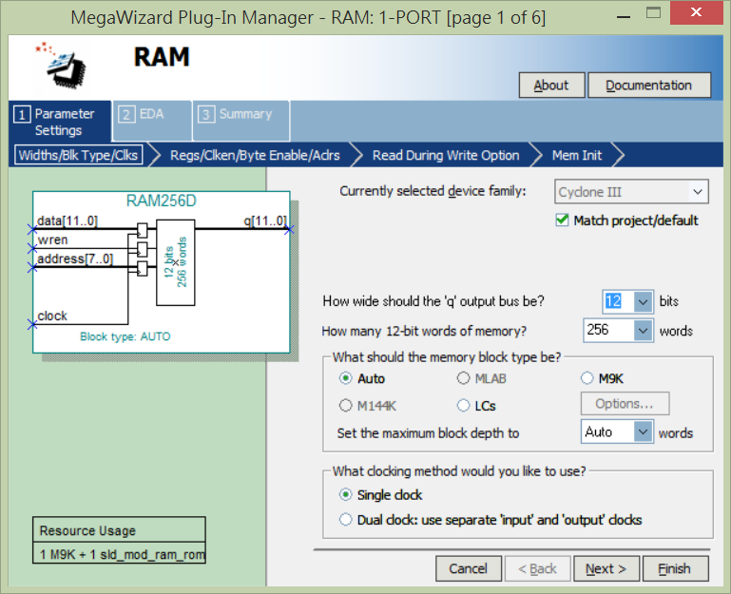
RAM Synthesized by MegaWizard
-- RAM256D.mif for SAP444 in Cyclone III/DE0
WIDTH=12;
DEPTH=256;
ADDRESS_RADIX=HEX;
DATA_RADIX=HEX;
CONTENT BEGIN
[00..FF] : 000; -- test2.asm
0 : 000;
1 : F11;
2 : C00;
3 : 911;
4 : B50;
… …
1C : 000;
1D : 006;
1E : 00F;
1F : 010;
END;
Loader : Quartus II

Slide 24
Simple Assembler for SAP444
BEGIN NOP
CAL SHOW
JMP BEGIN
L1 LDI 17
STA 80
…
…
NOP
RET
HLT
NOT
-- RAM256D.mif for SAP444 in Cyclone III/DE0
WIDTH=12;
DEPTH=256;
ADDRESS_RADIX=HEX;
DATA_RADIX=HEX;
CONTENT BEGIN
[00..FF] : 000; -- test2.asm
0 : 000;
1 : F11;
2 : C00;
3 : 911;
4 : B50;
… …
1C : 000;
1D : 006;
1E : 00F;
1F : 010;
END;
Assembler
(by C, Python,
etc.
or manually)
Source Code: Assembly Code
Object Code: Machine Code

Slide 25
Timing Closure
Power Consumption
A iterative process to optimize
timing of an IC circuit by adjusting
non-functional factors including
power and technology mapping.
Timing
Technology Mapping

Slide 26
Practice and Implementation on Cyclone III
ROM Reading
RAM Writing and Reading
Coding SAP444 in Verilog
Coding Assembler in C
Coding Assembly Programs and Testing

Slide 27
A Simplified MIPS Processor in Verilog

Slide 28
Instruction Cycles

Slide 29
Data Memory
module DM(MemRead, MemWrite, ABUS, DIN, DATABUS);
MemWrite: Nothing happens if 0. If 1, the memory at location ABUS will be written with DIN.
ABUS: At any moment, the data at location ABUS will appear at DATABUS.
MemRead: Not used.

Slide 30
Data Memory
Address bus: 8 bits.
Data bus: 32 bits. Each memory location holds 32 bits.

Slide 31
Data Memory
Init the contents in data memory with any value you like:
initial
begin
for (i=0; i <= DM_ADDR_MAX_m1; i = i + 1)
ram[i] = i*10 + 1;
end

Slide 32
Instruction Memory
module IM(CSB,WRB,ABUS,DATABUS);
CSB: chip select. If 0, selected. If 1, not selected.
WRB: Not used.
ABUS: Address bus. At any moment, if chip is selected, the data at location ABUS will appear at DATABUS.

Slide 33
Instruction Memory
Address bus: 8 bits.
Data bus: 32 bits. Each memory location holds 32 bits.

Slide 34
Instruction Memory
The most straightforward way of loading a program:
ram[0] = 32'b00100000000000000000000000000000; // addi $0, $0, 0
ram[1] = 32'b00100000001000010000000000000001; // addi $1, $1, 1
ram[2] = 32'b00100000010000100000000000000010; // addi $2, $2, 2
ram[3] = 32'b00100000011000110000000000000011; // addi $3, $3, 3
ram[4] = 32'b00000000000000000000000000000000; // nop
ram[5] = 32'b00000000000000000000000000000000; // nop
ram[6] = 32'b00000000000000000000000000000000; // nop
ram[7] = 32'b00000000000000000000000000000000; // nop
ram[8] = 32'b00000000000000000000000000000000; // nop
ram[9] = 32'b00000000000000000000000000000000; // nop

Slide 35
Get The Next PC
module getNextPC (PCSrc, currPC, offset, out);
parameter MIPS_PC_WIDTH_m1 = 7;
input PCSrc;
input [MIPS_PC_WIDTH_m1:0] offset;
input [MIPS_PC_WIDTH_m1:0] currPC;
output reg [MIPS_PC_WIDTH_m1:0] out;
always @(PCSrc, currPC, offset)
if (PCSrc == 0)
out <= currPC + 1;
else
out <= currPC + 1 + offset;
endmodule

Slide 36
PC
module MIPSPC(clk, newPC, PC);
Just an 8-bit D-flip-flop.

Slide 37
Register File
module MIPSREG(clk, RegWrite, ReadAddr1, ReadAddr2, WriteAddr, ReadData1, ReadData2, WriteData);
Just as what specified in the book.
RegWrite: If 0, disabling write. If 1, register WriteAddr register WriteAddr will be overwritten with WriteData.
At any time, ReadData1 is the content of reg ReadAddr1, and ReadData2 is the content of reg ReadAddr2.

Slide 38
ALU
module MIPSALU (ALUctl, A, B, ALUOut, Zero);
input [3:0] ALUctl;
input [31:0] A,B;
output reg [31:0] ALUOut;
output Zero;
assign Zero = (ALUOut==0); //Zero is true if ALUOut is 0; goes anywhere
always @(ALUctl, A, B) //reevaluate if these change
case (ALUctl)
0: ALUOut <= A & B;
1: ALUOut <= A | B;
2: ALUOut <= A + B;
6: ALUOut <= A - B;
7: ALUOut <= A < B ? 1:0;
12: ALUOut <= ~(A | B); // result is nor
default: ALUOut <= 0; //default to 0, should not happen;
endcase
endmodule

Slide 39
Sign Extension
module SignExtend (in, out);
input [15:0] in;
output [31:0] out;
assign out[15:0] = in[15:0];
assign out[31:16] = in[15];
endmodule

Slide 40
Two-to-one Selector
module STwoToOne32 (sel, in0, in1, out);
input sel;
input [31:0] in0, in1;
output reg [31:0] out;
always @(sel, in0, in1)
if (sel == 0)
out <= in0;
else
out <= in1;
endmodule

Slide 41
Control
module MIPSCtrl (instr, RegDst, ALUSrc, MemToReg, RegWrite, MemWrite, MemRead, branch, ALUCtrl);
Take the 32-bit instruction, generate the control signals.

Slide 42
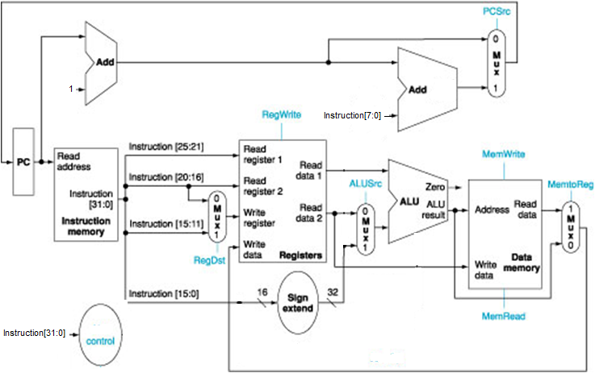
Data Path Setup According to

Slide 43
Supported instructions
add, sub, addi, lw, sw, beq.

Slide 44
Stepping through the program
The clock is set to be 200 time units. Run 200 every time.
Check the values of the wires in the waveform
Check the content of the registers and data memories in the memory windows.

Slide 45
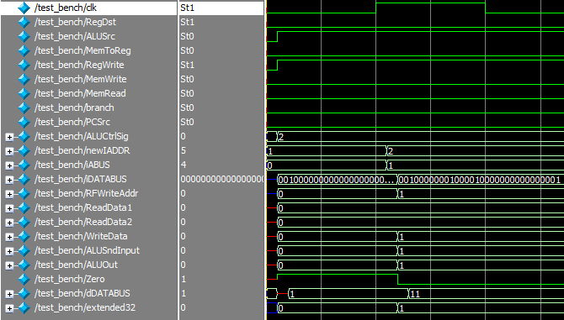
The waveform after two instructions
00100000000000000000000000000000; // addi $0, $0, 0
00100000001000010000000000000001; // addi $1, $1, 1

Slide 46
Supporting a new instruction
With the current data path, can we support a new instruction?
lwr $rs, $rt, $rd
What it does is to read from data memory at $rs-$rt, and write it to $rd
Suppose its opcode is 000001.

Slide 47
Supporting a new instruction
else if (instr[31:26] == 6'b000001) //lwr
begin
RegDst <= 1;
ALUSrc <= 0;
MemToReg <= 1;
RegWrite <= 1;
MemRead <= 1;
MemWrite <= 0;
branch <= 0;
ALUCtrl <= 4'b0110;
end

