Slide 1
MIPS CPU Design using Verilog
Tsung-Chu Huang
Dept. of Electronics Eng., National Changhua University of Education, Taiwan
2023/1/5

Slide 2
Outline
Introduction to MIPS32: ISA & SPIM
Instruction Formats
Addressing Modes
Instruction Set Architecture and Assembly Language Compiled by SPIM
Single-Stage MIPS Design
Program Counter (PC)
Instruction Memory (IM)
Register Files (RF)
Arithmetic Logic Unit (ALU)
Data Memory (DM)
5-Stage Pipeline MIPS Design
Basic Pipeline Design by Spatial Gate-Level Design
Explanation for Term Project

Slide 3
Introduction to MIPS
Famous Microprocessors
CISC:
4004: ’71 Intel. First CPU ➔ 8008 ➔ 8080 ➔ 80x86 (applied in PC)
6502 (#T) : Motorola (applied in Apple II) ➔ 68000 ➔ 68030 (applied in Sun Workstations)
RISC:
MIPS (Mega Inst. per Sec): ’81, Prof. Hennessy, Stanford U. ➔ ’92 MIPS Co. ➔ ’18 Wave Comp.
ARM (Advanced RISC Machine): ’83 Acorn Co. ➔ ’90 ARM Co. ➔ ’16 SoftBank
RISC-V: ’10 UCB Open Project ➔ ’15 Foundation
MIPS
MIPS Co. converted to develop RISC-V, but MIPS is still popular in CPU Design course/lecture due to its concise pipeline stages.
32 32-bit Registers:
argument: $a0~$a7 = $0~$7
save: $s0~$s7 = $8~$15
temp: $t0~$t9 = $16~$23
value: $v0~$v7 = $24~$31 (returned value)
$28=$gp (global pointer), $29=$sp (stack pointer), $30=$fp (frame pointer), $31=$ra (return address)
4GB Mem, 32-bit Word, 30-bit absolute address (therefore, only 2-bit J), State Control

Slide 4
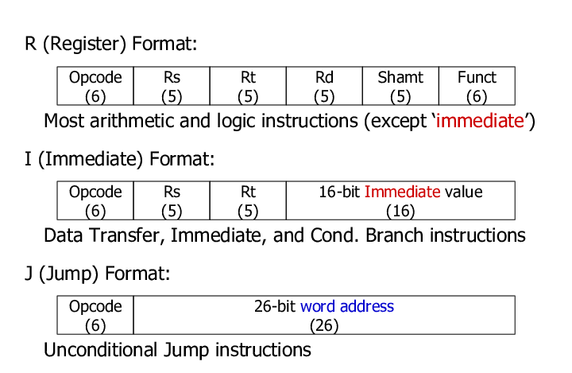
Instruction Formats
Destination $←$ Source $□$ Target
Shift Amount

Slide 5
MIPS Register Files (RF)
32 Registers
Pseudo Instructions in Assemblers
Register Number | Register Name | Description
0 | $zero | The value 0
2-3 | $v0 - $v1 | (values) from expression evaluation and function results
4-7 | $a0 - $a3 | (arguments) First four parameters for subroutine
8-15, 24-25 | $t0 - $t9 | Temporary variables
16-23 | $s0 - $s7 | Saved values representing final computed results
31 | $ra | Return address
Directive |  |  |  | Result
.word | w1, | ..., | wn | Store n 32-bit values in successive memory words
.half | h1, | ..., | hn | Store n 16-bit values in successive memory words
.byte | b1, | ..., | bn | Store n 8-bit values in successive memory words
.ascii str | Store the ASCII string str in memory. Strings are in double-quotes, i.e. "Computer Science"
.asciiz str | Store the ASCII string str in memory and null-terminate it Strings are in double-quotes, i.e. "Computer Science"
.space n | Leave an empty n-byte region of memory for later use
.align n | Align the next datum on a 2^n byte boundary. For example, .align 2 aligns the next value on a word boundary

Slide 6
MIPS Instruction Set
Arithmetic
Logical
Instruction | Example | Meaning
add | add $1,$2,$3 | $1=$2+$3
subtract | sub $1,$2,$3 | $1=$2-$3
add immediate | addi $1,$2,100 | $1=$2+100
add unsigned | addu $1,$2,$3 | $1=$2+$3
subtract unsigned | subu $1,$2,$3 | $1=$2-$3
add immediate unsigned | addiu $1,$2,100 | $1=$2+100
Multiply (without overflow) | mul $1,$2,$3 | $1=$2*$3
Multiply | mult $2,$3 | $hi,$low=$2*$3
Divide | div $2,$3 | $hi,$low=$2/$3
Instruction | Example | Meaning
and | and $1,$2,$3 | $1=$2&$3
or | or $1,$2,$3 | $1=$2|$3
and immediate | andi $1,$2,100 | $1=$2&100
or immediate | or $1,$2,100 | $1=$2|100
shift left logical | sll $1,$2,10 | $1=$2<<10
shift right logical | srl $1,$2,10 | $1=$2>>10

Slide 7
MIPS Instruction Set
Data Transfer
Conditional Branch
Instruction | Example | Meaning
load word | lw $1,100($2) | $1=Memory[$2+100]
store word | sw $1,100($2) | Memory[$2+100]=$1
load upper immediate | lui $1,100 | $1=100x2^16
load address | la $1,label | $1=Address of label
load immediate | li $1,100 | $1=100
move from hi | mfhi $2 | $2=hi
move from lo | mflo $2 | $2=lo
move | move $1, $2 | $1=$2
Instruction | Example | Meaning
branch on equal | beq $1,$2,100 | if($1==$2) go to PC+4+100
branch on not equal | bne $1,$2,100 | if($1!=$2) go to PC+4+100
branch on greater than | bgt $1,$2,100 | if($1>$2) go to PC+4+100
branch on greater than or equal | bge $1,$2,100 | if($1>=$2) go to PC+4+100
branch on less than | blt $1,$2,100 | if($1<$2) go to PC+4+100
branch on less than or equal | ble $1,$2,100 | if($1<=$2) go to PC+4+100

Slide 8
MIPS Instruction Set
Comparison
Jump
Instruction | Example | Meaning
set on less than | slt $1,$2,$3 | if($2<$3)$1=1; else $1=0
set on less than immediate | slti $1,$2,100 | if($2<100)$1=1; else $1=0
Instruction | Example | Meaning
jump | j 1000 | go to address 1000
jump register | jr $1 | go to address stored in $1
jump and link | jal 1000 | $ra=PC+4; go to address 1000

Slide 9
System Calls in SPIM
Service | Operation | Code (in $v0) | Arguments | Results
print_int | Print integer number (32 bit) | 1 | $a0 = integer to be printed | None
print_float | Print floating-point number (32 bit) | 2 | $f12 = float to be printed | None
print_double | Print floating-point number (64 bit) | 3 | $f12 = double to be printed | None
print_string | Print null-terminated character string | 4 | $a0 = address of string in memory | None
read_int | Read integer number from user | 5 | None | Integer returned in $v0
read_float | Read floating-point number from user | 6 | None | Float returned in $f0
read_double | Read double floating-point number from user | 7 | None | Double returned in $f0
read_string | Works the same as Standard C Library fgets() function. | 8 | $a0 = memory address of string input buffer $a1 = length of string buffer (n) | None
sbrk | Returns the address to a block of memory containing n additional bytes. (Useful for dynamic memory allocation) | 9 | $a0 = amount | address in $v0
exit | Stop program from running | 10 | None | None
print_char | Print character | 11 | $a0 = character to be printed | None
read_char | Read character from user | 12 | None | Char returned in $v0
exit2 | Stops program from running and returns an integer | 17 | $a0 = result (integer number) | None

Slide 10
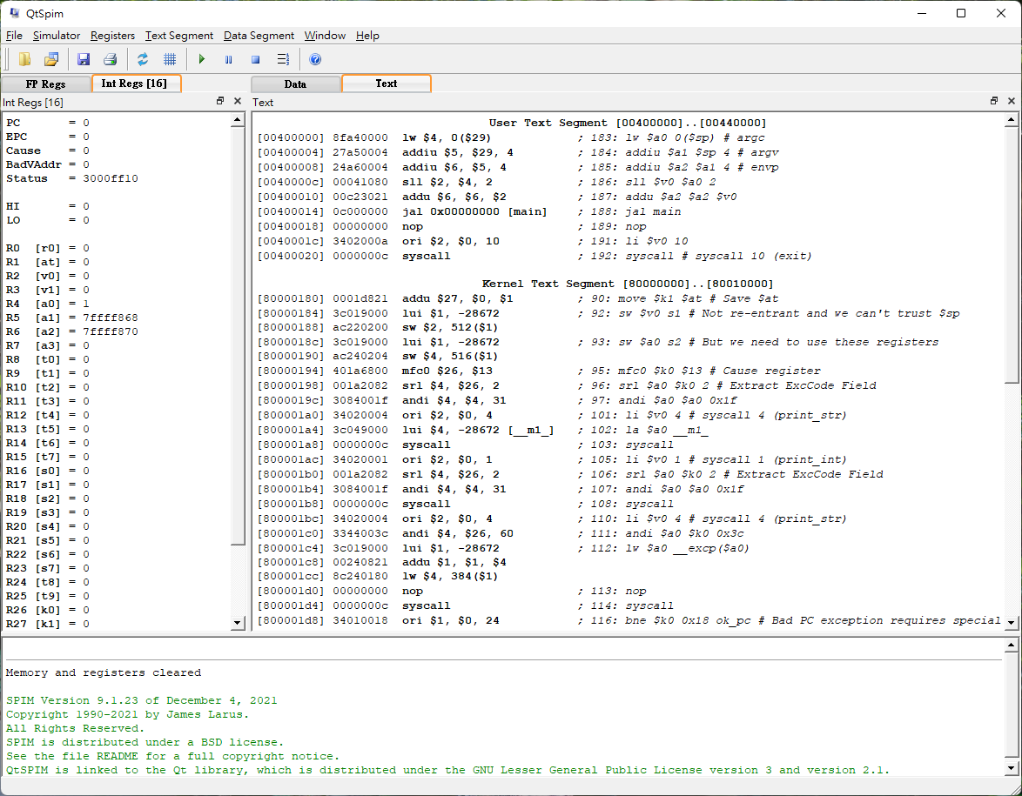
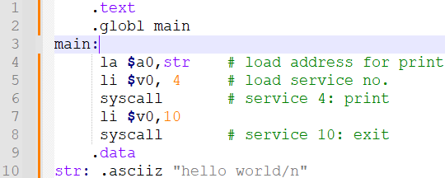
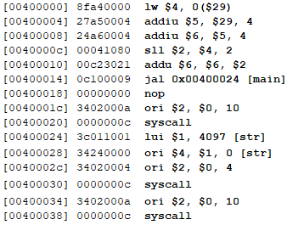
SPIM – Assembler of MIPS
Install QtSPIM from Cloud/Lab16, or + glibc for MIPS
> File > Load > Hello.asm

Slide 11
Modular (Gate-Level) Design
Program Counter (PC)
Instruction Memory (IM)
Register Files (RF)
Sign Extension Unit (SE)
Arithmetic Logical Unit (ALU)
Data Memory (DM)

Slide 12
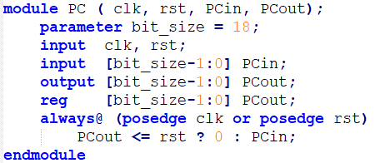
Program Counter
1
+
0
+
branch <<< 2
PC
4

Slide 13
Instruction Memory (IM)
IM
32
32
Address
Instruction

Slide 14
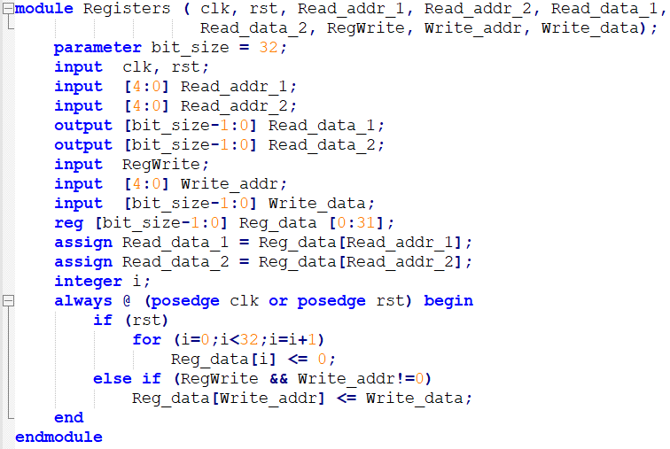
Register Files (RF)
5
RF
32
Read Reg1
Read Data1
5
32
Read Reg2
Read Data2
5
Write Reg
32
Write Data

Slide 15
Sign Extension
$$⋘2$$
0
0
16-bit branch x 4 = 32-bit offset address

Slide 16
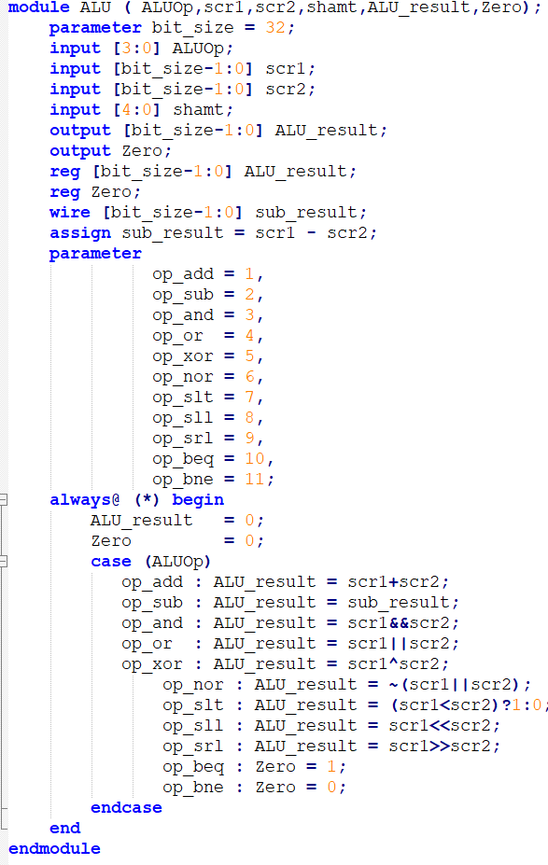
ALU
ALUop
shamt
4
5
32
scr1
Zero
ALU
32
ALU_result
32
scr2

Slide 17
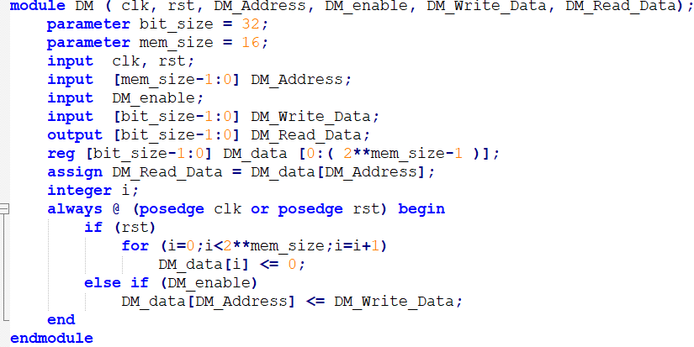
Data Memory (DM)
32
DM
Address
32
32
Write Data
Read Data
R/W

Slide 18
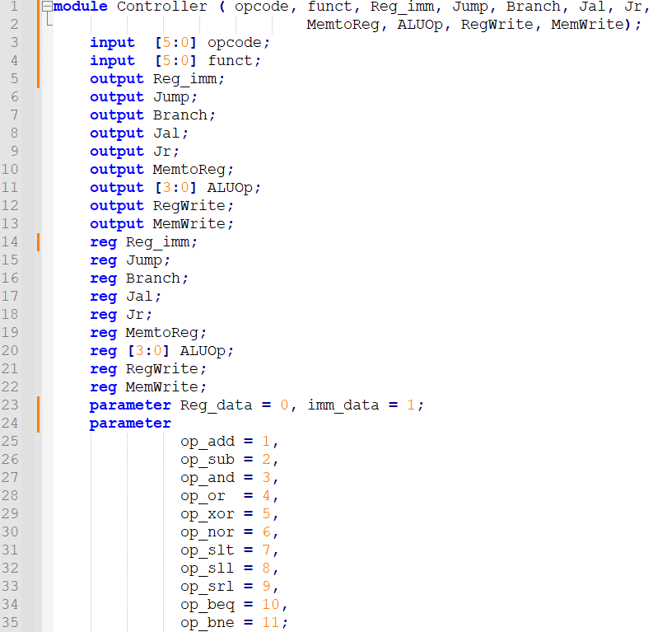
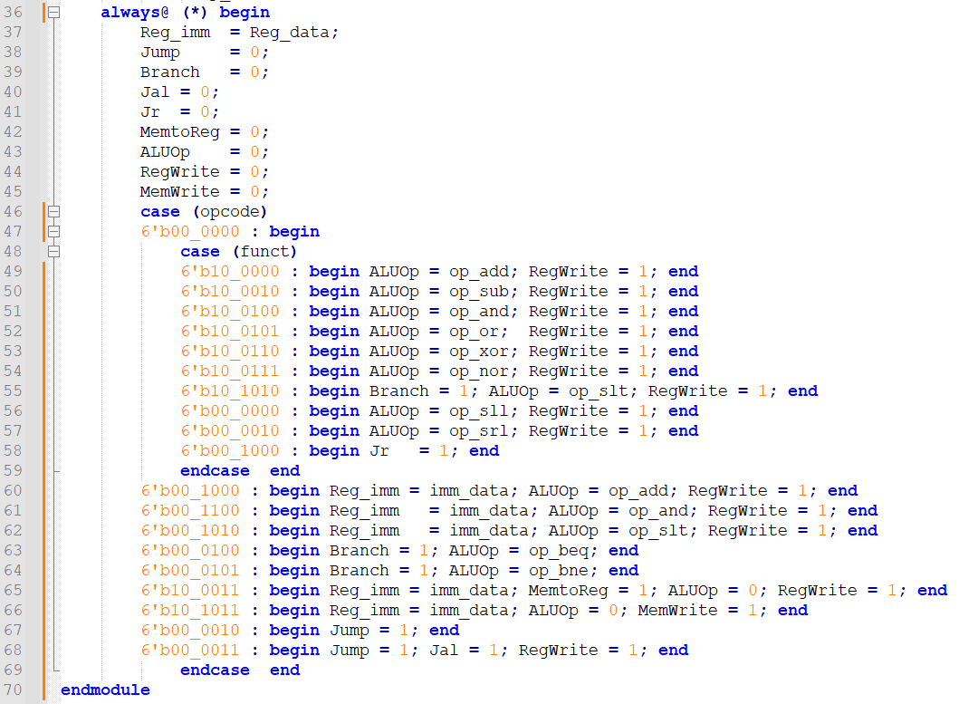
Controller
CU

Slide 19
Single-Stage Generic MIPS32
1
+
0
+
$$⋘2$$
RF
DM
PC
4
IM
ALU
Write Clk
CU

Slide 20
5-Stages Pipeline MIPS
IF (Instr. Fetch)
ID (Instr. Decoder)
EX (Execution)
MEM (Memory)
WB (Write Back)
1
+
0
+
$$⋘2$$
4
DM
PC
IM
RF
ALU
1
0
IF_ID
ID_EX
EX_M
M_WB

Slide 21
R-type Instructions with no confliction with others
IF (Instr. Fetch)
ID (Instr. Decoder)
EX (Execution)
MEM (Memory)
WB (Write Back)
1
+
0
+
$$⋘2$$
4
DM
PC
IM
RF
ALU
1
0
IF_ID
ID_EX
EX_M
M_WB

Slide 22
lw (Load Word)
IF (Instr. Fetch)
ID (Instr. Decoder)
EX (Execution)
MEM (Memory)
WB (Write Back)
1
+
0
+
$$⋘2$$
4
DM
PC
IM
RF
ALU
1
0
IF_ID
ID_EX
EX_M
M_WB

Slide 23
sw (Store Word)
IF (Instr. Fetch)
ID (Instr. Decoder)
EX (Execution)
MEM (Memory)
WB (Write Back)
1
+
0
+
$$⋘2$$
4
DM
PC
IM
RF
ALU
1
0
IF_ID
ID_EX
EX_M
M_WB

Slide 24
Branch Instructions
IF (Instr. Fetch)
ID (Instr. Decoder)
EX (Execution)
MEM (Memory)
WB (Write Back)
1
+
0
+
$$⋘2$$
4
DM
PC
IM
RF
ALU
1
0
IF_ID
ID_EX
EX_M
M_WB

Slide 25
Time-Space Diagram
Time
i1
i2
i3
i4
i5
1
1
i1
i2
i3
i4
1
1
1
0
+
0
+
0
+
+
+
0
0
+
$$⋘2$$
+
$$⋘2$$
+
$$⋘2$$
+
$$⋘2$$
+
$$⋘2$$
4
4
4
4
4
DM
DM
DM
i2
i1
DM
DM
RF
RF
RF
RF
i3
PC
IM
PC
IM
1
PC
IM
1
PC
IM
1
PC
IM
RF
ALU
0
ALU
0
ALU
0
ALU
1
ALU
1
0
0
i1
i2
i1
Space
(Simple MIPS without consideration of hazards ➔ stall ➔ forwarding)

Slide 26
RR-WR Read-Write (Forward) Dependency ➔ OK
Time
RR
WR
i3
i4
i5
1
1
RR
WR
i3
i4
1
1
1
0
+
0
+
0
+
+
+
0
0
+
$$⋘2$$
+
$$⋘2$$
+
$$⋘2$$
+
$$⋘2$$
+
$$⋘2$$
4
4
4
4
4
DM
DM
DM
WR
RR
DM
DM
RF
RF
RF
RF
i3
PC
IM
PC
IM
1
PC
IM
1
PC
IM
1
PC
IM
RF
ALU
0
ALU
0
ALU
0
ALU
1
ALU
1
0
0
RR
WR
RR
Space
(Simple MIPS without consideration of hazards ➔ stall ➔ forwarding)

Slide 27
WR-RR Write-Read (Backward) Dependency ➔ STALL
Time
Read an old value
WR
RR
i3
i4
i5
1
1
WR
RR
i3
i4
1
1
1
0
+
0
+
0
+
+
+
0
0
+
$$⋘2$$
+
$$⋘2$$
+
$$⋘2$$
+
$$⋘2$$
+
$$⋘2$$
4
4
4
4
4
DM
DM
DM
RR
WR
DM
DM
RF
RF
RF
RF
i3
PC
IM
PC
IM
1
PC
IM
1
PC
IM
1
PC
IM
RF
ALU
0
ALU
0
ALU
0
ALU
1
ALU
1
0
0
RR
WR
Space
(Simple MIPS without consideration of hazards ➔ stall ➔ forwarding)

Slide 28
Exercise & Lab16
(Install gcc with MIPS library –march=mips2)
(Write a program using C and compile to MIPS Assembly)
Install SPIM
Write an Assembly program (eg. Fibonacci.s ) using SPIM
Simulation in SPIM and prepare source codes and golden data.
Design a partial MIPS CPU using Verilog
Write a testbench (testfixture) for Golden Test
Simulation using ModelSim
(Modified several instructions for I/O in DE0/Cyclone III)
(Demo reduced MIPS using DE0/Cyclone III FPGA)

Slide 29
Term Project
Based on Lab16, demo and explain your MIPS by any of the following efforts:
Adding one or two instructions from a full MIPS and execute an assembly program with the additional instructions.
Install glibc/gcc and compile a C program to MIPS assembly code and then simulate them and explain. Hints:
Windows > cmd DOS > powershell PS > SWL --install PS > SWL SWL > sudo apt install gcc-mips-linux-gnu g++-mips-linux-gnu SWL > gcc-mips-linux-gnu -O3 -S -mfp32 -march=R2000 hello.c
Using Compiler Explorer at https://godbolt.org/
Adding I/O and demo on the DE0/Cyclone III.
EDA scripts for connecting the SPIM to MIPS Simulations
Any improvement that you deserve a bonus.

