Slide 1
HDL Scripting in Python with case study on CORDIC and VGA display by Cyclone III
Tsung-Chu Huang
IC-TestLab NCUE, Taiwan
2022/11/24

Slide 2
Outline
Scripting
Case Study: CORDIC
generate/endgenerate Block
Fixed-Point and Floating-Point Calculation
Overflow and Sign-Extension Traps
OU: VGA Display
Display Interface
Equation-Satisfied Coordinate Patterns
2-port (w/r) Memory Mapping
MU:
W/R basics
Coding & Demonstration

Slide 3
Scripting/Shell
Scripts:
Simple Command Rows Integrating Programs to System
APP Programs Utilities
Package/OS | Scripts | Interpreter
DOS | Some_batch.BAT | OS Shell
UNIX/Linux | sh, csh, tcsh, bsh | OS Shell
MS Office | VBA | Office
Cross OS | perl | Perl package
Cross OS | python | python pkg
Cross OS | General Language | Compiler
Cadence CAD | SKILL | CAD pkg
Other CAD | tcl | CAD pkg
Shell Scripts
OS

Slide 4
Straight-Translation Synthesis
Simple synthesizer without decision & optimization
Define/modify parameters
fprintf(fp, "module Circuit(Clk, In, Out, %d);", Param);
system("vsim Circuit.v –do some.tcl");
Useful Scripting
c
matlab
python
batch
Verilog
tcl
SPICE

Slide 5
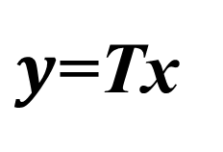




Case Study: CORDIC
Although similar math proposed by Briggs in 1624
COordinate Rotation DIgital Computer (Volder, 1956)
General CORDIC Conditions:
$y$=Tx
$$x_{1}$$
$$y_{1}$$
$$+$$
$$×$$
$$x_{2}$$
$$y_{2}$$

Slide 6
Case Study: CORDIC
$$y$$
Select $θ_{i}=\tan^{−1}{(2^{−i})}$
such that $x ∙ \tan\left(θ\right)= x ∙2^{−i} =x≫i$
$\prod_{i=1}^{n}{cos(tan^{−1}\left(2^{−i}\right))} →K_{n}≈0.607$
${(x}_{0}, y_{0})={(K}_{n}, 0)$; $θ_{0}=0$; s = +1;
$$1/\sqrt{2}$$
${(x}_{i}, y_{i})=(x_{i−1}−{sy}_{i−1}≫i, { sx}_{i−1}≫i+y_{i−1})$
$θ_{i}+=s∙tan^{−1}(2^{−i})$
h
$$1/\sqrt{2}$$
h
$$2h$$
$$x$$
$s= {θ>θ}_{i} ?1 :−1;$
$$4h$$
$$O$$
$$1$$
$$\left(\begin{matrix}cos⁡(θ) \\ sin⁡(θ)\end{matrix}\right)←cos⁡(θ_{3})\left(\begin{matrix}1 & −tan⁡(θ_{3}) \\ tan⁡(θ_{3}) & 1\end{matrix}\right)cos⁡(θ_{2})\left(\begin{matrix}1 & −tan⁡(θ_{2}) \\ tan⁡(θ_{2}) & 1\end{matrix}\right)cos⁡(θ_{1})\left(\begin{matrix}1 & −tan⁡(θ_{1}) \\ tan⁡(θ_{1}) & 1\end{matrix}\right)\left(\begin{matrix}0 \\ 1\end{matrix}\right)$$

Slide 7
General Superfunctions for CORDIC
Currently-Found Superfunctions:
Inverse functions can be also solved.
Can you expand a non-superfunction to a superfunction such that $T\left(x+x_{0}\right)=aT\left(x_{0}\right)T\left(x\right)+b$ ?
No. | Functions
1 | $$\left(\begin{matrix}cos⁡(α+β) \\ sin⁡(α+β)\end{matrix}\right)=\left(\begin{matrix}cos(β) & −sin⁡(β) \\ sin⁡(β) & cos⁡(β)\end{matrix}\right)\left(\begin{matrix}cos⁡(α) \\ sin⁡(α)\end{matrix}\right)$$
2 | $$\left(\begin{matrix}cosh⁡(α+β) \\ sinh(α+β)\end{matrix}\right)=\left(\begin{matrix}cosh⁡(β) & sinh⁡(β) \\ sinh⁡(β) & cosh⁡(β)\end{matrix}\right)\left(\begin{matrix}cosh⁡(α) \\ sinh⁡(α)\end{matrix}\right)$$
3 | $$e^{x+a}=e^{x}×e^{a}$$

Slide 8
Fixed-Point and Sign Extension
Fixed-Point Operations
Let <i, m> as a fixed-point format with i-bit integer and m-bit mantissa.
$<\max\left(i_{1}, i_{2}\right)+1, \max\left(m_{1}, m_{2}\right)> ← <i_{1},m_{1}> ± <i_{2},m_{2}>$
$<i_{1}+i_{2}, m_{1}+m_{2}{> ← <i_{1},m_{1}> × <i_{2},m_{2}>}$
IEEE1364-1995
Take care of 2’s complement operations by yourself.
reg [6:0] a=7’b1101010 ; // <3.4>=-1.375
reg [9:0] b = { 3{a[6]}, a} ;
Try to transfer to the maximum-length wires/reg before operations.
IEEE 1364-2001
Declare 2’s-complement as reg signed [6:0] a=-22;
Take care of the point position by yourself.

Slide 9
Floating-Point Operations
IEEE 754: $s×(1.M)×2^{E}$
Fraction (分數)is the rest deducted the integer part of a real number.
Mantissa (尾數)is the tail cut off integer bit of a number 1.M
Exponent is an offset-integer with base-2 exponent E=E' - ${(2}^{e−1}−1)$
Extended widths for operations and normalized for final formats.
Custom FP operations: extra position integer p
Derive the maximum positive M and minimum negative m and expected resolution with b-bits of fraction
➔ width of p = $\log_{2}p={max(log}_{2}{M,\log_{2}\left(−m\right))+b}$
s
e-bit exponent E’
m-bit mantissa M (m=23 for 32-bit or 52 for 64-bit)

Slide 10
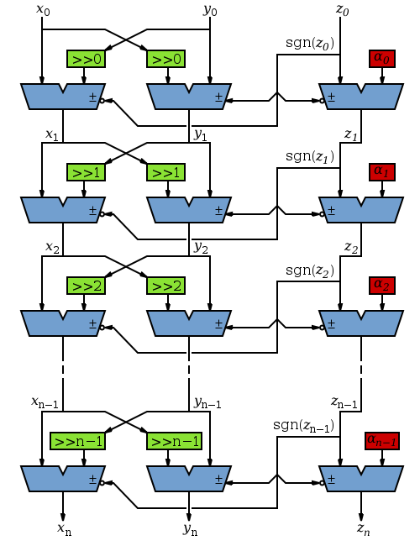
Parallel CORDIC.v
parameter N, W, Kn= …;
parameter a[0:N]= …; // Look-Up Table
module CORDIC(theta, cos, sin);
input [W-1:0] theta;
output [W-1:0] cos, sin;
wire [W-1:0] x[0:N], y[0:N], z[0:N]; //<2.W-2>
assign z[0] = theta;
assign x[0]=Kn;
assign y[0]=0;
genvar i;
for(i=0; i<N; i=i+1) begin : Stage
AddSub U1(!z[i][W-1], x[i+1], x[i], y[i]>>i);
U2(z[i][W-1], y[i+1], x[i]>>i, y[i]);
U3(!z[i][W-1], z[i+1], z[i], z[i]);
end
assign cos = x[N];
assign sin = y[N];
endmodule
module AddSub(A, X, Y, S);
… assign S = X + A ? Y : ~Y + 1; endmodule

Slide 11
Pipeline CORDIC.v
parameter N, W, Kn= …;
parameter a[0:N]= …; // Look-Up Table
module CORDIC(Clk, theta, cos, sin);
input Clk;
input [W-1:0] theta;
output [W-1:0] cos, sin;
wire [W-1:0] x[0:N], y[0:N], z[0:N]; //<2.W-2>
assign z[0] = theta;
assign x[0]=Kn;
assign y[0]=0;
genvar i;
for(i=0; i<N; i=i+1) begin : Stage
AddSub U1(Clk, !z[i][W-1], x[i+1], x[i], y[i]>>i);
U2(Clk, z[i][W-1], y[i+1], x[i]>>i, y[i]);
U3(Clk, !z[i][W-1], z[i+1], z[i], z[i]);
end
assign cos = x[N];
assign sin = y[N];
endmodule
module AddSub(Clk, A, X, Y, S);
… always@(posedge Clk) S = X + A ? Y : ~Y + 1; endmodule

Slide 12
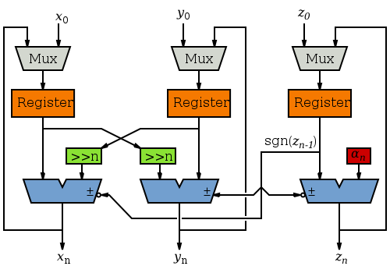
Serial CORDIC.v
parameter N, W, Kn= …;
parameter a[0:N]= …; // Look-Up Table
module CORDIC(Clk, Rst, theta, cos, sin, Rdy);
input Clk; output Rdy;
input [W-1:0] theta;
output [W-1:0] cos, sin;
wire [W-1:0] x[0:N], y[0:N], z[0:N]; //<2.W-2>
reg i;
reg [W-1:0] Rx, Ry, Rz;
AddSub U1(Clk, !z[i][W-1], x[i+1], x[i], y[i]>>i);
U2(Clk, z[i][W-1], y[i+1], x[i]>>i, y[i]);
U3(Clk, !z[i][W-1], z[i+1], z[i], z[i]);
always@(posedge Clk) if(Rst) begin x[0]=Kn; y[0]=0; z[0] = theta;
i=0; Rdy = 0; end
else if(i==32) Rdy = 1;
else begin i=i+1; Rx = x[i]; Ry = y[i]; Rz = z[i]; end
assign cos = x[N]; assign sin = y[N];
endmodule
module AddSub(A, X, Y, S);
… S = X + A ? Y : ~Y + 1; endmodule

Slide 13
Why Scripting
Why Scripting
No commands for iterating in App.
Irregularly duplicating.
Parameter calculating outside of APP.
Variety of designs.
Many iterations for timing/power closure and experiments.
How Scripting
Try small designs in APP.
Draft the scripts for design and TCL.
Plan what you need.
Increase the options in scripts.

Slide 14
Simulation Environments
Tools Installation in Windows
ModelSim (command-line: vsim)
Python/numpy/matplotlib
Note: Add paths to system variables
Scripting Flow
def CORDIC
… … … …
Script.py
Comparison:
… … … …
Report
Python
module CORDIC(
… … … …
Design.v
initial begin
… … … …
Testbench.v
vlog Design.v
… … … …
vsim.tcl
# data
# 1.234 701
… … … …
Transcript
ModelSim
Rapid
Prototyping

Slide 15
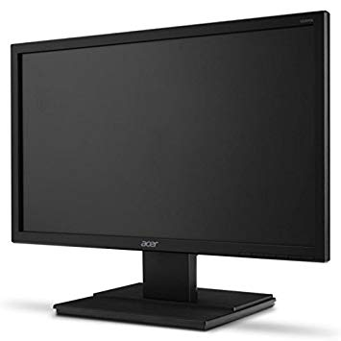
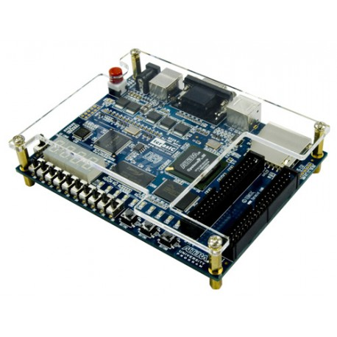
Rapid Prototyping Environments
Facility & Tools Installation
Quartus II Synthesizer with DE0/EP3C
VGA Display (also as a case for OU study)
Verification Flow

Slide 16
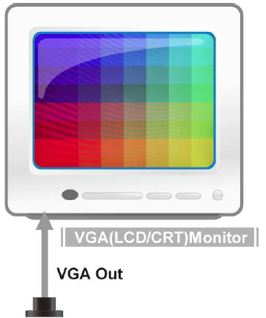
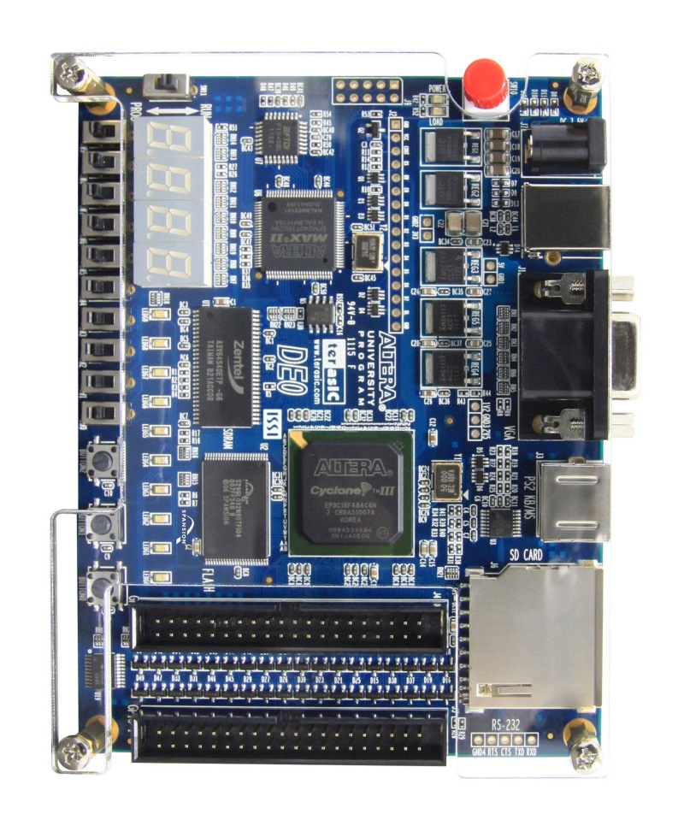
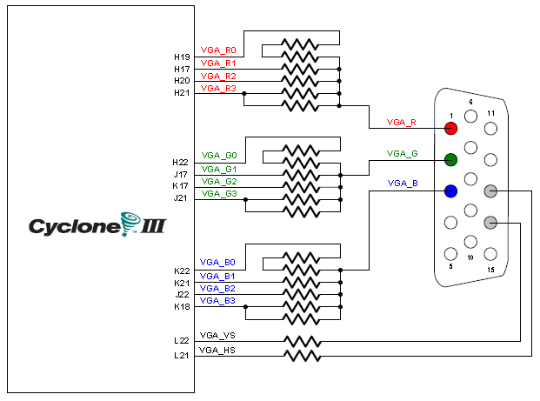
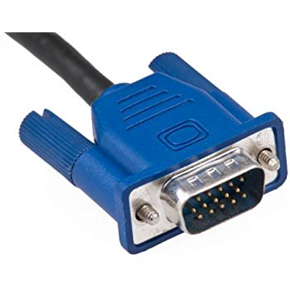
VGA Display Principle

Slide 17
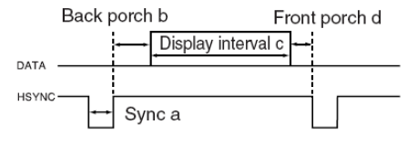
Horizontal and Vertical Synchronization

Slide 18
Cycles in a Frame in 60Hz
$$1.9μs$$
$$25.4μs$$
$$0.6μs$$
$$3.8μs$$
$f=60×525×640×31.7÷25.4$
$f=25160315Hz\sim 25MHz$
Then the pixels in a h scan:
48 + 640 + 15 + 96
Then the controller is responsible to
Generate vsync and hsync clocks
Sending data after $31.7×33+1.9μs$ behind vertical sync.
33
640 pixels, $25.4μs$
VGA
480 Lines
525 Lines
10

Slide 19
DE0 Template: DE0_Default
DE0_CORDIC
CORDIC_Test
VGA_OSD_RAM
VGA_Ctrl
IMG_RAM
CORDIC
VGA_Clk

