Slide 1
Hardware Description Language
-- Logic Design using Verilog
Tsung-Chu Huang
Dept. of Electronic Eng.
National Changhua University of Ed.
Email: tch@cc.ncue.edu.tw
2022/11/03

Slide 2
Delay Models
Zero-Delay
Considering only Boolean functions.
Without inertia delay and glitch problems.
Gate Delay Model
Define a predicate #delay in gate-level description.
GATE #delay instance(ports);
Path Delay Model
Define a path delay (=>) predicate in a specify block.
specify (INi => OUTj) = delay; endspecify
Constant Delay Model
`define delay #constant
Define GATE `delay instance(ports); for all
General Delay Model
Usually extracting signal delay file (SDF) for post-layout timing simulation
Mapping a physical delay to each path or gate.

Slide 3
Data Type time, Variables $time & $realtime
`back-quote and $dollar-sign Directives
Datatype
time: is an 8-byte integer;
Use long integer for some tools.
Declare time t1, t2; for calculating the simulation and real time.
$time
The circuit simulation time elapsed by the # directives.
@event also returns a simulation time point.
$realtime
Returns a CPU time
Used for comparison of different simulation algorithms or flows.
Also used for stamping the simulation date.

Slide 4
Inertia Delay
Inertia delay
The minimum time to propagate a pulse.
The typical delay is default to its inertia.
Inertia Delay Model of a Block
Evaluate the function first.
Filtered by a inertia delay window.
Inertia
delay

Slide 5
Glitch
Glitch
Unconsidered in functional (zero-delay) design phase.
For a Boolean function, it occurs due to different paths from a minterm to another minterm in K-map or cube.
1
1
1
1
1
1
1
1
Narrow Glitch and Inertia Delay
Narrow glitches can be filtered by inertia delay.
It still dissipates considerable dynamic power due to incomplete (half) charging.

Slide 6
Example
Edge Detector
In “Functional Design Phase”, we consider only the inverter’s delay
However, the delay and inertia delay of the NAND gate, τ_{NAND}
Using odd n inverters with delay τ_{NOT} respectively
n τ_{NOT} > τ_{NAND}

Slide 7
`timescale
Simulation Directives:
`timescale unit / precision
The same sequences with the same elapsing time but different units can have the same simulation result if the precision is the same.
`timescale 1us/1ps
:
nand #0.05 g1(o, i1, i2);
:
`timescale 1us/10ps
:
nand #0.05 g1(o, i1, i2);
:
||
||
`timescale 1ns/1ps
:
nand #50 g1(o, i1, i2);
:
`timescale 1ns/10ps
:
nand #50 g1(o, i1, i2);
:

Slide 8
Gate Delay Time Modeling
Typical Delay Time
#3
x
#4
#6
z
y
#5
nand #4 g1(w, x, y);
nand #3 g2(p, w, x), #5 g3(q, w, y);
assign z = #6 p||q;
#(min_delay, typical_delay, max_delay)
nand #(3,4,5) g1(w, x, y);
assign z = #(5.5: 6.0: 6.2) ~(x&&y);

Slide 9
Gate Delay Time Modeling
Path Delay Specification
A
F
B
module NOR2(F, A, B);
input A, B;
output F;
nor (F, A, B);
specify
(A=>F) = 5;
if(B) (B=>F) = 7; //fall delay
if(~B) (B=>F) = 8; //rise delay
endspecify
endmodule
a[2:0]=>b[2:0] specifies 3 parallel paths
a[2:0]*>b[3:0] specifies all 3X4 paths

Slide 10
Huffman Model for a Finite State Machine
Single Clock, Synchronous, DFF-based
PI:
Primary Inputs
PO:
Primary Outputs
N
X
Combinational
Circuit
Z
L
PPI:
Pseudo PI
PPO:
Pseudo PO
Q
D
M
Q
D
M
Q
D
Q
D
Q
D
PS: Present State
y
Y
NS: Next State
Clk

Slide 11
Setup Time and Hold Time
Data, D
D
$setup(D, C, setuptime);
Clock, C
t_{CQ}
$hold(C, D, holdtime);
Q
Output, Q
Time, t

Slide 12
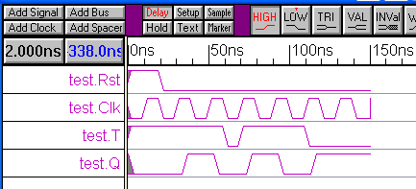
Setup and Hold Time
Example: 4-Bit Counter
module TFF(Rst, Clk, T, Q);
input Rst, Clk, T;
output Q;
reg Q;
always@(posedge Clk or posedge Rst)
if(Rst) Q = #2 0;
else Q = #5 T^Q;
specify
$setup(T, posedge Clk, 3);
$hold(posedge Clk, T, 1);
endspecify
endmodule
Clk
T
setup
time
hold
time
module test;
reg Rst, Clk, T;
TFF FF1(Rst, Clk, T, Q);
initial Clk=0;
always Clk=#10 ~Clk;
initial begin
Clk=0; Rst=1; T=1;
#20 Rst=0;
#40 T=0;
#10 T=1;#41 T=0;
#40 $stop;
end
endmodule

Slide 13
Setup Time Rule
Period T = 1/f
D
Q
propagation time
t_{p}
$setup(D, C, 0.13);
transcript:
setup-time violation …
Q
D
Q
D
slack
Q
D
Q
D
Clock-to-Q time t_{CQ}
$$t_{s}$$
C
Setup time $≜min⁡(t_{C}−t_{D})$
Clk
Clock-to-Q time of FF₁
Setup-Time Rule: $slack12=T −t_{CQ1} −t_{p12} −t_{s2} −t_{J} −t_{SK12}$
Propagation time from FF₁ to FF₂
jitter
skew
setup time of FF₂

Slide 14
Hold Time Rule
D₁
Q₁
t_{CQ1}
t_{sk1}
t_{J}
t_{p12}
t_{sk21}
Clock Jitter
t_{sk2}
Skew
D₂
Q₂
Hold-Time Rule: $t_{H}<t_{CQ1}+t_{p} −t_{sk21} −t_{J}$

Slide 15
Parallel Simulation under Sequential Environment
Computing:
All concurrent events are sequentially pushed into the queue at the same $time of the time wheel and executed sequentially.
Tricks:
#0 generates another queue with the same $time.
Define all initial values prior to continuous assignments.
Make sure that the goal is simulation only, synthesis only or both.
initial
always
initial
$time=0
#0
#elapsing_time
statement1
forever
statement2
#0

Slide 16
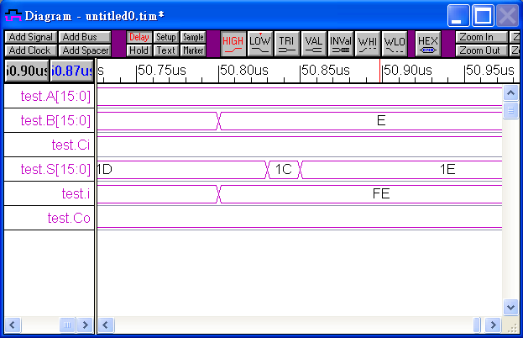
Example
Comparison of a Variety of Adders
Adders
Ripple-Carry Adder
Carry Select Adder
Carry Save Adder
Carry Lookahead Adder
module HA(A, B, C, S);
input A, B;
output C, S;
xor #15 g1(S, A, B);
and #10 g2(C, A, B);
endmodule
module adder(A, B, Ci, Co, S);
parameter N = 16;
input [N-1:0] A, B;
input Ci;
output Co;
output [N-1:0] S;
FA g0(A[0], B[0], Ci, C[0], S[0]);
FA g1(A[1], B[1], C[0], C[1], S[1]);
FA g2(A[2], B[2], C[1], C[2], S[2]);
FA g3(A[3], B[3], C[2], C[3], S[3]);
FA g4(A[4], B[4], C[3], C[4], S[4]);
FA g5(A[5], B[5], C[4], C[5], S[5]);
FA g6(A[6], B[6], C[5], C[6], S[6]);
FA g7(A[7], B[7], C[6], C[7], S[7]);
FA g8(A[8], B[8], C[7], C[8], S[8]);
FA g9(A[9], B[9], C[8], C[9], S[9]);
FA g10(A[10], B[10], C[9], C[10], S[10]);
FA g11(A[11], B[11], C[10], C[11], S[11]);
FA g12(A[12], B[12], C[11], C[12], S[12]);
FA g13(A[13], B[13], C[12], C[13], S[13]);
FA g14(A[14], B[14], C[13], C[14], S[14]);
FA g15(A[15], B[15], C[14], C[15], S[15]);
endmodule
module FA(A, B, Ci, Co, S);
input A, B, Ci;
output Co, S;
HA g1(A, B, C1, S1);
HA g2(S1, Ci, C2, S);
or #10 g3(Co, C1, C2);
endmodule

Slide 17
Comparison of RCA & CLA
module testCLA2RCA;
reg [15:0] A, B;
reg Ci;
wire [15:0] Srca, Scla;
RCA rca(A, B, Ci, Crca, Srca);
CLA16 cla(A, B, Ci, Ccla, Scla);
initial begin
A=6;
B=8;
Ci=1;
#200;
A=16'hffff; //Testing the Carry Propagation
B=16'hffff;
Ci=1;
#200 $stop;
end
endmodule

Slide 18
Comparison of RCA & CLA
Exhaustively Simulation-Based Functional Verification using Command Line Monitoring
module testCLA2RCA;
reg [15:0] A, B;
reg Ci;
wire [15:0] Srca, Scla;
integer i; //32 bits
RCA rca(A, B, Ci, Crca, Srca);
CLA16 cla(A, B, Ci, Ccla, Scla);
initial begin
Ci=0;
for(i=0;i>0;i=i+1) begin
A=i[31:16];
B=i[15:0];
#120; //>carry propagation time
$display("RCA=%b %h, CLA=%b %h", Crca, Srca, Ccla, Scla);
if((Crca!=Ccls)||(Srca!=Scla)) $display("Error Verified!");
end
Ci=1;
for(i=0;i>0;i=i+1) begin
A=i[31:16];
B=i[15:0];
#120; //>carry propagation time
$display("RCA=%b %h, CLA=%b %h", Crca, Srca, Ccla, Scla);
if((Crca!=Ccls)||(Srca!=Scla)) $display("Error Verified!");
end
$stop;
end
endmodule
%verilog testCLA2RCA.v HA.v FA.v RCA.v CLA.v CLA16.v
Terrible! 2³³ rows to be listed.
NP-Complete!

Slide 19
Lab08 Multipliers and Timing Closure
Parametered N-bit Serial Multiplier
Parametered N-bit Parallel Multiplier
Measure the performance for combinational circuits and sequential circuits.
Problem 1. Given a unsigned multiplier, design a 2’s complement multiplier.
Problem 2. Design a serial divider.
Problem 3. Design a parallel divider. Is the parallel power-efficient?

