Slide 1
UART Transmitter and Receiver
Tsung-Chu Huang
NCUE
2022/10/27

Slide 2
Outline
Review of 4-bit Morse Codes and Display
Introduction to RS232 & PS/2 Connectors
Introduction to basic UART
Block Diagrams
Counter Extraction from Macro-States
Transmitter Tx
Receiver Rx
Coding
Demonstration

Slide 3
Reviewing 4-Bit Morse Code
always@(*) case(PS)
HIGH: NS = KeyN ? HIGH : LOW;
LOW : NS = KeyN ? RISE : LOW;
RISE: NS = HIGH;
endcase
always@(posedge Clk100Hz)
if(!RstN) begin H=0; X=0; b=0; PS = HIGH; end
else begin PS = NS;
case(PS)
HIGH: T=0;
LOW : T= E ? T : T+1'b1;
RISE: if(E) H = {4'b0, H[15:4]};
else if (b==3) begin b=0; H = {H[11:0], X, B}; end
else begin b = b+1; X = {X[1:0], B}; end
endcase
end
HIGH
T=0
RISE
HXBb
LOW
T++
assign E = (T==e);
assign B = (T>s);

Slide 4
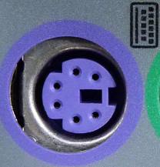
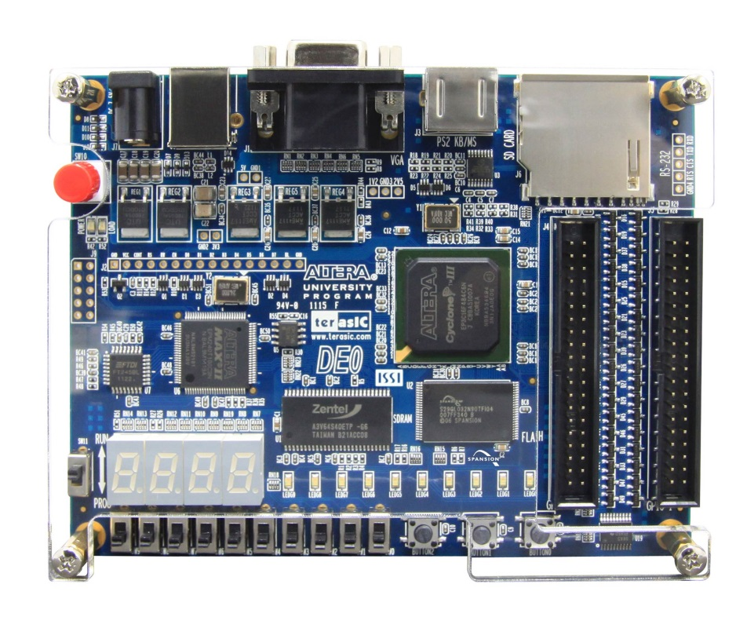
Simple Channel via PS/2
Hexidecimal [15:0] reg H
Scroll left for possible extension
Buttons 0-2: RstN, EntN, KeyIn
Scroll-left register H records current digits
P21, R22 for later extension
Convenient for stripped wires instead of Dupone lines.
R22 J3-2
P21 J3-1

Slide 5
UART, RS232 & PS/2
RS232 is a set of standards including the electrical properties and data properties.
PS/2 is an extension of serial port SPI with 2 set of UARTs.
RS232
PS/2
Connectors
Vcc
Cable
etc.
Connectors
Vcc
Cable
Synchronous
Or Async.
etc.
UART

Slide 6
Spec in this Experiment
8 Data Bits + Start/Stop Bits
Baud Rate: 9.6kbps (bit per second)
System Clock: Clk50MHz
Start
D₀
D₁
D₂
D₃
D₄
D₅
D₆
D₇
Stop
Rx
Rx
P21
R22
Tx
R22
P21
Tx

Slide 7
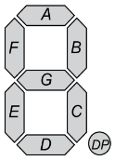
IU-Tx/Rx-OU Block Diagram
KeyN
IN
Data
Data
RstN
Data
Data
RstN
Tx
Rx
Enter
Ready
Send
SampleClk
SysClk2
EN
SysClk1
Ready
EN
Clk50MHz
Clk50MHz

Slide 8
Tx State Diagram
Start
D₀
D₁
D₂
D₃
D₄
D₅
D₆
D₇
Stop
b= 0
1
2
3
4
5
6
7
8
9
10
Reset
Idle
Start
b=0
R←H
EntN
b=10
!EntN
Elapse
t++
Shift
t=0
b++
Shift
0: Out=0
9: Out=1
others: shift (Out, R)
case(b)
t=T

Slide 9
Rx State Diagram
Start
D₀
D₁
D₂
D₃
D₄
D₅
D₆
D₇
Stop
b= 0
1
2
3
4
5
6
7
8
9
10
Rest
Idle
Start
b=0
E=0
1
0
Elapse
t++
t=0
E=!E
Shift
E→b++
0: (push)
9: (flash, pop)
others: shift (R, In)
if(E) case(b)
t=T/2

Slide 10
Another Rx State Diagram
Start
D₀
D₁
D₂
D₃
D₄
D₅
D₆
D₇
Stop
b= 0
1
2
3
4
5
6
7
8
9
0
Idle0
READY
SAMPLE
b==8
T==P
PERIOD
b++
1
T++
Rest
Idle1
ZERO
0
1
START
b=0
HALF
T==H
T=0
T++

Slide 11
Baud Rate and Half-Period Frequency
Baud rate = 9.6kbps ➔ $f=9.6kHz$, $f_{h}=19.2kHz$
If $f_{s}=50MHz$, modulo count M = $5×10^{7}$/$(1.92×{10}^{4})$
M = 2604.167 ~ 2,604 ➔ count from 0 to 2602 + 1 state for setting
Skew allowance = 1/(2*Length) x 100% ~ $±260$
reg [12:0] T;
always@(posedge Clk50MHz)
case(PS)
START : b=0;
RESET : begin T=0; (processing;) end
ELAPSE: T = T + 1;
endcase
always@(*)
case(PS) ...
S2 : NS = b==10 ? IDLE : ELAPSE;
ELAPSE: NS = T==(M-2) ? NEXT : ELAPSE;
endcase

Slide 12
UART Transmitter and Receiver (Corrected & Updated)
Tsung-Chu Huang
NCUE
2018/11/30

Slide 13
Another Rx State Diagram
Start
D₀
D₁
D₂
D₃
D₄
D₅
D₆
D₇
Stop
b= 0
1
2
3
4
5
6
7
8
9
0
Idle0
READY
SAMPLE
b==8
T==P
PERIOD
b++
1
T++
Rest
Idle1
ZERO
0
1
START
b=0
HALF
T==H
T=0
T++

Slide 14
Blocking/Nonblocking Syntheses
// Nonblocking
always@(posedge Clk)
begin
A <= B;
B <= A;
end
// Blocking
always@(posedge Clk)
begin
A = B;
B = A;
end
Q₂
D₁
Q₂
D₂
Q₁
D₁
FF
Latch
Q₄
D₃
Q₄
D₄
Q₃
D₃
Clk
Clk

Slide 15
Reviewing 4-Bit Morse Code
always@(*) case(PS)
HIGH: NS = KeyN ? HIGH : LOW;
LOW : NS = KeyN ? RISE : LOW;
RISE: NS = HIGH;
endcase
always@(posedge Clk100Hz)
if(!RstN) begin H=0; X=0; b=0; PS = HIGH; end
else begin PS = NS;
case(PS)
HIGH: T=0;
LOW : T= E ? T : T+1'b1;
RISE: if(E) H = {4'b0, H[15:4]};
else if (b==3) begin b=0; H = {H[11:0], X, B}; end
else begin b = b+1; X = {X[1:0], B}; end
endcase
end
HIGH
T=0
RISE
HXBb
LOW
T++
assign E = (T==e);
assign B = (T>s);

Slide 16
Baud Rate and Half-Period Frequency
Baud rate = 9.6kbps ➔ $f=9.6kHz$, $f_{h}=19.2kHz$
If $f_{s}=50MHz$, modulo count M = $5×10^{7}$/$(1.92×{10}^{4})$
M = 2604.167 ~ 2,604 ➔ count from 0 to 2602 + 1 state for setting
Skew allowance = 1/(2*Length) x 100% ~ $±260$
reg [12:0] T;
always@(posedge Clk50MHz)
case(PS)
START : b <= 0;
RESET : begin T<=0; (processing;) end
ELAPSE: T <= T + 1;
endcase
always@(*)
case(PS) ...
S2 : NS = b==10 ? IDLE : ELAPSE;
ELAPSE: NS = T==(M-2) ? NEXT : ELAPSE;
endcase

