Slide 1
FSM-Based Design for Hex-decimal Morse Code in DE0/Cyclone III
Tsung-Chu Huang
2022/10/20
NCUE

Slide 2
Outline
Introduction to Morse Codes
Experiment:
Frequency Divider:
Sampling Debounce: tB~0.1ms < T=1/f < tK~0.1s
Timer: short di < 0.25s < long da < 1.2 s
IU: 4-Bit Morse Code-like
OU: 4-Digit Scroll-Left Hexidecimal LEDs
State Diagram
3-State FSM: easily understood
8-State FSM: flexible for extension
Coding and Demonstration

Slide 3
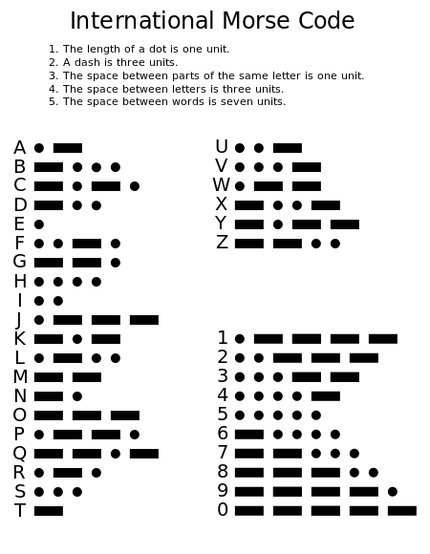
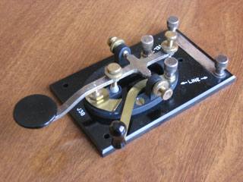
Standard Morse Codes
Properties:
applied for 160 years
1~5 bits, variant
Huffman-code-like, efficient (the more frequent the shorter)
Di:Da:NextChar ~ 1:3:5 or 7

Slide 4
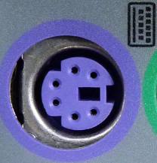
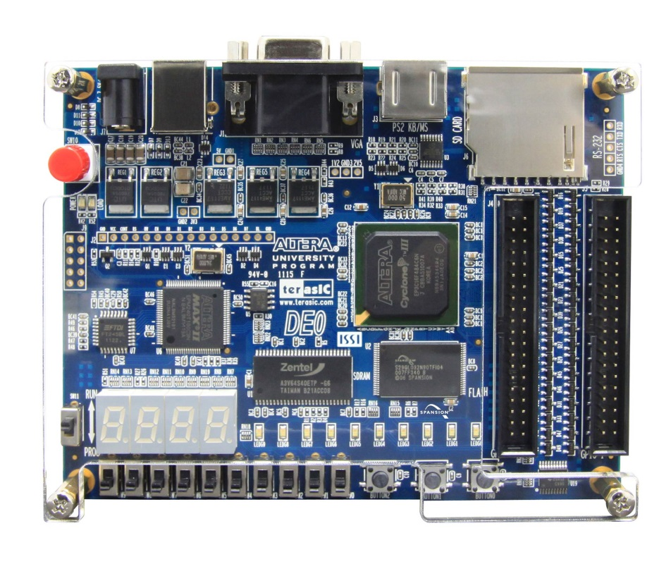
4 7-Seg LEDs as OU
Hexidecimal [15:0] reg H
Scroll left for possible extension
Buttons 0-2: RstN, EntN, KeyIn
Scroll-left register H records current digits
P21, R22 for later extension
R22 J3-2
P21 J3-1

Slide 5
Debouncer for Buttons or Keys
Single-Pole Double Throws (1P2T, 單刀雙投)
Floating Transitions
Single-Pole Single-Throws (1P1T)
Possible Single Floating Transitions
Possible Both Bi-stable Bouncing
(1) Latching
Sync.
(4) FSM
(3) Masking
Async.
V_{DD}
1-shot
t_{K}
(1) Latching
V_{OUT}
(2) Schmitt
Trigger
t_{B}
(5) Sampling

Slide 6
Frequency Divider and Timer
Debounce & Timer: select f = 100Hz
Timer: 7 bits are enough (0~127), Unit: 10ms
1:3:5 ➔ short-time threshold ~ 25 units
Overtime: stop incrementing
reg [18:0] FD;
always@(posedge Clk50MHz) FD = FD + 1;
assign Clk100Hz = FD[18];
reg [6:0] T;
always@(posedge Clk100Hz)
T = (PS == ClearState) ?
0 :
(T==127) ? 127 : T+1 );

Slide 7
Typical FSM Template
reg [1:0] PS, NS;
always@(*)
case(PS)
endcase
always@(posedge Clk100Hz)
if (!RstN) begin
end
else begin
end
Combinational
Circuits
always@(*)
assign wires =
Gate g1( , , );
S1: NS = … ;
S2: NS = … ;
PS
H = 0; …
other
reg
PS = NS;
Other reg = … ;

Slide 8
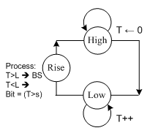
3-State FSM for b-bit KeyIn
Take short time (Di) or long time (Da) as 0/1
Constant bit count, eg. 4-bit hexidecimal (16) Morse-like Codes
b records for the current bit count
Code Digit X records previous bits
Scroll-left register H records current digits

Slide 9
Coding Step by Step : FSM Template
always@(*) case(PS)
HIGH: NS = KeyN ? HIGH : LOW;
LOW : NS = KeyN ? RISE : LOW;
RISE: NS = HIGH;
endcase
always@(posedge Clk100Hz)
if(!RstN) begin PS = S1; H=0; X=0; b=0; end
else begin PS = NS;
case(PS)
HIGH: T=0;
LOW : T= (T==e) ? T : T+1'b1;
RISE: if(T<L) if(b==3) begin b=0; H = {H[11:0], X, B}; end
else begin b = b+1; X = {X[1:0], B}; end
else H = {4'b0, H[15:4]};
endcase
end

Slide 10
Coding Step by Step : Observation
always@(*) case(PS)
HIGH: NS = KeyN ? HIGH : LOW;
LOW : NS = KeyN ? RISE : LOW;
RISE: NS = HIGH;
endcase
always@(posedge Clk100Hz)
if(!RstN) begin PS = S1; H=0; X=0; b=0; end
else begin PS = NS;
case(PS)
HIGH: T=0;
LOW : T= (T==e) ? T : T+1'b1;
RISE: if(T<L) if(b==3) begin b=0; H = {H[11:0], X, B}; end
else begin b = b+1; X = {X[1:0], B}; end
else H = {4'b0, H[15:4]};
endcase
end

Slide 11
Coding Step by Step : Implied State
always@(*) case(PS)
HIGH: NS = KeyN ? HIGH : LOW;
LOW : NS = KeyN ? RISE : LOW;
RISE: NS = HIGH;
endcase
always@(posedge Clk100Hz)
if(!RstN) begin PS = HIGH; H=0; X=0; b=0; end
else begin PS = NS;
case(PS)
HIGH: T=0;
LOW : T= (T==e) ? T : T+1'b1;
RISE: if(T<L) if(b==3) begin b=0; H = {H[11:0], X, B}; end
else begin b = b+1; X = {X[1:0], B}; end
else H = {4'b0, H[15:4]};
endcase
end
HIGH
T=0
RST

Slide 12
Coding Step by Step : INIT & IDLE
always@(*) case(PS)
HIGH: NS = KeyN ? HIGH : LOW;
LOW : NS = KeyN ? RISE : LOW;
RISE: NS = HIGH;
endcase
always@(posedge Clk100Hz)
if(!RstN) begin H=0; X=0; b=0; PS = HIGH; end
else begin PS = NS;
case(PS)
HIGH: T=0;
LOW : T= (T==e) ? T : T+1'b1;
RISE: if(T<L) if(b==3) begin b=0; H = {H[11:0], X, B}; end
else begin b = b+1; X = {X[1:0], B}; end
else H = {4'b0, H[15:4]};
endcase
end
HIGH
T=0

Slide 13
Coding Step by Step : Timing
always@(*) case(PS)
HIGH: NS = KeyN ? HIGH : LOW;
LOW : NS = KeyN ? RISE : LOW;
RISE: NS = HIGH;
endcase
always@(posedge Clk100Hz)
if(!RstN) begin H=0; X=0; b=0; PS = HIGH; end
else begin PS = NS;
case(PS)
HIGH: T=0;
LOW : T= (T==e) ? T : T+1'b1;
RISE: if(T<L) if(b==3) begin b=0; H = {H[11:0], X, B}; end
else begin b = b+1; X = {X[1:0], B}; end
else H = {4'b0, H[15:4]};
endcase
end
HIGH
T=0
LOW
T++

Slide 14
Coding Step by Step : Process
always@(*) case(PS)
HIGH: NS = KeyN ? HIGH : LOW;
LOW : NS = KeyN ? RISE : LOW;
RISE: NS = HIGH;
endcase
always@(posedge Clk100Hz)
if(!RstN) begin H=0; X=0; b=0; PS = HIGH; end
else begin PS = NS;
case(PS)
HIGH: T=0;
LOW : T= E ? T : T+1'b1;
RISE: if(E) H = {4'b0, H[15:4]};
else if (b==3) begin b=0; H = {H[11:0], X, B}; end
else begin b = b+1; X = {X[1:0], B}; end
endcase
end
HIGH
T=0
RISE
HXBb
LOW
T++
assign E = (T==e);
assign B = (T>s);

Slide 15
Combinational Circuits
// Look-Up-Table-Style
always@*
case (input)
case1: value= ;
case2: value= ;
endcase
// Combinational Netlist
GATE1 g1(…);
GATE2 g2(…);
Module1 u1(…);
Module2 u2(…);
// RTL Style with formulation
assign F = Arithmetic/Logic-representation ;
Synchronous Finite State Machine Design
always@(posedge Clk)
Present_State ⬅ Next_State;

Slide 16
Basic 4 Meta States of a Button
HIGH
T1
I = 0
FALL
RISE
T1=0
T2=0
I = 1
LOW
T2

Slide 17
Then you can separate to macro states:
Symbol3
Symbol4
T1
Operation1
Timing
Clock Reset
Clock Reset
Timing
Timing
Operation1
Symbol4
Symbol3

Slide 18
always@(posedge Clk)
K = 1
HEAD
T=0
HIGH
T=T+1
K = 0
EOL/EOW/?
RISE
T ?
0/1/?
FALL
T ?
K = 1
LOW
T=T+1
TAIL
T = 0
K = 0

Slide 19
Synchronous Design
Synchronous Design:
Single-Clock FSM
Be careful of
Glitches of Frequency-Divider and Clock-Generator
Glitches of NS-Logic
Error between Button and Clock
Asynchronous Design:
Note: Event-Dependencies
↑Key asynchronously resets High-Timer TH
↓Key asynchronously resets Low-Timer TL
Prevent from Timers’ overflows. ➔ Stop counting.

Slide 20
Lab07 Hexadecimal Morse Codes
Practice:
Design a 3-state hexadecimal Morse Codes
Extend to a fixed-length word
Extend with backspace functions
Problems:
Note: Event-Dependencies
↑Key asynchronously resets High-Timer TH
↓Key asynchronously resets Low-Timer TL
Prevent from Timers’ overflows. ➔ Stop counting.

